Slide 1
Hebrews
Theme: Advancing towards so great salvation (2:3), let us go on to Christian maturity (6:1).
Key Verse: How shall we escape if we neglect so great salvation? Heb 2:3.
Outline
I. Introduction: God has spoken through His Son, Heb. 1:1-3.
II. Christ’s person is superior to all other people, Heb 1:4-6:20.
III. Christ’s priesthood is superior to old covenant priesthood, Heb 7:1-10:39.
IV. Christ’s superior example of living by faith, Heb 11:1-13:19.
V. Concluding remarks, Heb 13:20-25
VI. Conclusion: The great Shepherd totally equips the believer through the blood of the eternal covenant, Heb 13:9-25.
Copyright 2016. Reprinted from Baptist Bible Graphics. www.biblegraphics.com

Slide 2
Baptist Bible Graphics LISTEN MY CHILDREN: GOD HAS SPOKEN Hebrews
Jesus was a Jew, Mt 1:1-17. The first disciples and the 12 apostles were Jews, Mt 2:2; 10:1. Salvation is of the Jews, Jn 4:24. The first Christians were Jews, Acts 2:10. They were sorely persecuted, five in Acts, and under repeated pressures from their unbelieving fellow Jews to return to Judaism, Col 2:14. They were tempted to mix Christianity with rabbinical traditions and the worship of angels, Col 2:16-19. Who is Jesus Christ that we should obey Him?
Answer. The reason for the Epistle to the Hebrews/Jews. Gen 14:1.
Copyright 2016. Reprinted from Baptist Bible Graphics. www.biblegraphics.com

Slide 3
Hebrews
Who wrote to these Jews and when did he write? The author knew Timothy, so it could be Paul. For that matter it could be Barnabas who was a Levite Acts 4:36, apostle Acts 14:4, 14, and was there when Timothy was converted Acts 16:1-3. In an ancient catalog of canonical books the book of Hebrews is listed under the name of the Epistle of Barnabas. The one geographical reference to Italy doesn’t solve the authorship, Heb 13:24. Jerusalem hadn’t been destoyed (70AD), Timothy was still alive, and perhaps Paul was already martyed as one might expect him to join Paul after Timothy’s release from prison, Acts 13:23.
Author: uncertain. Date: 64-69.
In any case, it’s divine authority is clearly manifest.
Copyright 2016. Reprinted from Baptist Bible Graphics. www.biblegraphics.com

Slide 4
Hebrews Outline
I. The First Narrative: Christ is Superior.
A. In his Person: He has a more excellent name.
Better than the angels, 1-2. (Better is used 13 times; better hope, 7:19;
Better than Moses, 3. better covenant and better promises, 8:6.)
Better than Aaron, 4.
B. In his Priesthood duties: His Melchizedek priesthood is superior to the Aaronic.
A perfect order, 7. (Perfect is used 14 times; In Christ we have a perfect standing
A perfect covenant, 8. before God not attainable by the levitical priesthood, 7:11, by
A perfect sanctuary, 9. the law, 7:19, nor by the blood of animal sacrifices, 10:1.)
A perfect sacrifice, 10.
II. The Second Narrative: Faith is Superior. (Get the picture?)
Faith to hear God’s salvation: So don’t drift from what God has spoken, 2:1-4.
Faith to rest despite the circumstances: So don’t doubt what God has spoken, 3:7-4:13.
Faith to advance in Christian maturity: So don’t be dull towards what God has spoken, 5:1-6:20.
Faith to remember our Lord in his sufferings. So don’t despise what God has spoken, 10:19-39.
III. The two Narratives are joined as one: Faith in Christ is superior.
The history of faith finds its fulfillment in Jesus Christ, 11.
Faith to look unto Jesus for power to live the Christian life, 12.
Faith to pursue the normal Christian life, 13.
Conclusion: Leave Jerusalem behind; place your faith in Jesus, the great Shepherd of the sheep.
Copyright 2016. Reprinted from Baptist Bible Graphics. www.biblegraphics.com

Slide 5
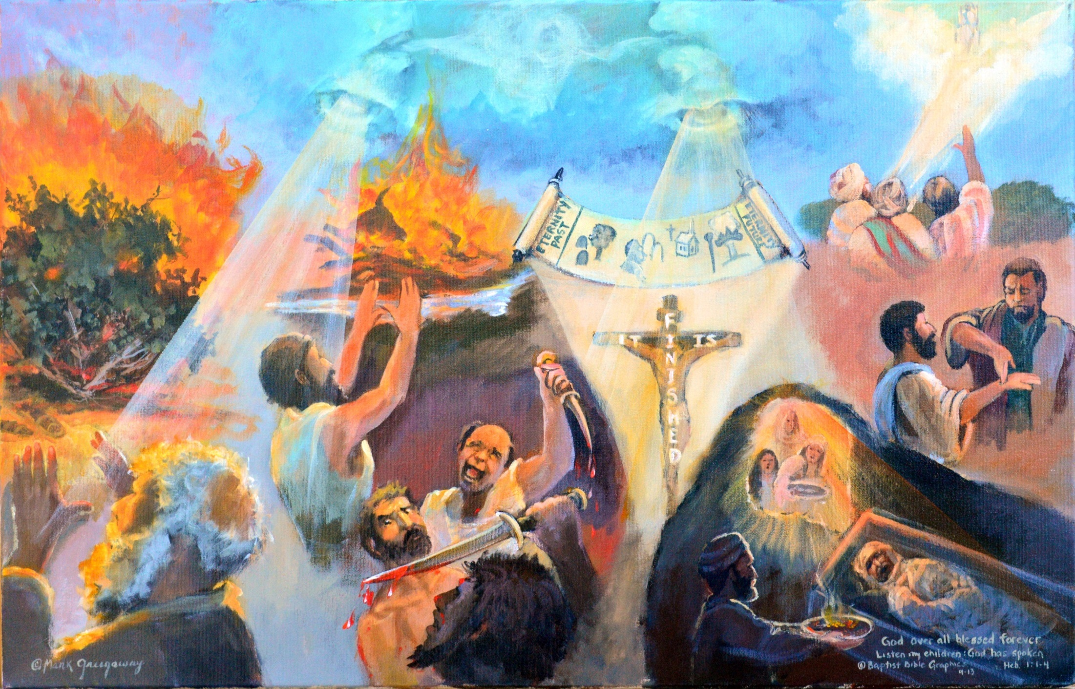
a
God spoke many times to fathers by prophets 1:1-3. Moses at bush; Elijah on Carmel. God spoke once to us by his Son. Who is the Son? Scroll: A plan, Eternal God, Creator; Cross: Purification of sin; Resurrection, ascension, sat down: A picture of the finished character of Christ’s once-for-all sacrifice for sin, Heb 10:10, 12. Right hand: Indicates the place of honor which Jesus Christ occupies. God’s revelation in the Son has a definite quality that previous revelation lacked, final and complete.
Copyright 2016. Reprinted from Baptist Bible Graphics. www.biblegraphics.com
Notes:
Contrasts the many ways God spoke (left) with the final and complete revelation in Christ (right). Direct and authoritative revelation is not given by God to people today apart from Scripture,
1. Mouth 1:1. God in many portions and in many ways having spoken, first aorist active participle, originally used for the chattering of birds, then for speech, ATR. There is no physical representation of God, Who is spirit Jn 4:24.
2. Moses Ex 3: God spoke out of a bush that was on fire; sandals, take off your shoes, I AM WHO I AM, this is holy ground. The author of Hebrews purpose was to contrast the old covenant ratified by Moses with the new covenant ratified by Jesus Christ. He wanted them to mature in Christ, pursue peace and holiness in the Lord, apart from earthly Jerusalem Heb 12:14, 22.
3. Elijah 1 Ki 18: Ox on altar, water poured around, fire fell, Jehovah is God. In contrast are two Baal worshipers dancing with knives. Sandwiched between them is a Hebrew man caught on the horns of a dilemma. V 21 literally, How long are you hopping between two forks? RSB; choose God or Baal; vascilation will make your soul fear and your eyes bug out. Fear God, Prov 9:10. The author’s purpose for writing Hebrews was to encourage Jewish Christians not to waver between two opinions; choose Jesus Christ, not Judaism.
4. Moses and Elijah, hands spread apart, arms extended: is a symbol of God’s willingness to receive Israel, Isa 65:2; Rom 10:20-21. Contrasted with the prophets of Baal with their arms extended, hold death in their hands. So the author of Hebrews asks, Why leave Jesus Christ to return to Judaism? That’s dead works Heb 6:1; 9:14. Why bolt from Jesus Christ who is so willing to receive you?
5. Mouth 1:2: Out of heaven God spoke, first aorist indicative, in these last days, in a final and full revelation, ATR. The Son is God’s spokesman to us. The idea is only what is said but who said it, the heir and creator of all things.
6. Scroll: In these last days, the dispensation we now live in, 1st to 2nd advent.
7. Crucifix: purification of our sins. It is finished. A picture of the finished character of Christ’s once-for-all sacriffice for sin. Jesus is to the Father what the rays of the sun are to the sun, not a mere reflection. The Son is the radiance of God’s glory, the outshining of the Father, revealing the very substance of God. He who has seen Jesus has seen the Father; I and My Father are one.
8. Incense: Jesus with the expression, Why the incense? God will not allow My body to undergo decay Ps 16:10. I bear all things by the word of My power.
9. He sat down: Nessecitates his burial, resurrection, appearances on earth and his ascension. God’s revelation has a definite quality that previous revelation lacked; it is final and complete.
9. Right hand: Indicates the place of honor that Jesus Christ now occupies.

Slide 6
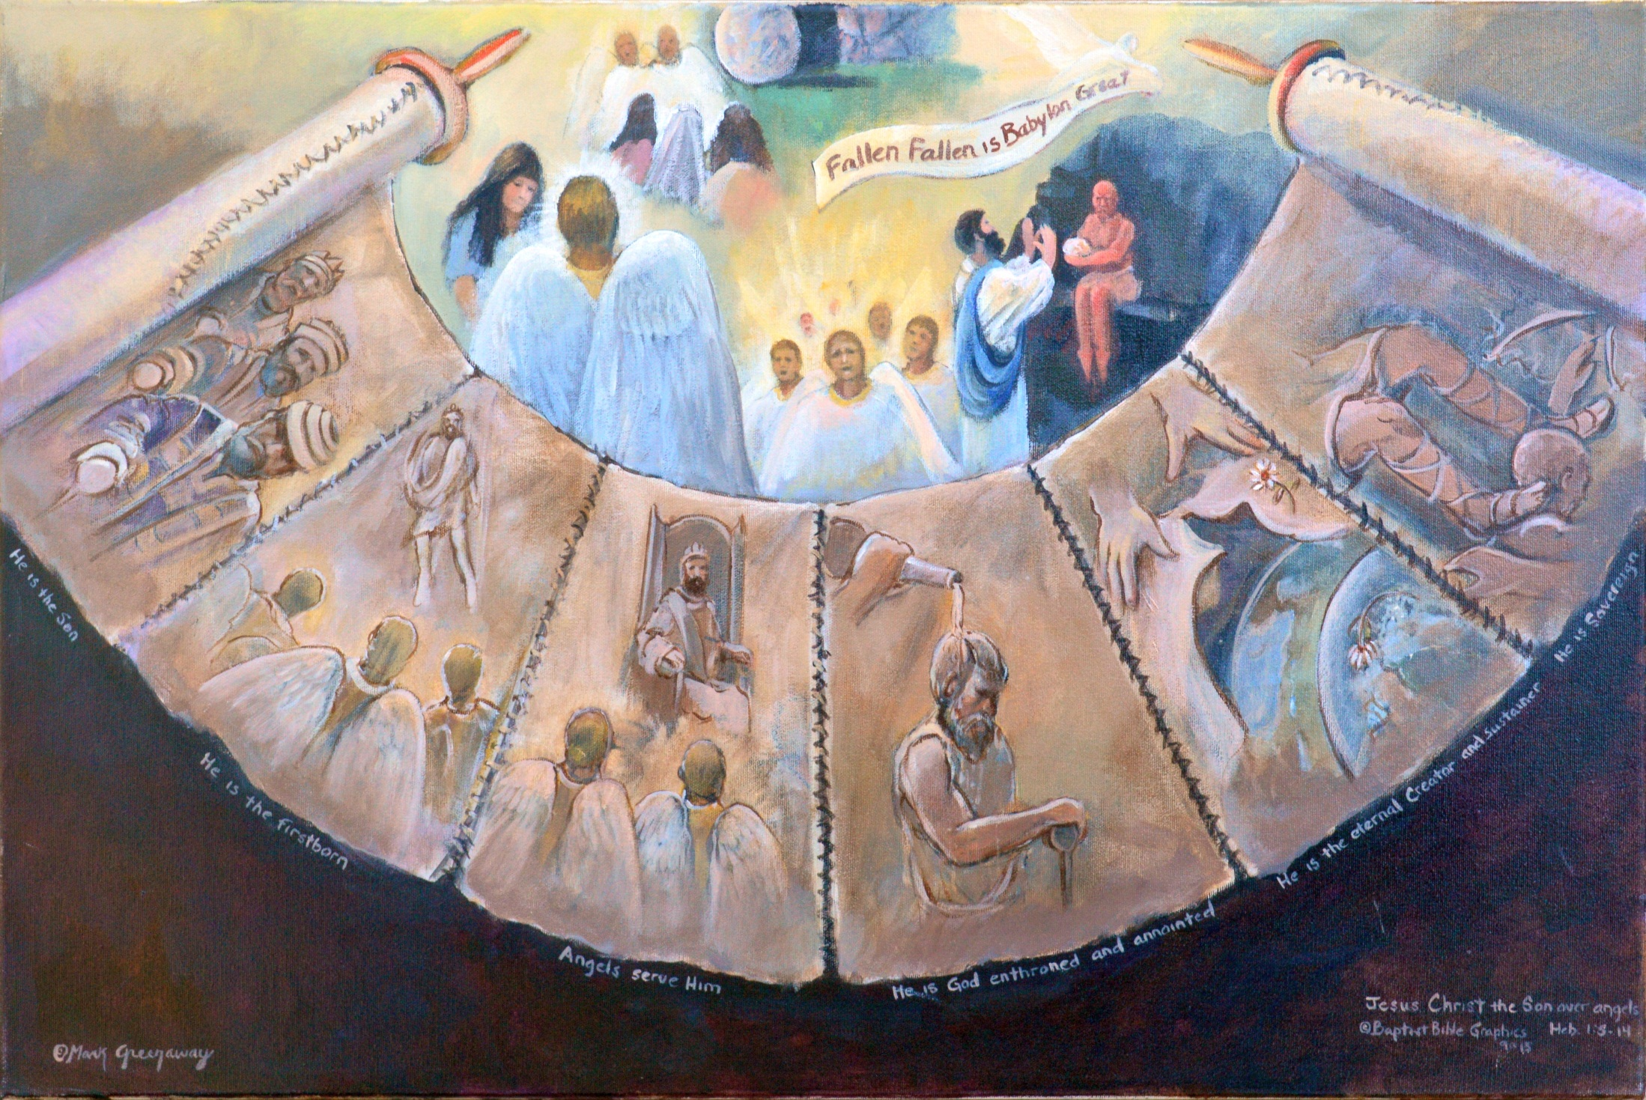
a
Son of God, 1:4-14/ 1:4 Angels: At birth, tempt, resur, 2nd C / Scroll: Defeated Satan by Scripture/ 1:5 1st Com: King Messiah Son, Ps 2/ 1:6, 2nd Coming: angelic worship, Ps 97:7/ 1:7-8, Throne, angelic worship, Ps 104:4; 45:6/ 1:9, Anointed, Ps 45:7/ 1:10-12, Creator, Ps 102:26-27/ 1:13-14, King, Ps 110:1. To Christ is given the final victory when all enemies are placed under his feet. Heirs of salvation, sons and daughters in the kingdom.
Copyright 2016. Reprinted from Baptist Bible Graphics. www.biblegraphics.com
Notes:
Angels in contrast to Jesus Christ.
Angels: are important, good angels ministered to him and an evil one tempted him. They even minister to people and will be very active in the future.
Scroll: In contrast, Scripture says that Jesus Christ is better. There is a logical sequence in the evidence presented.
On earth, first coming 1:5: In Psalm 2 he is the Son, the last of three identities in Psalm 2. The other two are Messiah and king. Our picture shows him wearing these three hats. Further proof is cited from 2 Sam 7:14. Christ fulfilled these words, not angels.
Descending, second coming 1:6: In Psalm 97:7 as he descends God presents his Firstborn into the world and angels worship him; he is better than the angels.
Sitting on throne reigning on earth 1:7-8. During the millennium angels worship Jesus the king, Ps 104:4; 45:6; he is better than the angels.
God anointing his Son with oil 1:9. This one reigning in the millennium was anointed with the oil of gladness because he loves righteousness and hates iniquity.
Hands casting aside an old garment for a new one 1:10-12. Even so, the old earth will be cast aside for a new one, Ps 102:25-27. The kingdom of the Son who is the Lord will survive the final shaking of the creation. The Lord is immutable, something not able to be said of angels.
Foot on neck of enemy 1:13-14. In his millennial reign the Son will have the final victory over his enemies, Ps 110:1. The victory is his and not the angels. He is thus better than the angels, who are ministering spirits to the Lord and to his sons and daughters who are heirs of salvation.

Slide 7
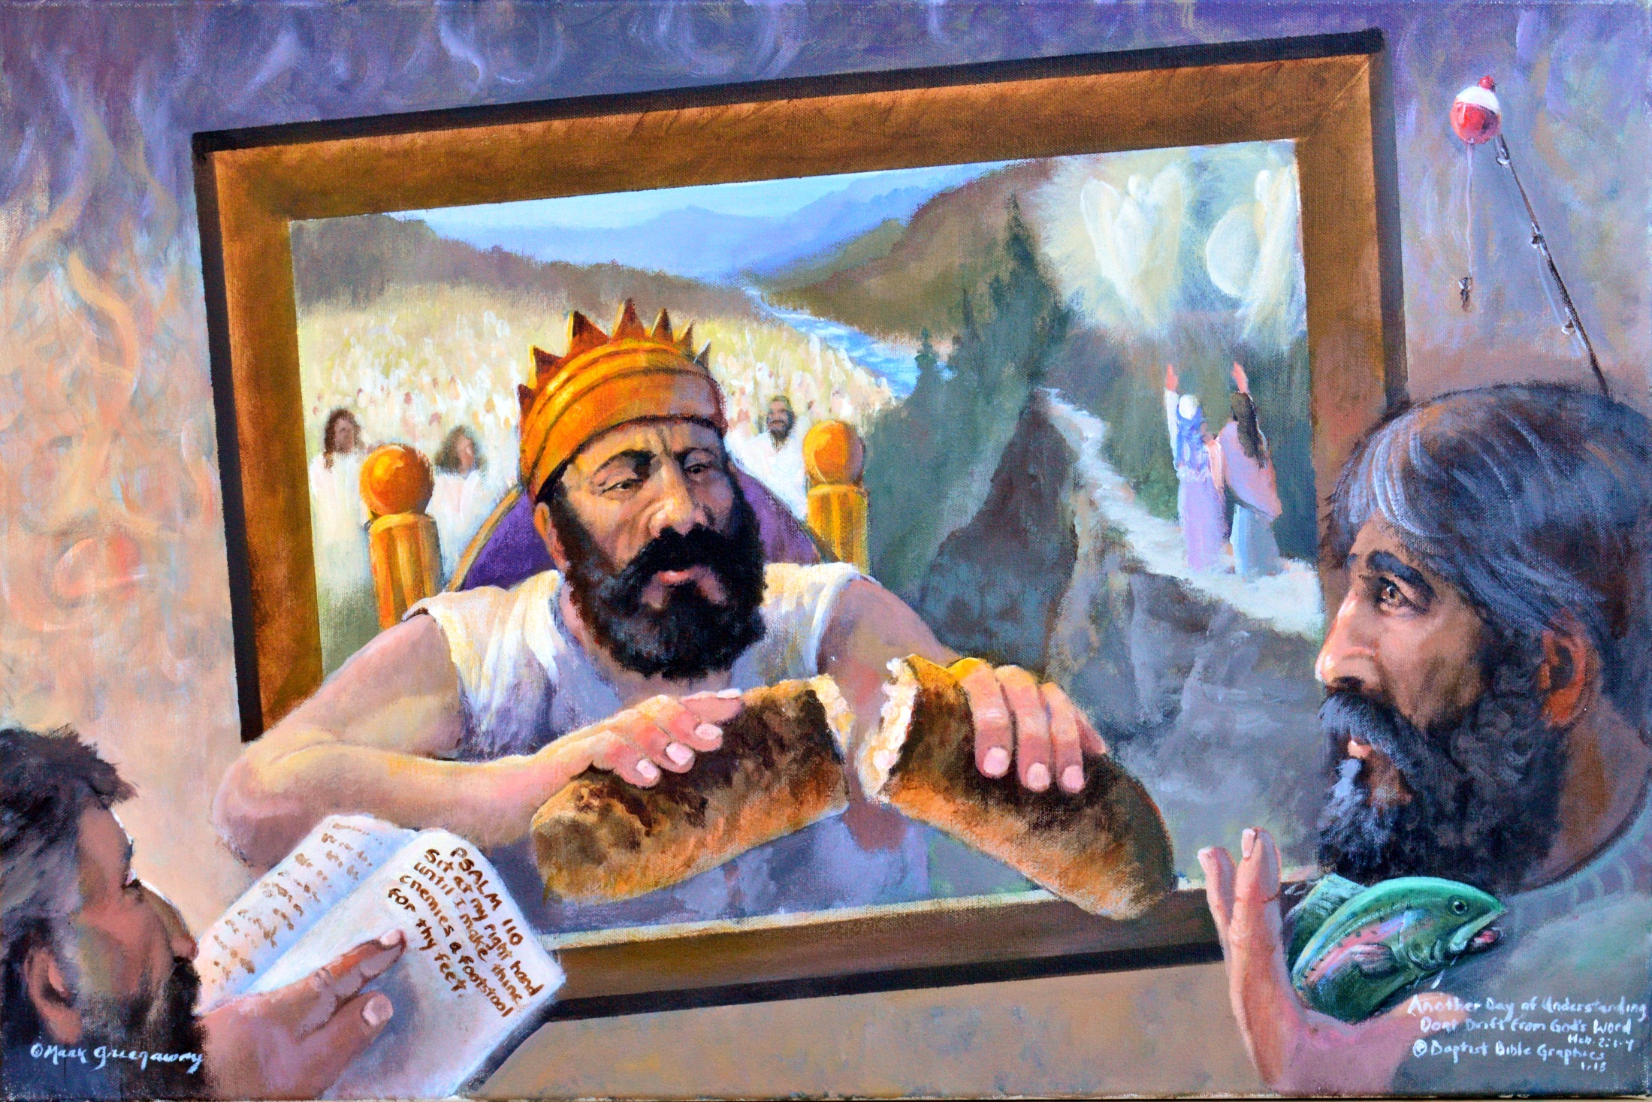
a
Faith to hear God’s salvation, Heb 2:1-4; Ps 110. Book: since Jesus’ resurrection, He is sharing the Father’s kingly authority. Crown: Begins his rule on earth at His Second Coming, Ps 110:2 Bobber: Pay attention, the anchor doesn’t drift-slip we do. Fish: Escape, when we don’t hear-obey. Bread: God bore witness to remember Christ. Take, eat: this is my body broken for you. Glory: to eat at my table in my kingdom, Luke 22:17-30.
Copyright 2016. Reprinted from Baptist Bible Graphics. www.biblegraphics.com
Notes:
The son and daughters are encouraged to hear more about their inherited salvation, lest they drift from their Lord. This is the first instalment of the second narrative, it’s a strong statement needed to boost their faith in God’s saving work on their behalf which will be consumated during the millennium.
1. The Bible opened to Psalm 110:1. Citing this passage about putting all enemies under his feet reminded the author of our inherited salvation in the millennium 1:14.
Fishing bobber 2:1. Hey folks, don’t get sidetracked, start to day dream and slip from our anticipated salvation. Why the bobber? My Gk/Eng lexicon reads: to flow by, to wash away, to drift. Being a fisherman, that’s what happens to my bobber when I’m not paying attention. Next thing I know, I’m entangled in the brush.
Sitting on throne: Jesus is in heaven sharing his kingly authority with the Father. Our Lord has not yet entered into his earthly kingdom but he has been enthroned in glory, Eph 1:20. He sits at the Father’s right hand, the place of honor, until he subjugates all enemies at his second coming, Ps 110:2. Then he will rule the earth from Zion on the throne of David. The Bible does not teach the “already not yet” notion of his kingdom rule.
The road to Emmaus Lu 24:27: Expounding to them in all the scriptures the things concerning himself. After Jesus Christ’s resurrection he began to share the father’s kingly authority,
Fish escaping 2:2-3. What can be the consequences if we ignore so great salvation? We who have ultimate victory and deliverance within our grasp will suffers retribution. What type? The author doesn’t say. So heed and obey what God has spoken.
Companions behind the throne 2:3-4. His faithful followers will participate with him in his future kingdom Lu 12:31-32; 22:29-30. The millennial salvation experience first announced by our Lord received confirmation by signs and wonders which the disciples were empowered to perform. The writer of Hebrews regarded these miracles as the powers of the world to come 2:5. Peter and others also saw them as expressions of the One who had gone to sit at God’s right hand Acts 2:43; 4:30; 5:12; 6:8; 8:6, 13; 14:3; 15:12 BKC.
Breaking bread 2:4. Our Lord reaches out to you and me to authenicate the message thru the scriptures, not thru signs and wonders. This do in remembrance of me until I come in my kingdom. Our attention is directed toward our eventual reunion in the future millennial kingdom with its joy and fellowship, Mt 26:29.

Slide 8
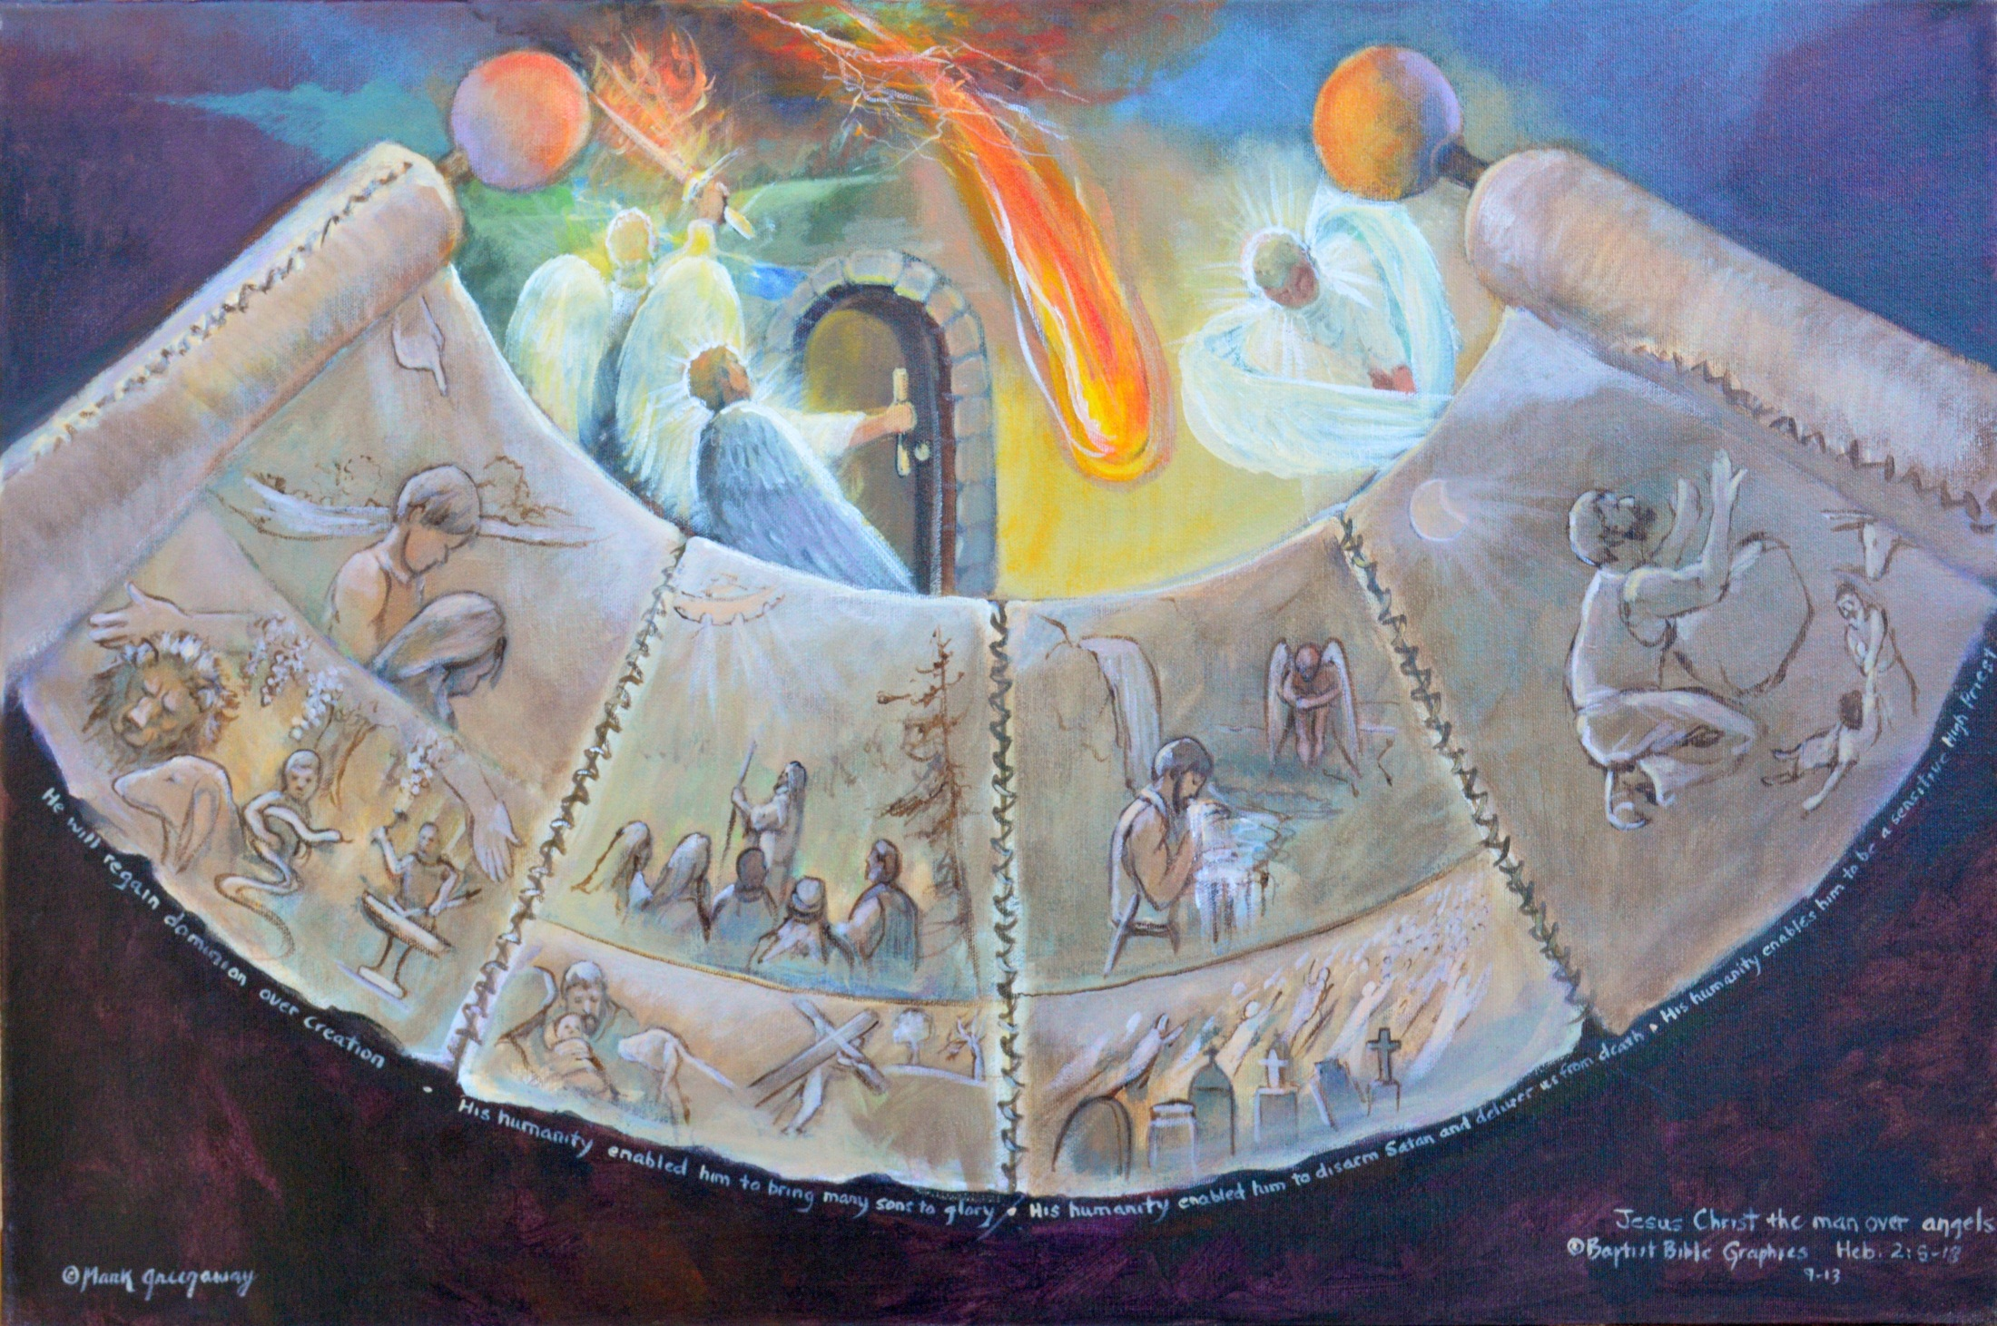
Son of Man, 2:5-18, Angels: Will not rule in coming inhabited earth, 2:5/ 2:5-9 Creation: Restore what Adam lost,Ps 8:4-6/ 2:10-13. Door: the way, only door to bring many to glory, Ps 22:2; Isa 8:17-18/ 2:14-15. Drinking running water: Victorious, Satan disarmed and we’re freed from death. Satan fallen from heaven, Lu 10:10/ 2:16-18. High Priest: Not save fallen angels but fallen men, 2 Cor 11:14; sensitive to our needs, Lu 10:30.
Copyright 2016. Reprinted from Baptist Bible Graphics. www.biblegraphics.com
Notes:
Hebrews 2:5-18. The author picks back up were left off, our Lord in his millennial reign, where he put all enemies under his feet 1:13-14.
Angels 1:5. They will not rule in the world to come, the coming inhabited earth, the millennium.
Adam and Eve 2:6-8: Heads bowed, they were expelled from the Garden. Christ will restore what Adam lost Ps 8:4-6. Below Adam and Eve are pictures depicting restoration. Above the scroll are angels with flaming swords guarding the way back into the Garden. The Restorer of creation is better than the guards at the gate.
Jesus leading the way 2:9-13. The captain of our salvation is leading the way, bringing many sons to glory Isa 8:17-18. Below is the Lamb who is the way tasting death for every man. Above is an angel at a door unable to open the way. Jesus is greater than the angel trying to open the door; he is the door Jn 10.

Slide 9
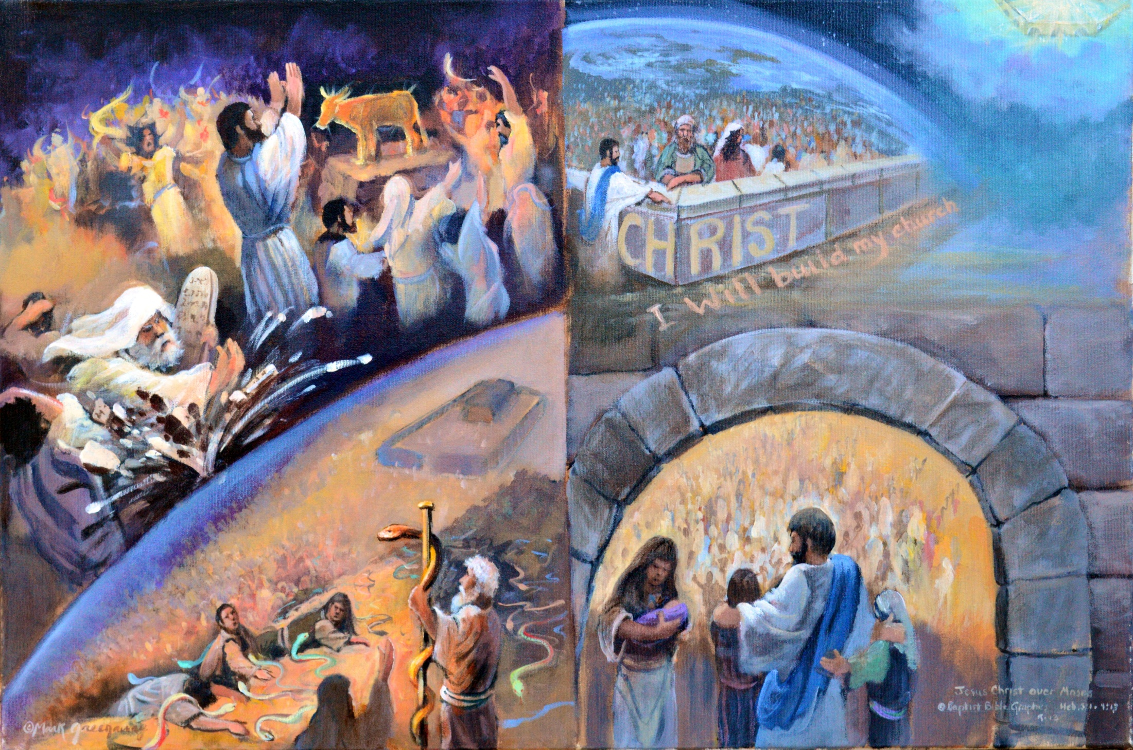
Christ is better than Moses, 3:1-11. Holy brethren: An unbelieving heart was luring some to return to Moses. Lawgiver: Moses was a servant representing God to man. Cornerstone: Christ is an apostle sent from God to represent God to us, the builder. Moses holding up serpent: Moses never rested representing man to God. Headstone holding up arch: Our high priest finished the work he began and rested. He perfectly represents us to God. Thru Christ the believer enters rest, 4:9. Children: Holding fast to Christ, not to Moses.
Copyright 2016. Reprinted from Baptist Bible Graphics. www.biblegraphics.com

Slide 10
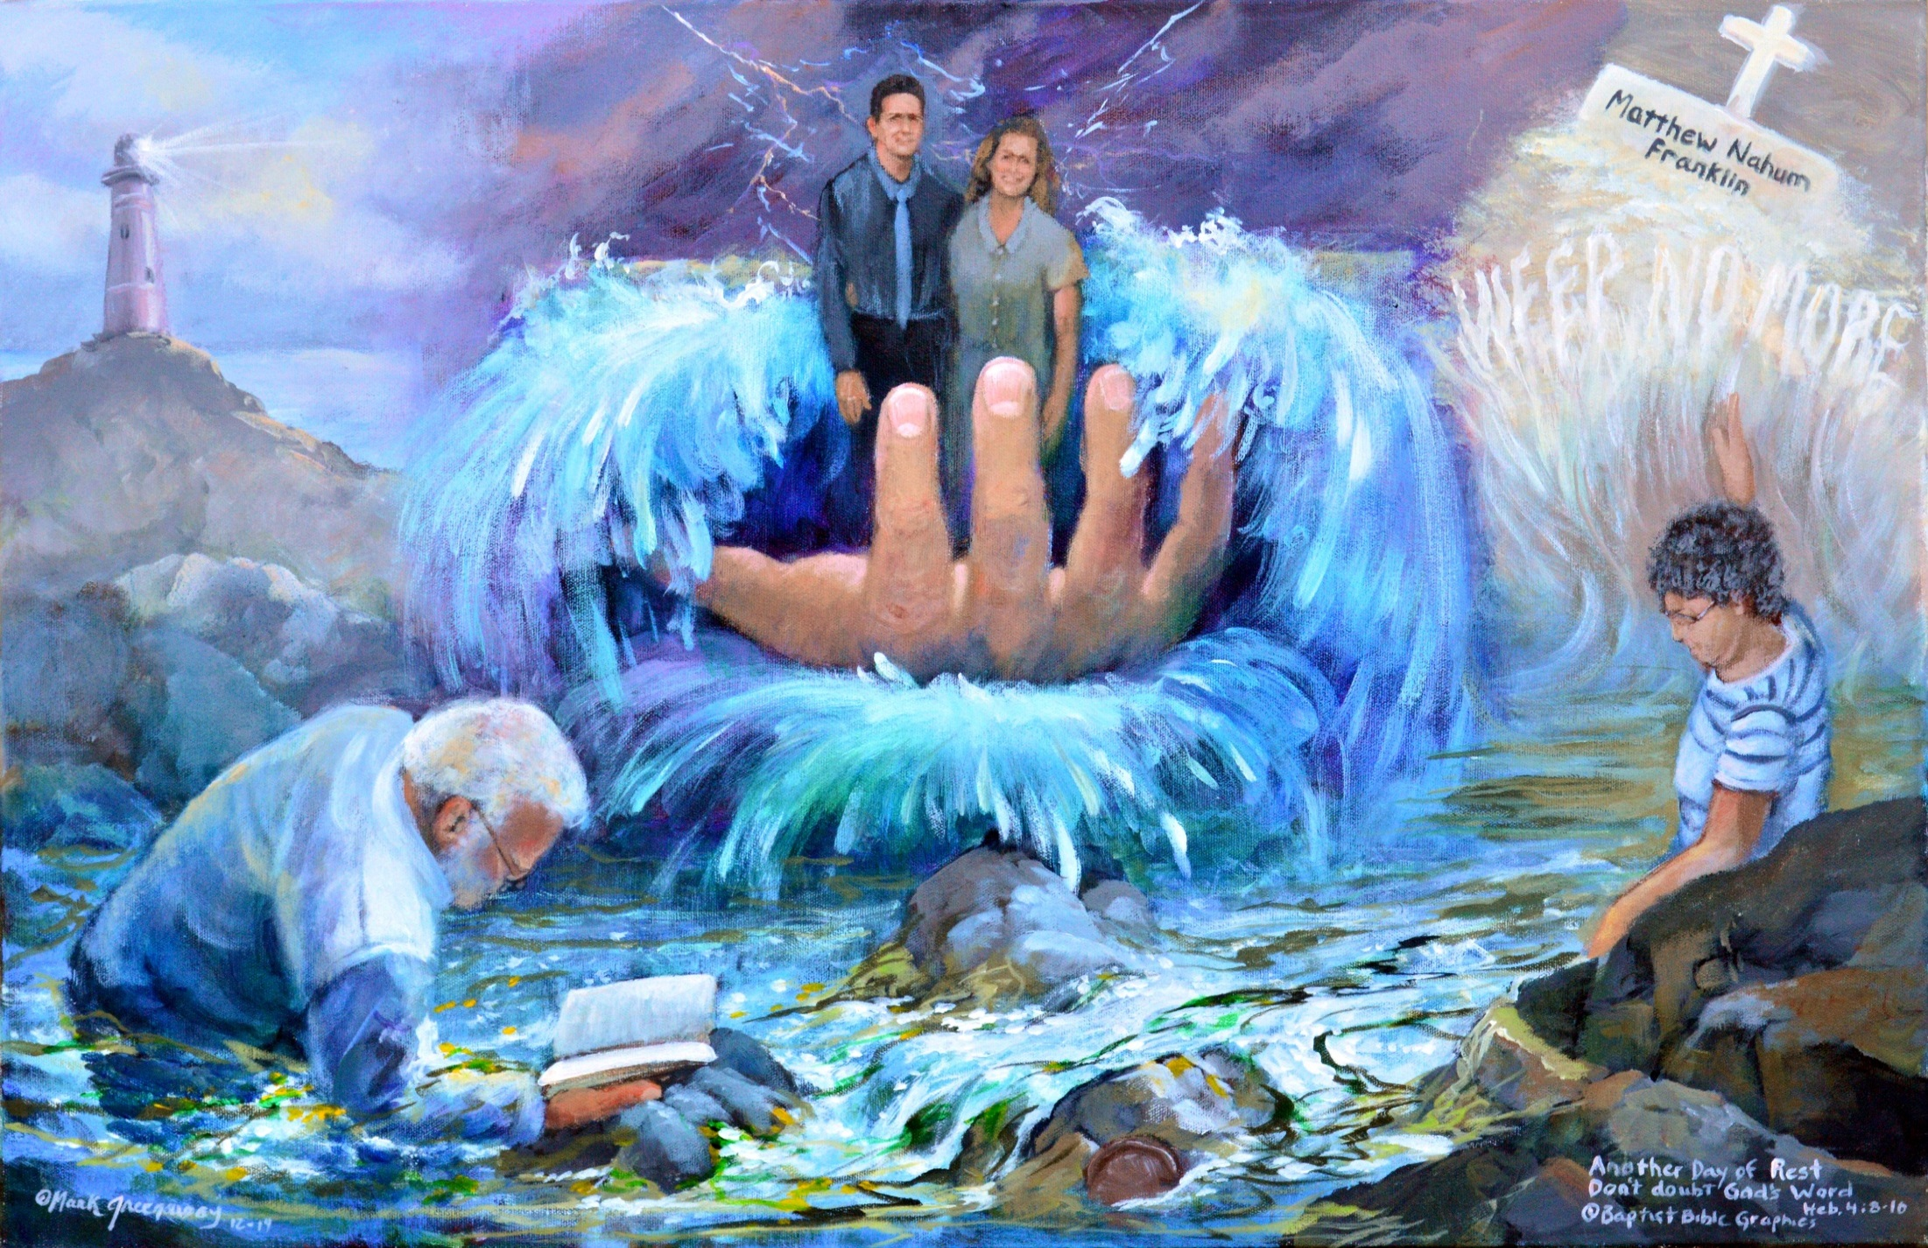
a
Faith to rest despite circumstances, Heb 3:7-4:16; Ps 95. Lighthouse: On the rock of our salvation. Sea: God made the sea, the restless waves and calm tidal pools, Ps 95:5. Kneeling: O come, worship, bow down, kneel. Today, while you still have opportunity, encourage one another, Ps 95:6; Heb 3:7-13; 4:12. Standing: He is our God, we are the sheep of his hand. Today, hold steadfast until the end, Ps 95:7; Heb 3:14-19. Resting: Today, enter into inheritance rest Ps 95:11; Heb 4:1-10. Weeping: All are manifest in his sight. He is touched with our infirmities, Heb 4:11-16.
Copyright 2016. Reprinted from Baptist Bible Graphics. www.biblegraphics.com

Slide 11
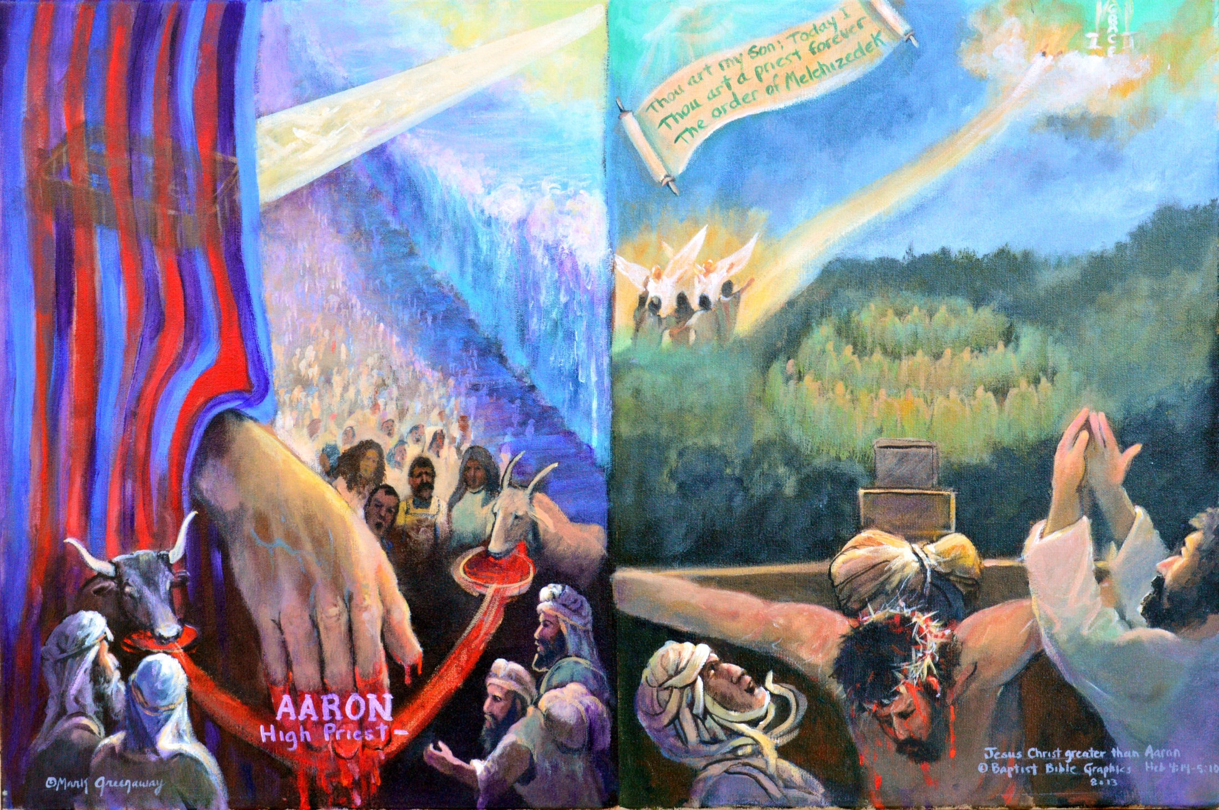
Christ better than Aaron, 5:1-10. Christ is superior in his qualifications. Red Sea/ Gethsemene: Needs to be a man 5:1, Aaron taken among masses, a sinner; Christ alone, Son. Hand dipped in blood/ His own blood: Have compassion when offering for sins 5:2-3. Animal blood veil/Own blood, cross: Chosen by God 5:4-10. Aaron high priest until death; Jesus great high priest forever order Melchizedek, Ps 2:7; 110:4
Copyright 2016. Reprinted from Baptist Bible Graphics. www.biblegraphics.com

Slide 12
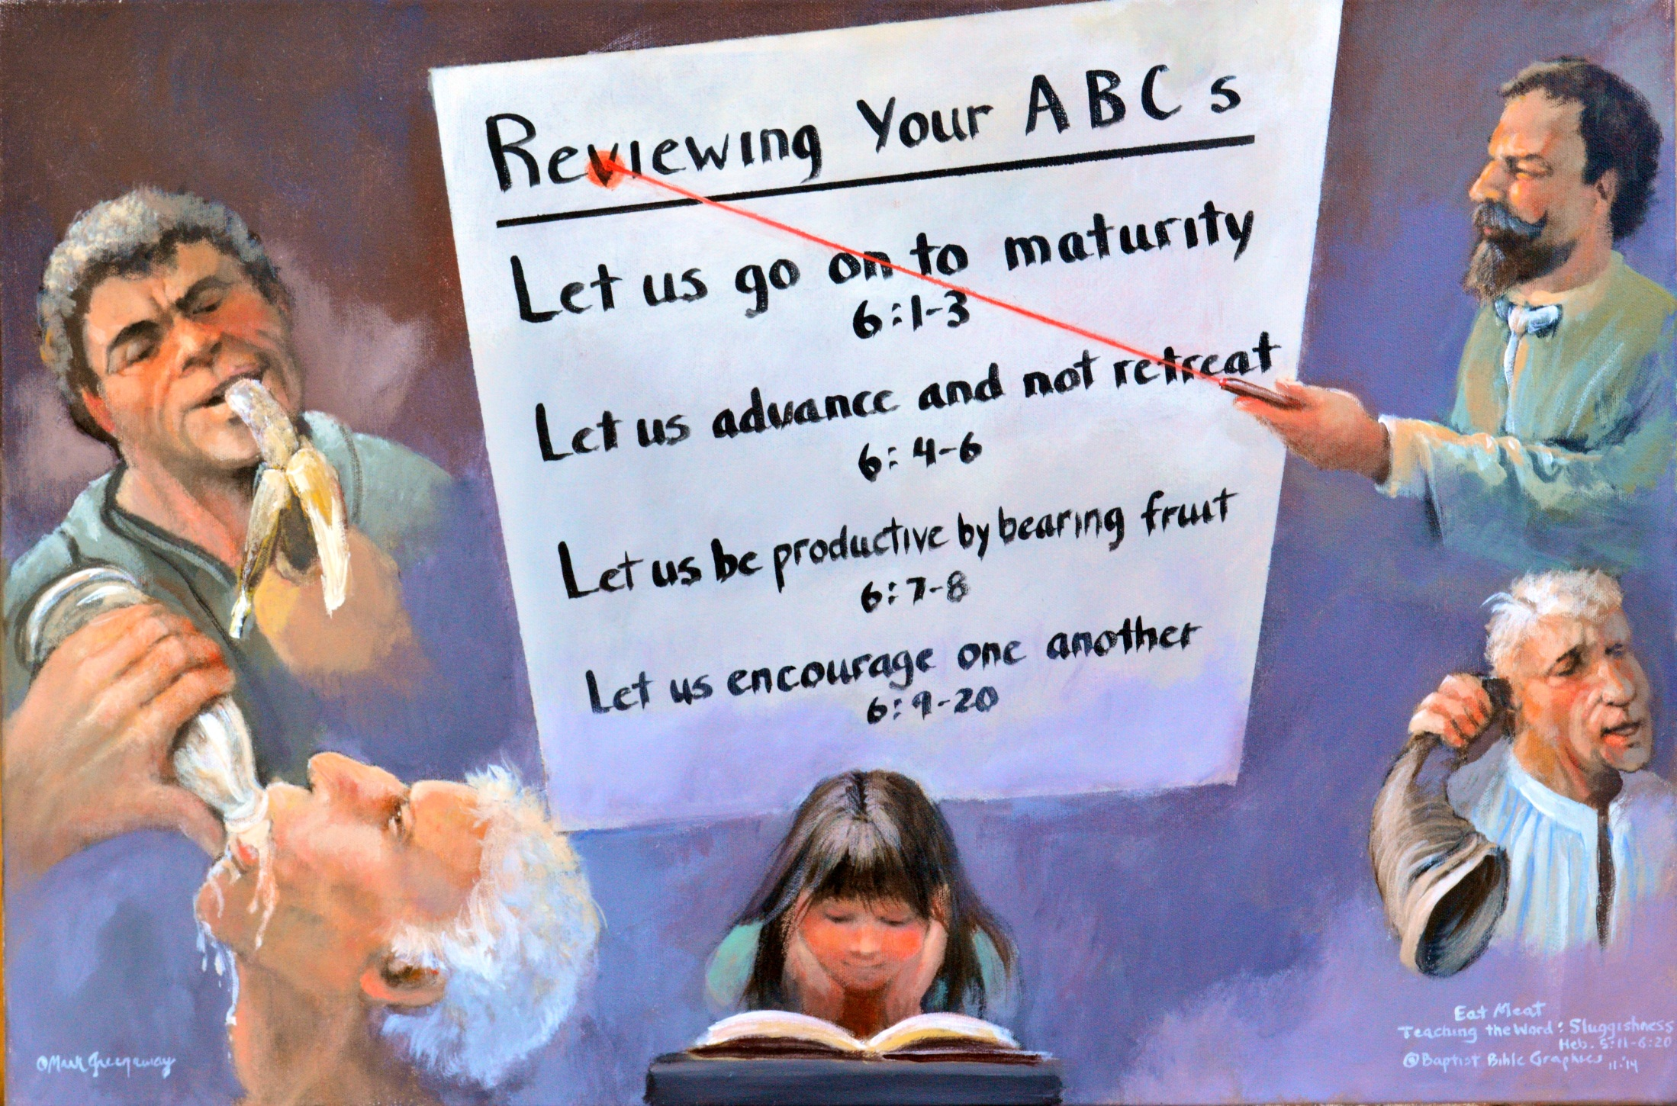
Faith to advance in Chrisiian maturity Heb 5:11-6:16. Teacher: He had a lot to say to dramatically pull them forward but it would be hard to explain because they were slow to learn. Baby bottle: Old in the faith but immature. Ram’s horn: A call to action, not a hearing aid. Dull, wavering state of mind to lure from faith. Rotten Banana: While sleeping, harvest past, lacks interest Child Learn like a child come to Him in humility Lu 18:17.
Copyright 2016. Reprinted from Baptist Bible Graphics. www.biblegraphics.com

Slide 13
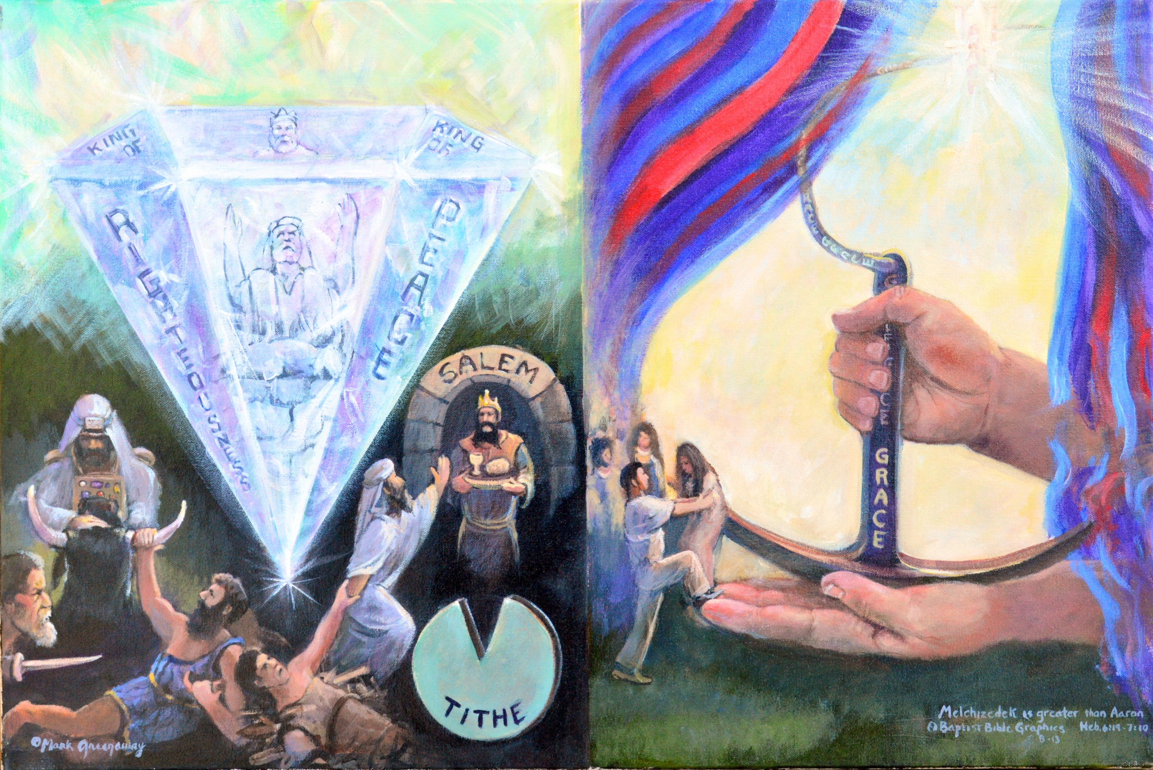
The superior priest,6:17-7:10. Cristal: Reminds us of heaven. In Christ heaven has touched earth. A King and priest superior to Aaron. Anchor: Reminds us of earth. In Christ we on earth touch heaven. Tithe: Abe and his seed reached back to Melchizedek. Hands: Christ and his seed reaches up to heaven where Christ went, the heavenly sanctuary behind the veil. Hold on and let Christ give you his grace and truth continuously.
Copyright 2016. Reprinted from Baptist Bible Graphics. www.biblegraphics.com

Slide 14
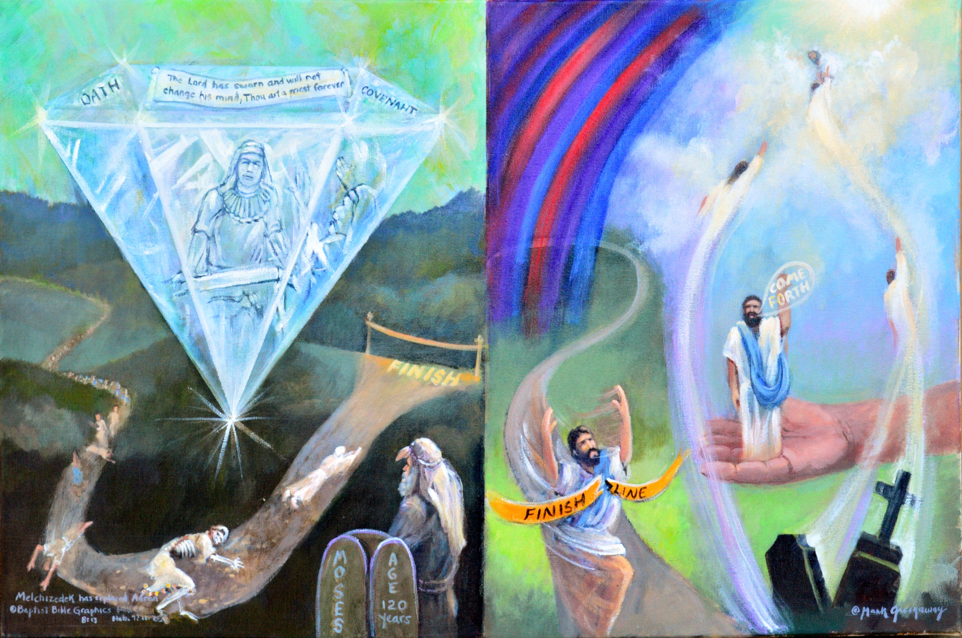
The new priesthood supercedes the old, 7:11-24. Cristal: Change in the presthood requires a change of the legal system. Judah is pictured, not Levi. Christ: Complete communion with God. Come forth, you are not under the Law of Moses, Rom 6:14. Race: Carnal commandment, people of flesh who all died. Race: Perfect, can accomplish its objectives for those who approach God. Christ rose again and lives eternally in heaven.
Copyright 2016. Reprinted from Baptist Bible Graphics. www.biblegraphics.com

Slide 15
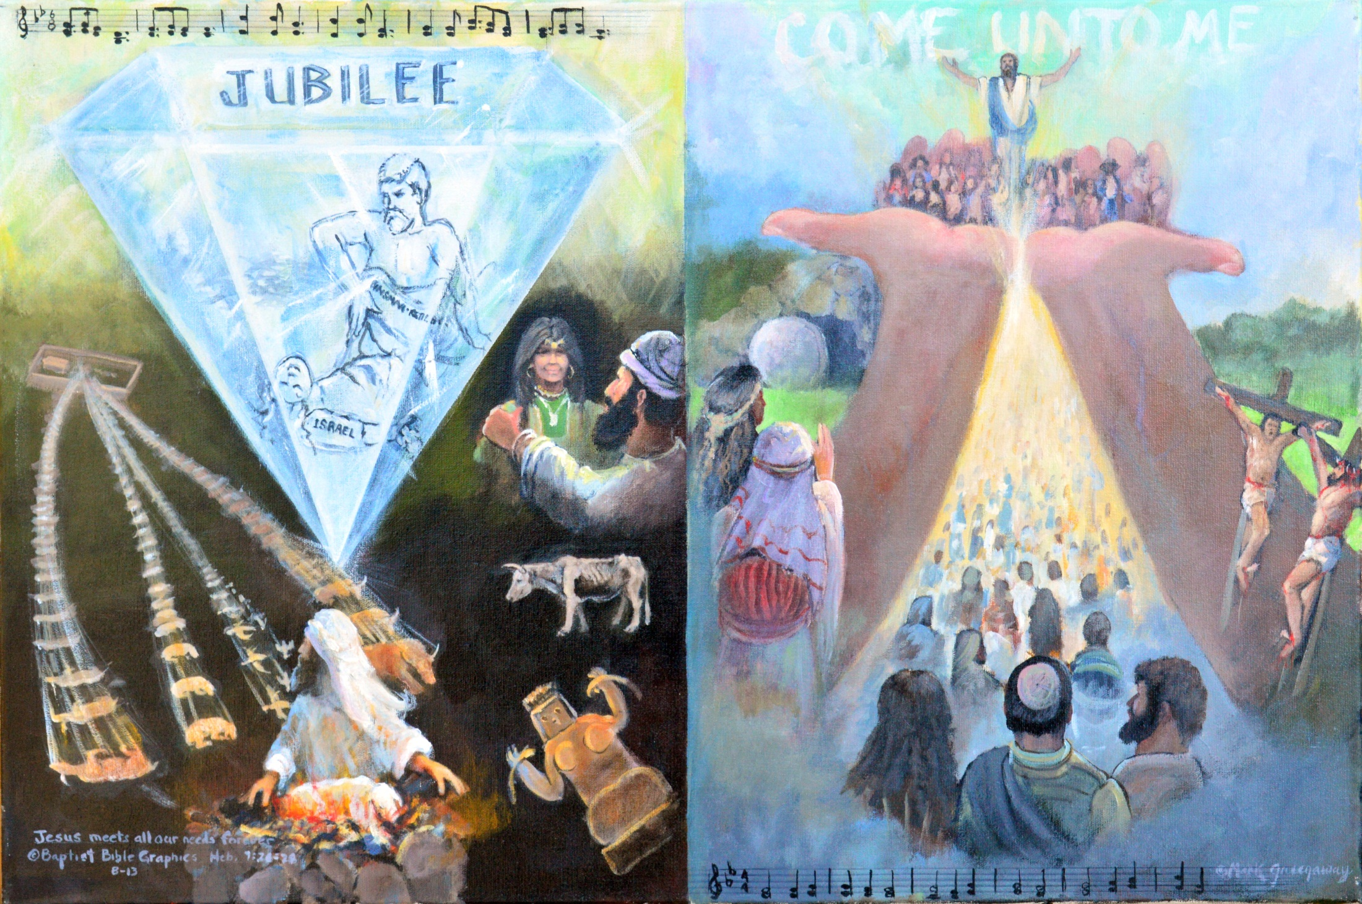
The superiority of the new priest, 7:25-28. Cristal: The kinsman redeemer brought heaven to earth; music, Silent Night. Christ: Brings sinners to heaven. Aaronic sacrifices: Repeated sacrifices produced unreasonable worship and repeated sins. Christ’s sacrifice: One sacrifice forever perfected those who are sanctified. By Jesus’ death and ressurection his sons are seated in the heavenlies; music, Up From the Grave He Arose.
Copyright 2016. Reprinted from Baptist Bible Graphics. www.biblegraphics.com

Slide 16
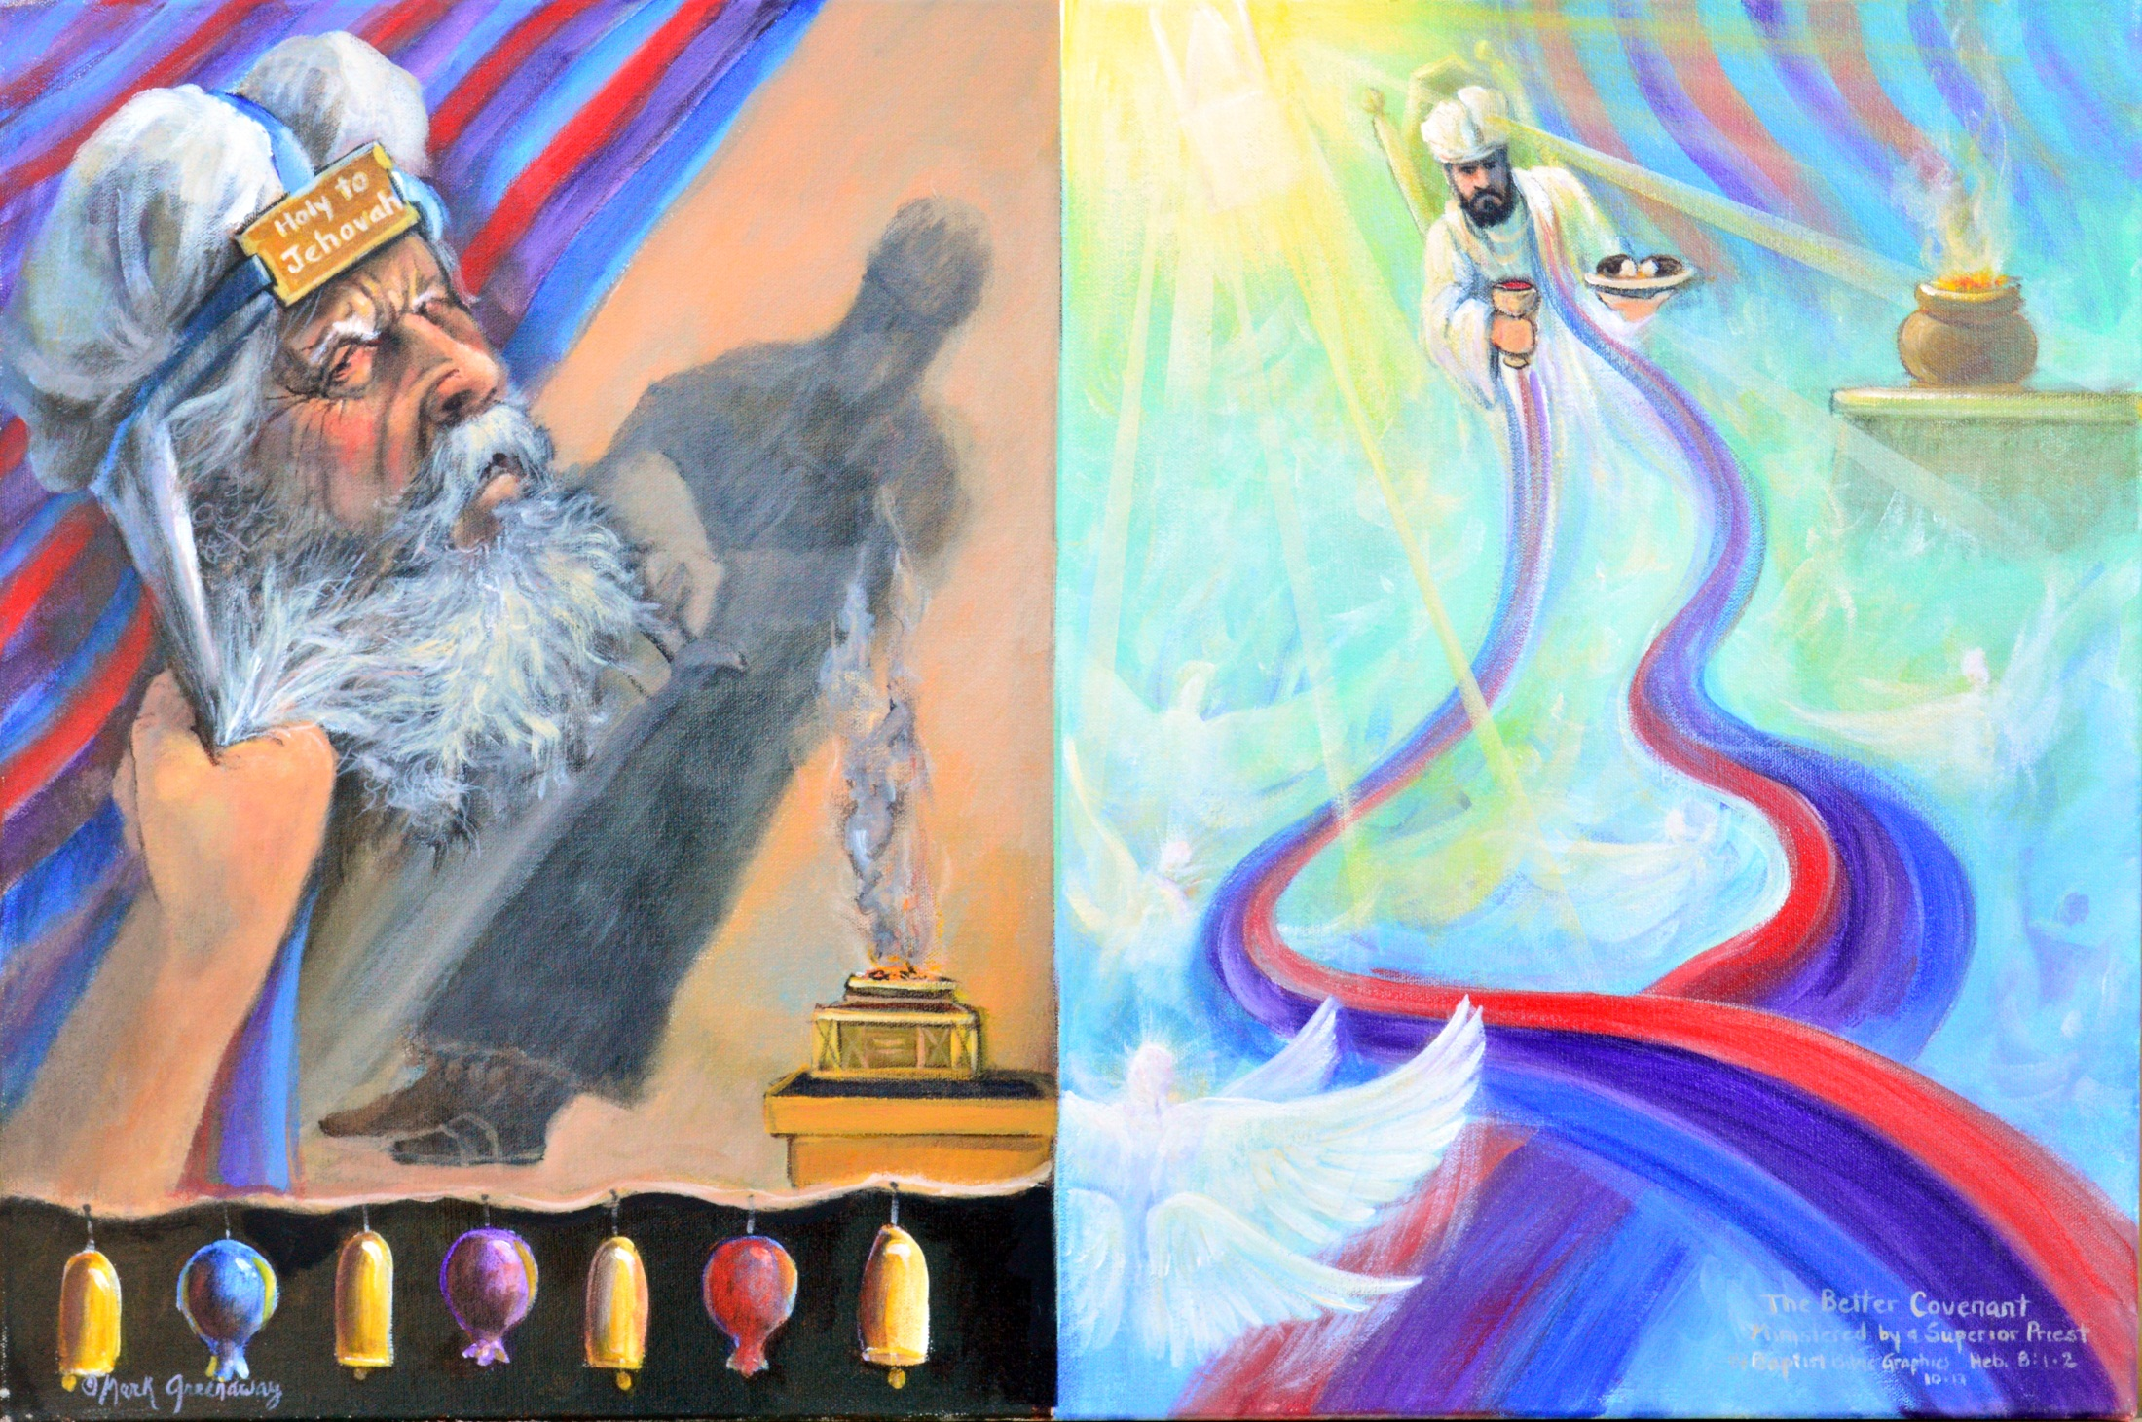
A superior priestly service, 8:1-3. Earthly curtain: Let’s summarize. You who are clutching after Aaron and want to abandon Christ are just grasping after repeated ritual. Heavenly train: Make progress towards Christ Heb 6. His ministry is based on a better priesthood Heb 7; by a better covenant Heb 8; and in a better sanctuary Heb 9. Shadow: Aaron always stood, his ministry never finished. Light: Christ is seated with gifts to offer.
Copyright 2016. Reprinted from Baptist Bible Graphics. www.biblegraphics.com

Slide 17
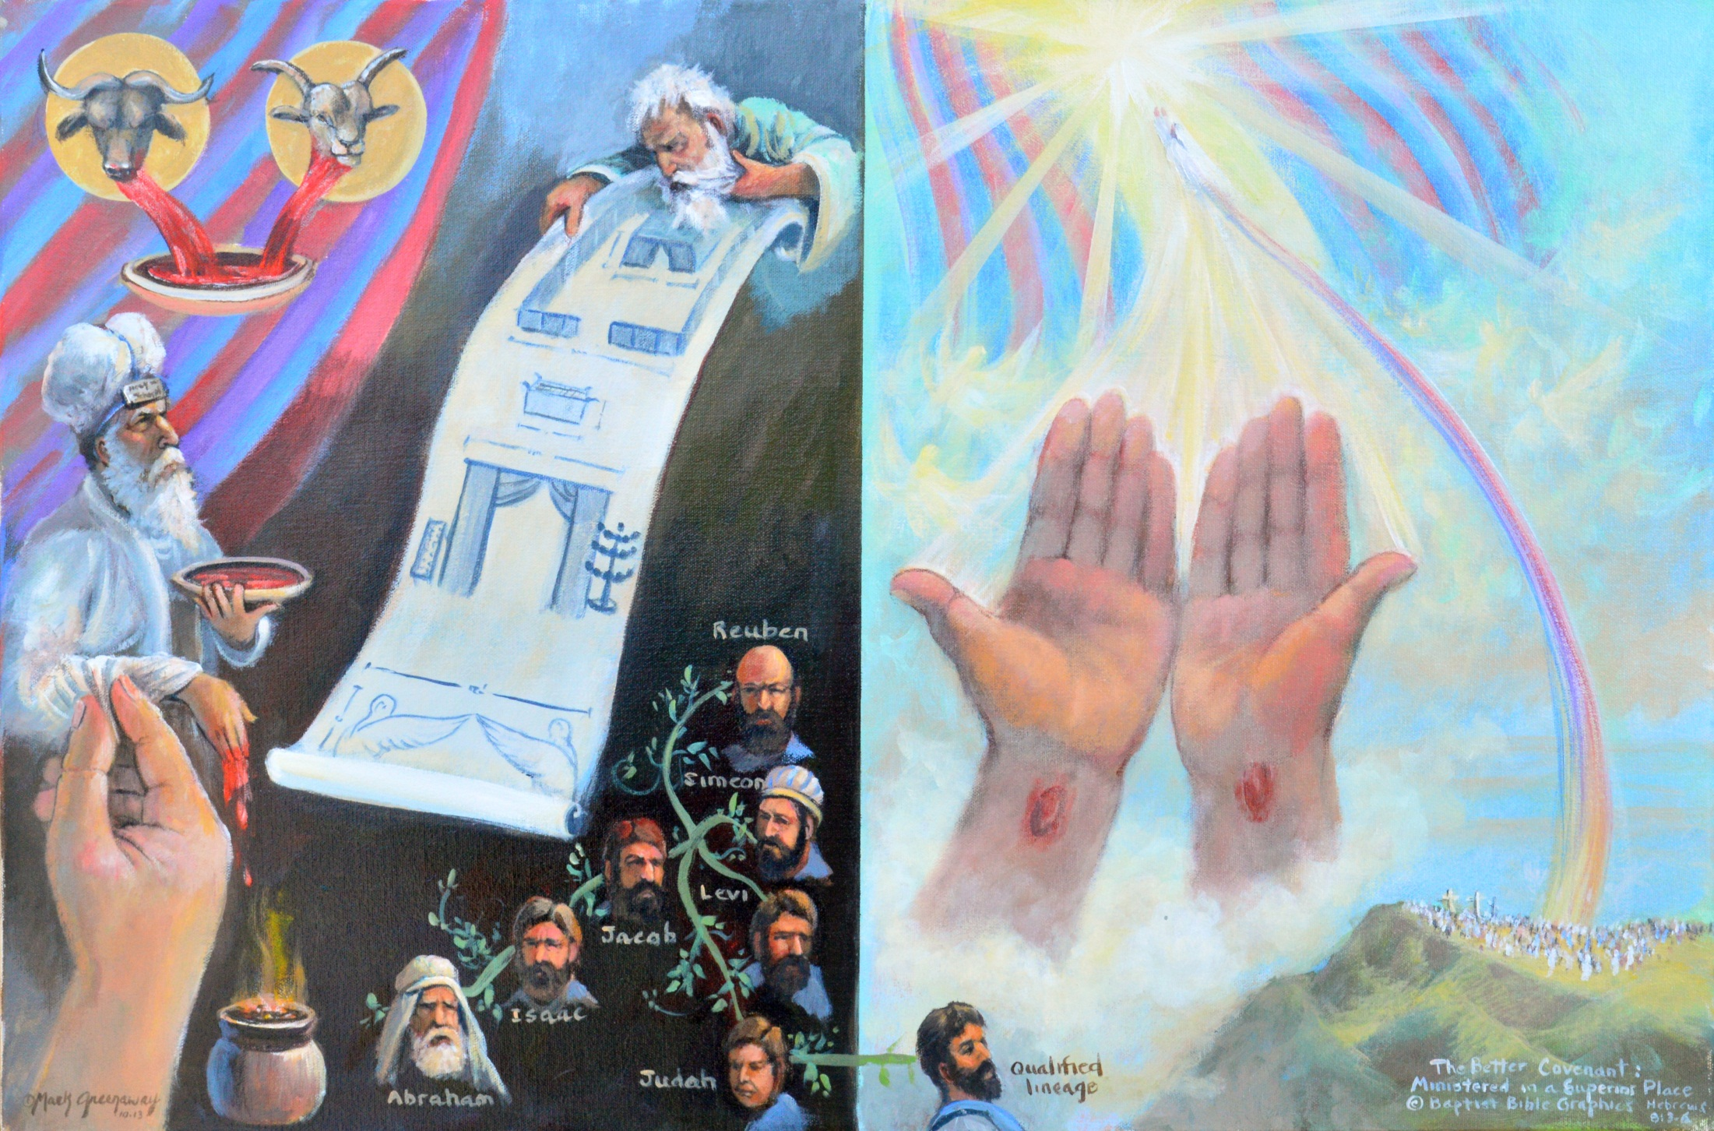
A superior place to serve, 8:3-5. Hand: Aaron’s sacrifices were repeated and visible. Hands: Christ had something to offer once for all. Genealogy: The Law said only Levites on earth. Judah to Jesus:But Christ ministers in heaven. Moses eyeing the blueprint: The sanctuary which we see was a copy. Jerusalem to heaven: Christ serves in the original sanctuary. Sure, no one has gone to heaven to see the sanctuary but it is still real.
Copyright 2016. Reprinted from Baptist Bible Graphics. www.biblegraphics.com

Slide 18
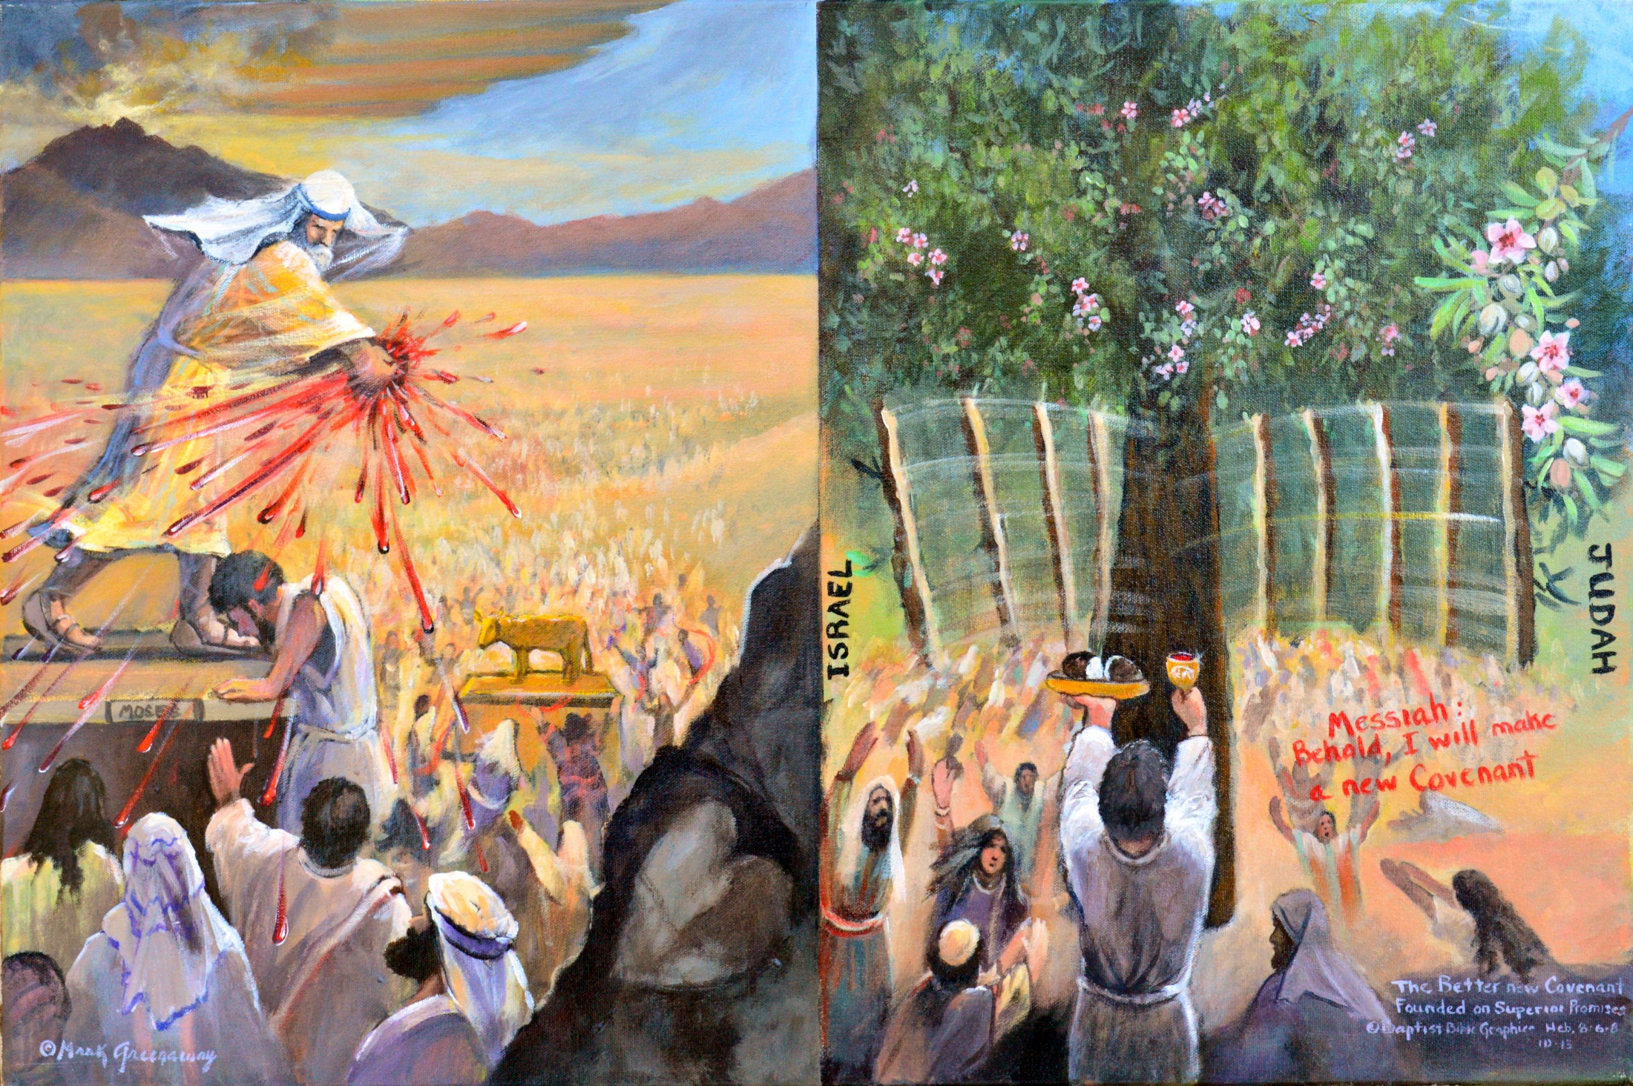
Better covenant based on better promises 8:6-7. Hand down: Moses ratified old covt with animal blood, Jews that preferred Moses speak to them instead of God Ex 20:19. Hands up: Only a few believed on Jesus the mediator by his own blood of the new covt. Heart: Old covt failed because of the sinfulness of the nation Col 2:13. Two sticks: Rod, the sinful nation separated from each other and from God are made one by the new covt.
Copyright 2016. Reprinted from Baptist Bible Graphics. www.biblegraphics.com

Slide 19
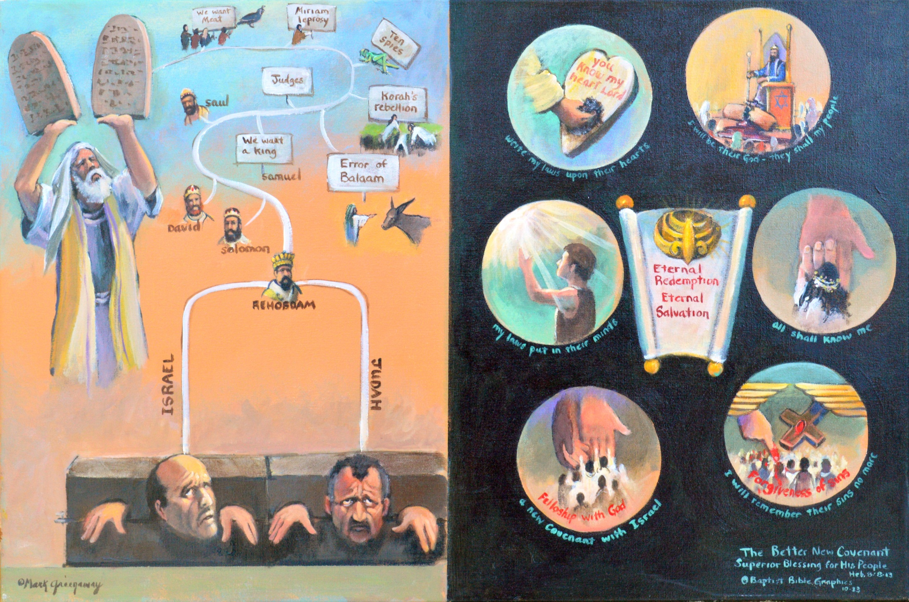
Better covt with better blessings, 8:8-13. Two stones: The Jews promised Moses they would keep the Law but disobeyed; Stephen’s indictment Acts 7. Scroll: Christ will fulfill the Abrahamic Covt with eternal blessings of redemption and salvation. Two captives The law is obsolete, growing old; it failed because Israel sinned; sin always beset their good intentions Ex 24:7. Six rings: Six times God said “I will” and being sinless, he is able.
Copyright 2016. Reprinted from Baptist Bible Graphics. www.biblegraphics.com

Slide 20
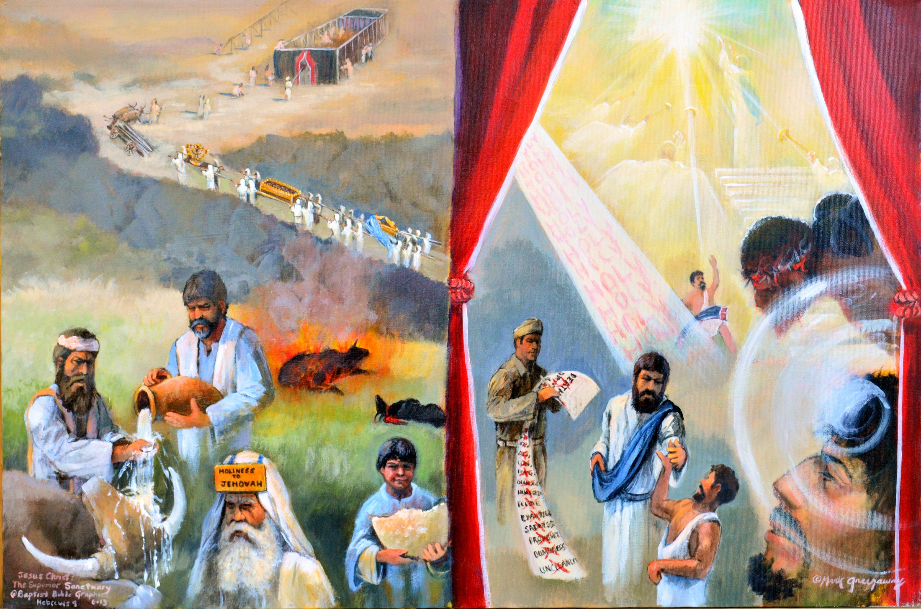
Sanctuary, better care, earthly needs vs heavenly 9:1, 11. Aaron: Met earthly needs for the moment. Christ: Sufficient to heal. Heifer: A stop-gap solution. Jacob: The writer also looked beyond earthly to see heavenly sufficiencies Gen 28:12. Pouring water. Dt 21:1 Cleanse every unresolved murder. Writing: All enemies mustered out. Priest’s son: Ate presence bread but got hungry again. Lame man: Made whole until death. Goats, calves, ashes: Earth’s needs. Thorns: Heaven’s needs. Tabernacle: Earth bound. Ladder: Heaven bound Jn 1:51.
Copyright 2016. Reprinted from Baptist Bible Graphics. www.biblegraphics.com

Slide 21
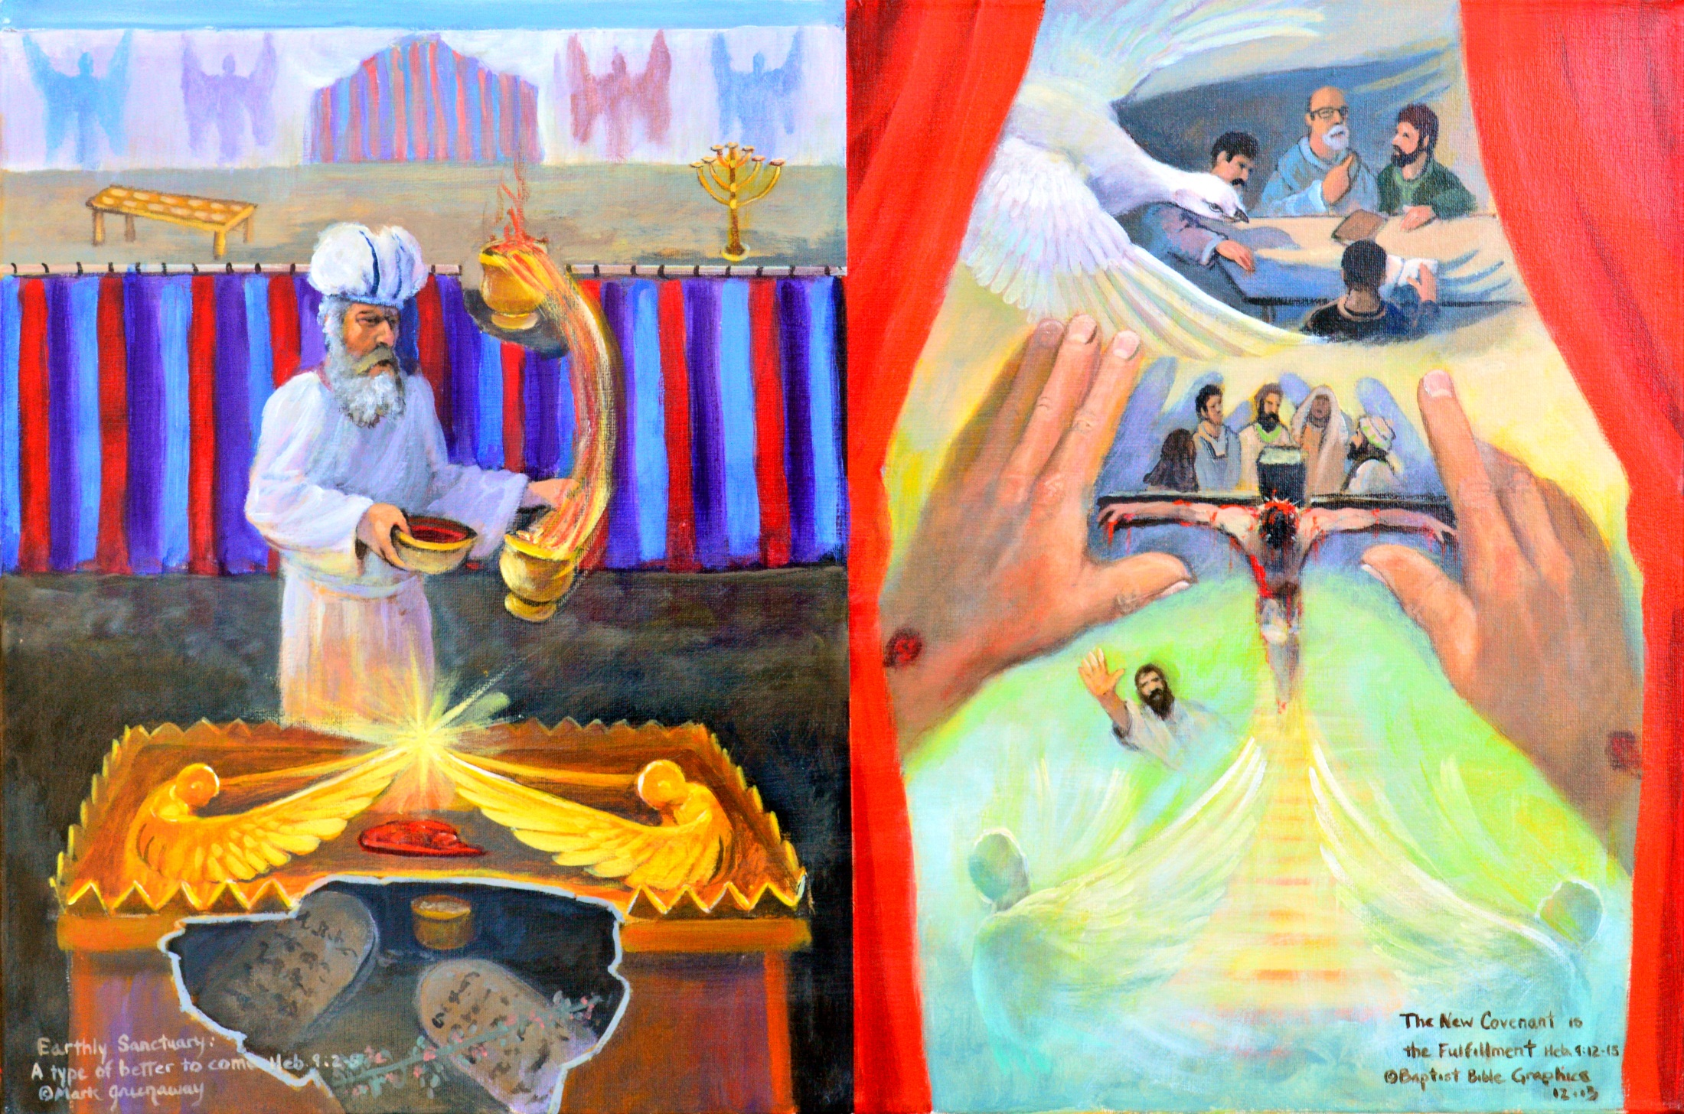
Sanctuary: Type of something better, animal blood vs Christ’s blood, 9:2-5, 12-15. Animal blood: Sprinkled on mercy seat the high priest could enter God’s presence. Christ’s blood: By his own blood entered once into heavenly tabernacle. Incense: Smoke dimmed Aaron’s view and the mercy seat hid the broken law from God’s sight. Dove: HS reveals the Son who reveals the Father to us, the promised eternal inheritance.
Copyright 2016. Reprinted from Baptist Bible Graphics. www.biblegraphics.com

Slide 22
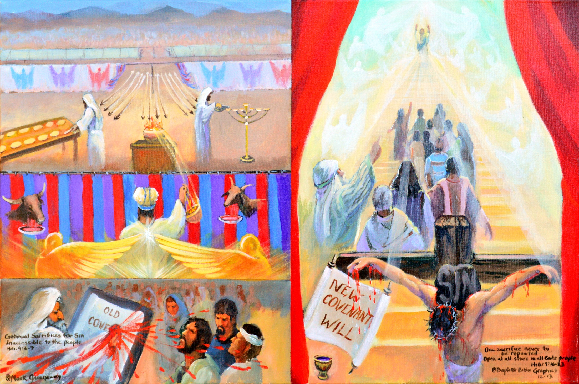
Sanctuary, a better finished work; continual sacrifices for sin vs once for all sacrifice for sin 9:6-7, 12. Moses: Inaugurated the old covt with animal blood. Christ on cross: At his death inaugurated the new covt, just like a will is not in force until the testator dies. Priests Repeatedly entered for over 1400 years. Christ in heaven: By his own blood he entered in once into the heavenly sanctuary, having obtained eternal redemption for us.
Copyright 2016. Reprinted from Baptist Bible Graphics. www.biblegraphics.com

Slide 23
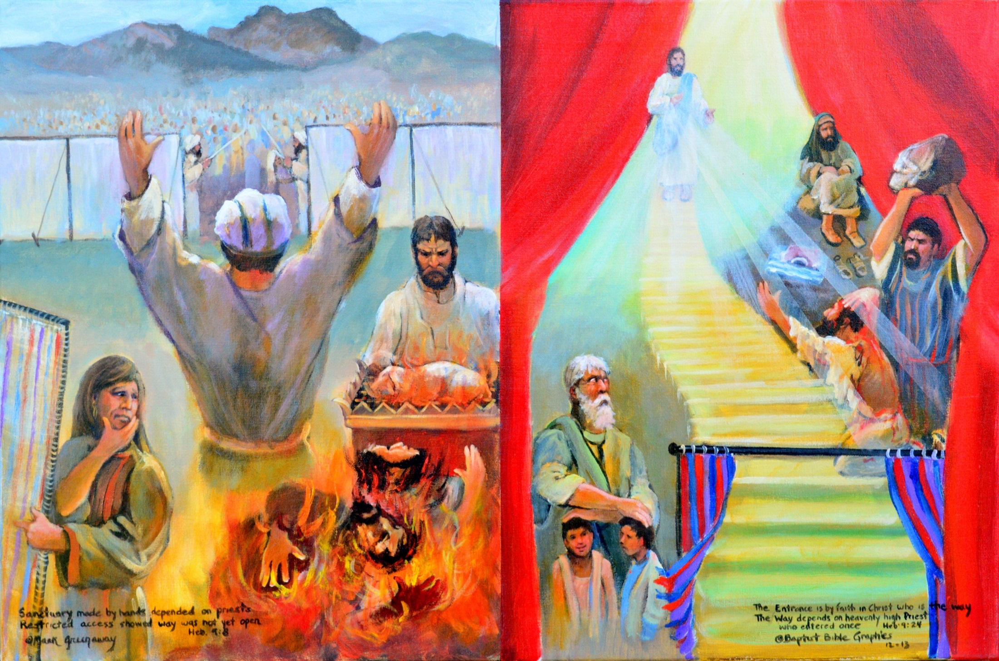
Sanctuary, better heart devotion: depending on faithfulness of man vs depending on the faiithfulness of God. 9:8, 23-24. Aaron: Restricted access, can only keep you out. Christ: Unlimited access, willing to bring everyone in. Sinner/Priest: First offer for own sins, then for others. Savior/Priest: No sacrifice needed for sin. Nadab & Abihu: Strange fire led to their death. Jacob: Blind but saw God’s faithfulness. Miriam: Doubted God’s faithfulness. Stephen: I see heaven open, Son standing.
Copyright 2016. Reprinted from Baptist Bible Graphics. www.biblegraphics.com

Slide 24
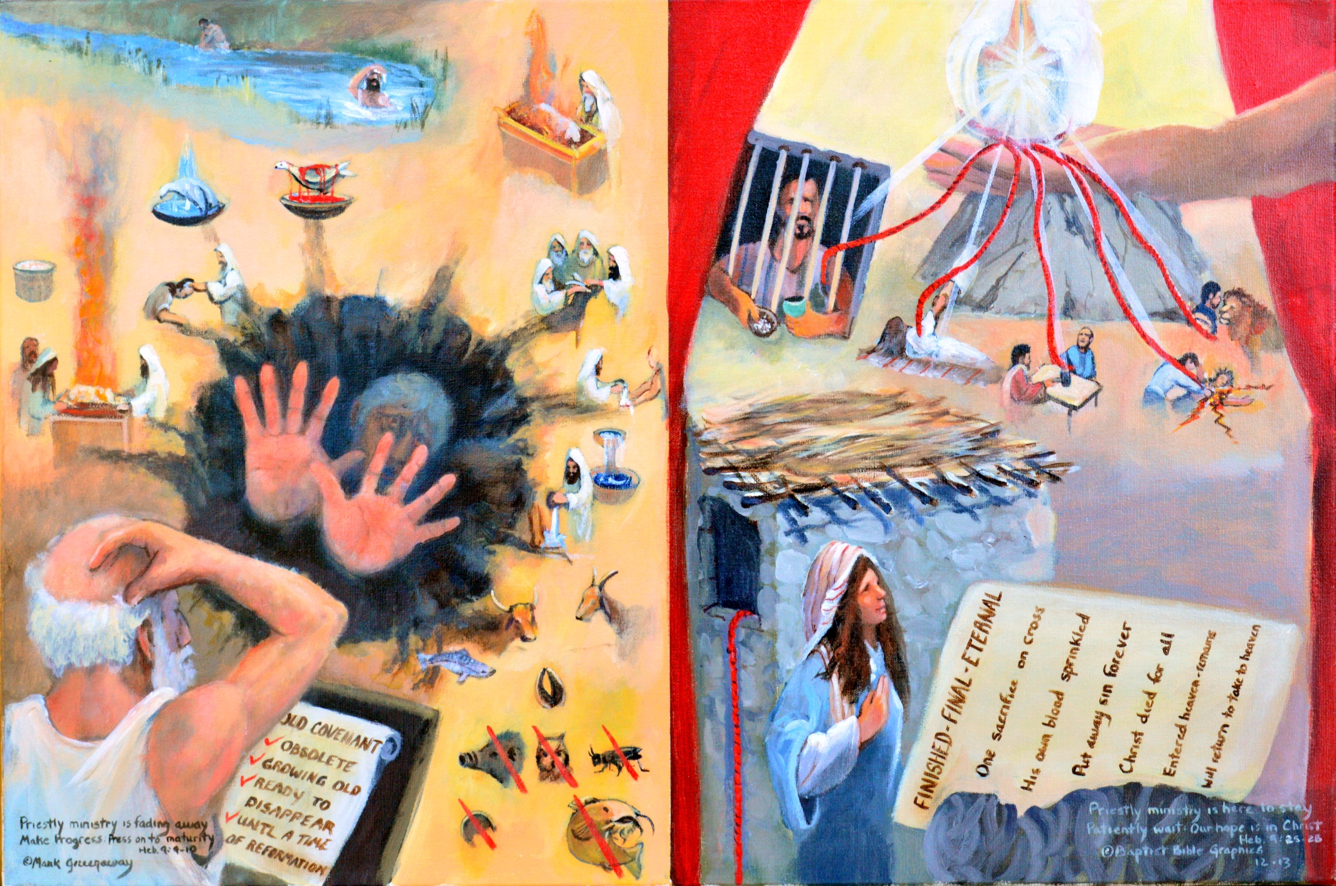
Sanctuary, a better connection to God, earthly priesthood is fading vs the heavenly is here to stay 9:9-10, 25-28. Moses Woe is me, gifts and sacrifices that can’t purify the guilty conscience are growing old. Rahab: Like Abraham, she patiently waited with the red rope hanging down Jericho’s walls, she being dead yet speaketh. Sinkhole: No firm standing for the cerimonial washings, fire, blood and food laws that have disappeared. No no, don’t fall into this mire. Rock: The Holy Spirit enlightens the heart that the true way to God is by Christ’s sacrifice.
Copyright 2016. Reprinted from Baptist Bible Graphics. www.biblegraphics.com

Slide 25
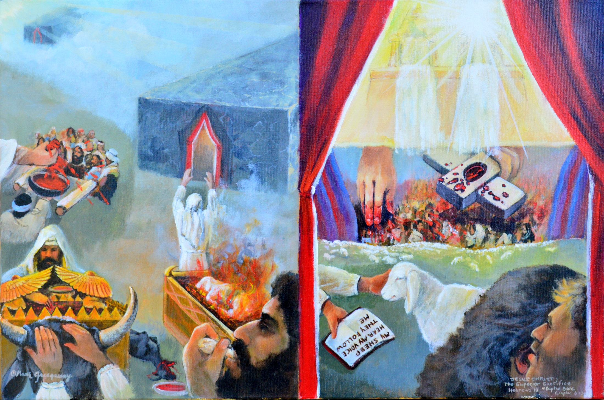
A superior sacrifice 10:1-18. system of laws, sacrifices, eating foods with no end in sight vs a Savior whose sacrifice is final. The author reaches back to 9:26 making this a summary of what came before. Men reaching up: They are all reaching up but they are still on earth. God reaching down: Reaching down to earth to bring sinners higher than the heavens. Curtains: Both entered by blood, an earthly shadow vs a heavenly glory.
Copyright 2016. Reprinted from Baptist Bible Graphics. www.biblegraphics.com

Slide 26
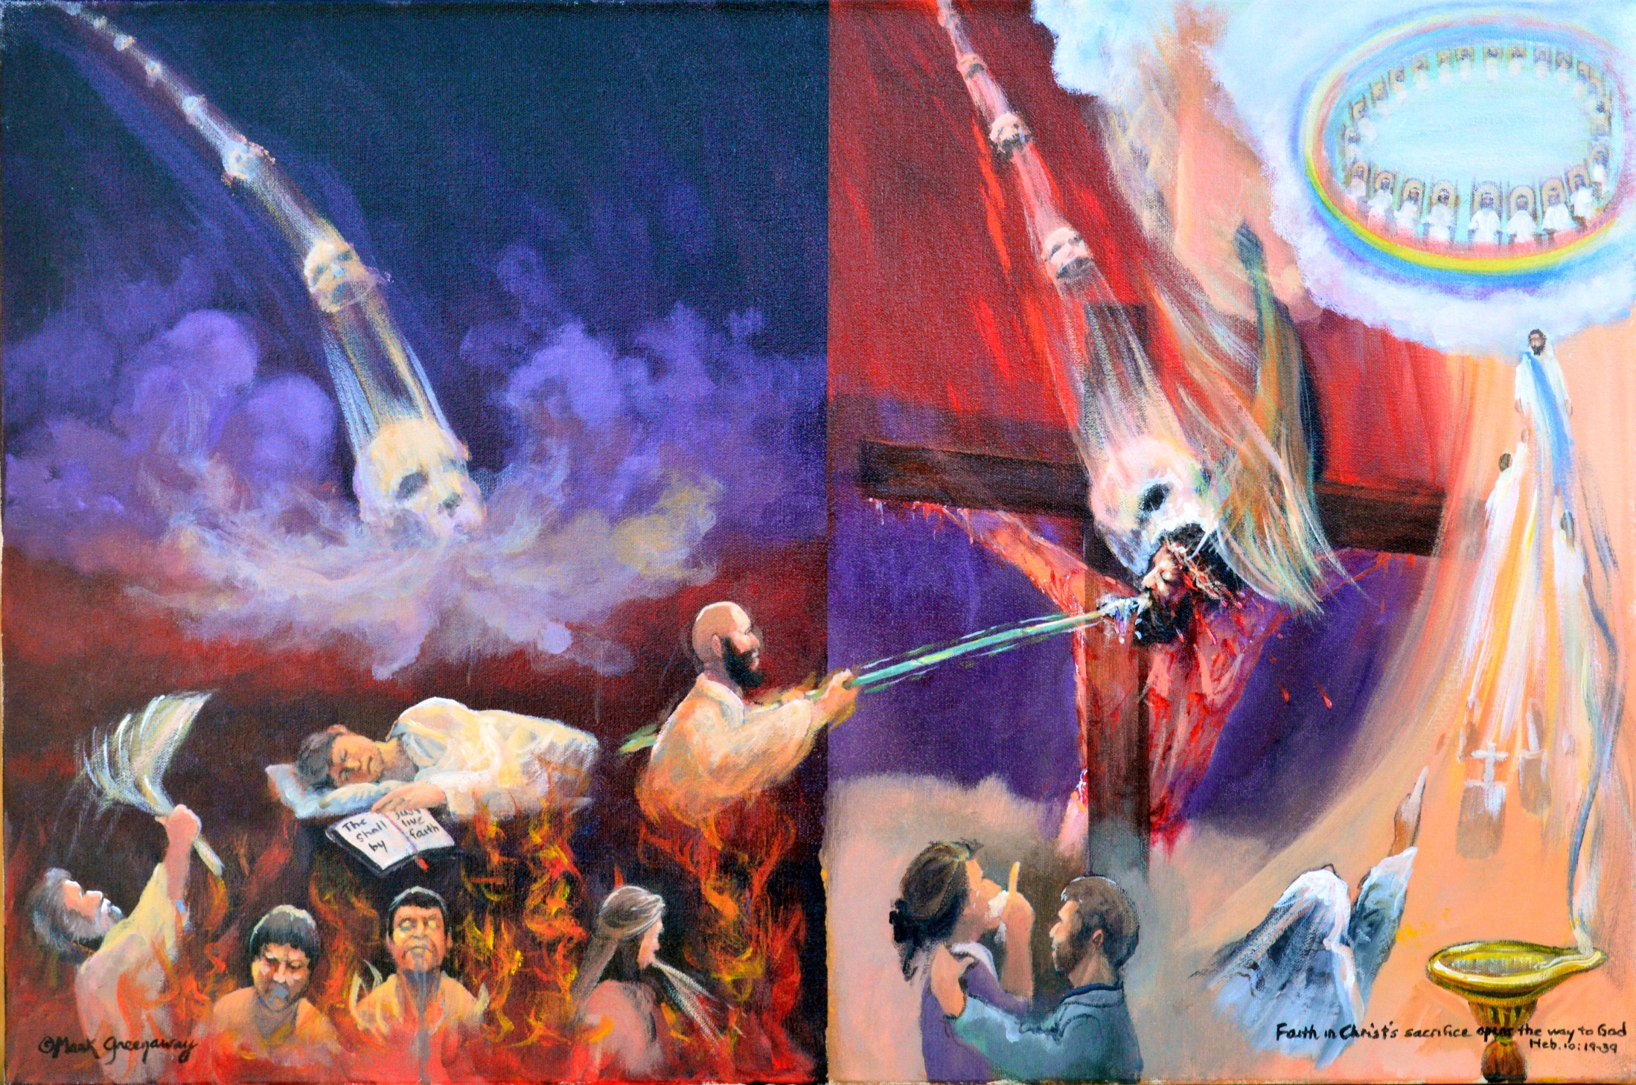
Judgment hour 6:6; 10:19-25. The weight of dead works placed on me vs the weight of dead works placed on my substitute. Threshing floor of firey judgment Lu 22:31. Wrath results when grace is rejected Rom 2:5. Firey judgment on cross: If you reject my sacrifice, there remains no other sacrifice for sins. You’ve trampled underfoot the Son of God. Cast not away your confidence; draw near to Me. Heaven: You have a great reward.
Copyright 2016. Reprinted from Baptist Bible Graphics. www.biblegraphics.com
Notes:
Heb 10:19-25

Slide 27
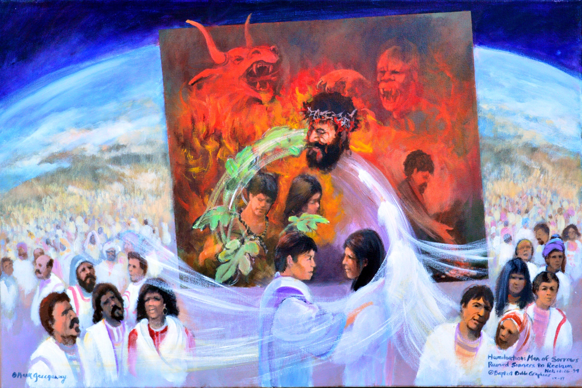
Faith to remember our Lord in his suffering 10:26-39. Wild beasts/Man-lion Ps 22. Pictures sin’s weight placed upon Christ. Fig leaves Adam and Eve’s sin was placed on Jesus. Sins washed white as snow Isa 1:18. The sin of the world was placed on Christ. All men benefit by his death but only those who believe have the benefits applied to them Is 53. Cain: drew back, no faith. Faith binds the two narratives of Hebrews together, 10:38
Copyright 2016. Reprinted from Baptist Bible Graphics. www.biblegraphics.com

Slide 28
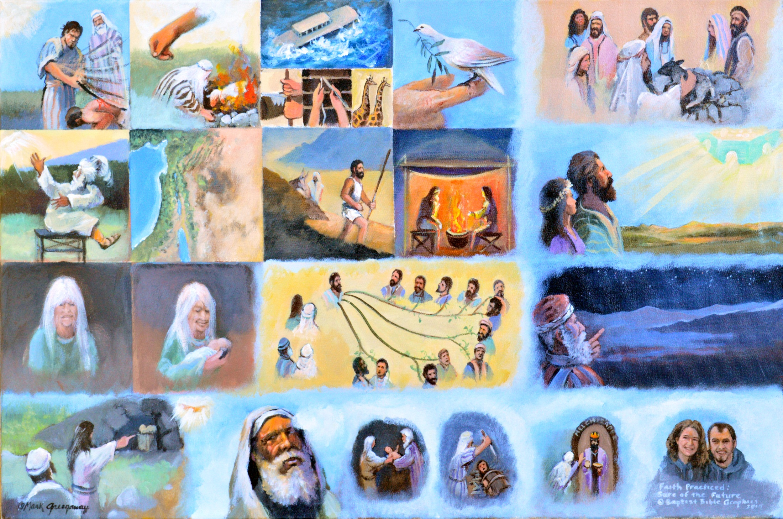
Faith evidenced 11:1-16 All who lived by faith looked forward to a certain future Abel Dead, by faith he still speaks Enoch By faith he didn’t die. Noah By faith entered the ark. Dove. By faith opened the window and worshipped. Abraham: Became a wanderer, didn’t put down roots in this old world. Sarah: No child, getting old, the best medicine is laughter and that’s what she named her son. Died in faith because object of faith was God.
Copyright 2016. Reprinted from Baptist Bible Graphics. www.biblegraphics.com

Slide 29
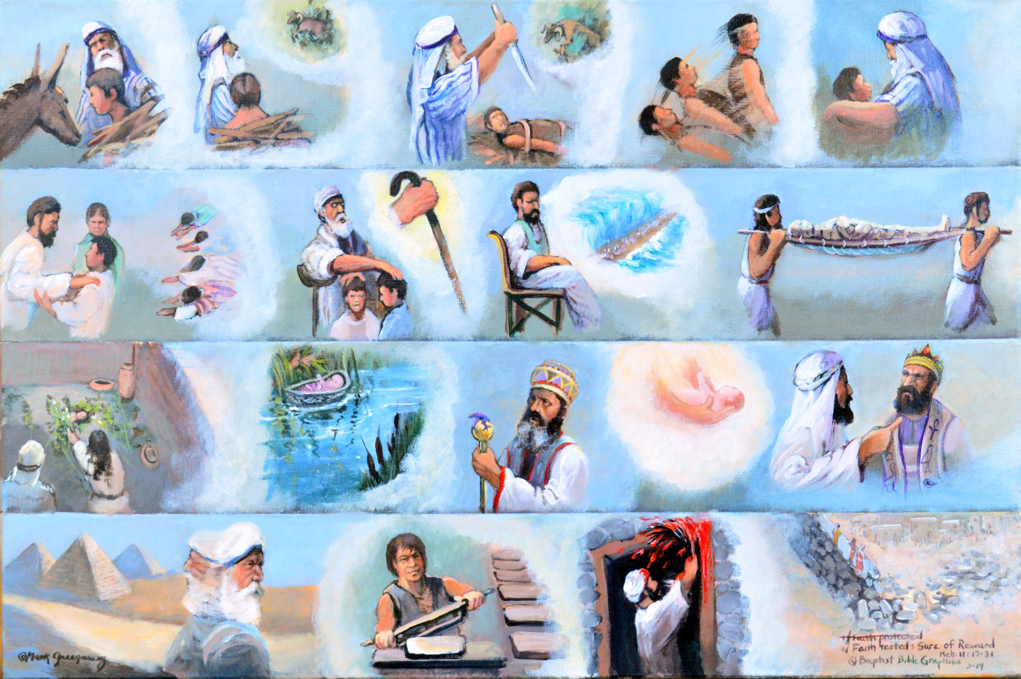
Faith tested and rewarded 11:17-31. All who live by faith look forward to a certain reward within the reach of faith, not some dream unable to be grasped. The best way to grow in faith is to walk with the faithful so we return to Abraham, then Isaac, Jacob, Joseph, Amram & Jochebed. Moses turned his back on Egypt and kept looking away from worldly pleasures. Rahab She waited 40 years and was rewarded, the last ones standing on the walls of Jericho.
Copyright 2016. Reprinted from Baptist Bible Graphics. www.biblegraphics.com

Slide 30
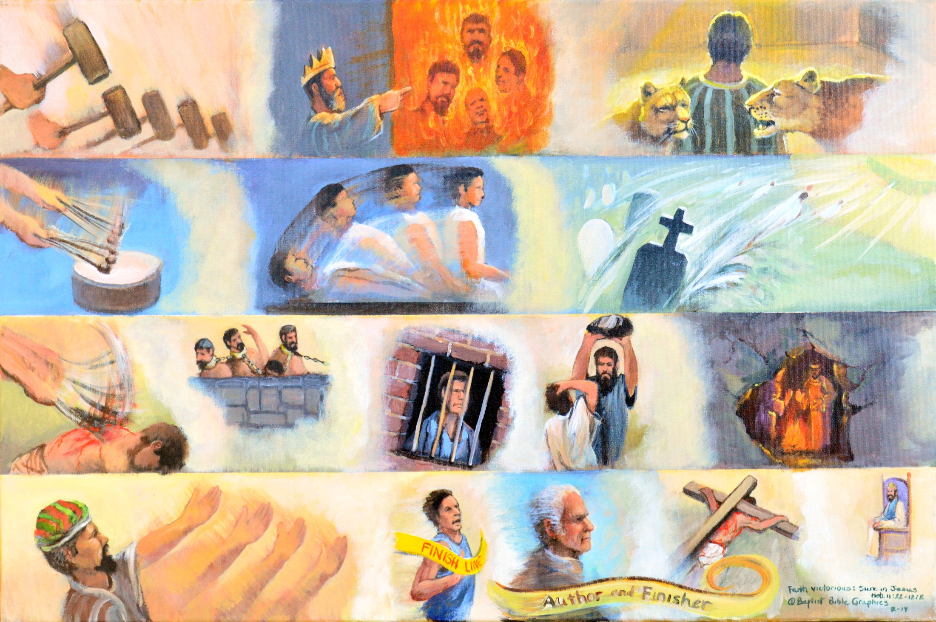
Faith victorious, 11:32-40. Because the object of our faith is victorious. We are winners because the One in who we place our faith is a winner. Hammering: The tempo has quickened, the intensity felt, 11:32-34. Beating drum: Death took it’s toll but faith triumphed as some were resurrected. Whipping: But others were tortured; it took more faith to endure than to escape. Abel: reaching out, perfecting, their hope awaits for us.
Copyright 2016. Reprinted from Baptist Bible Graphics. www.biblegraphics.com

Slide 31
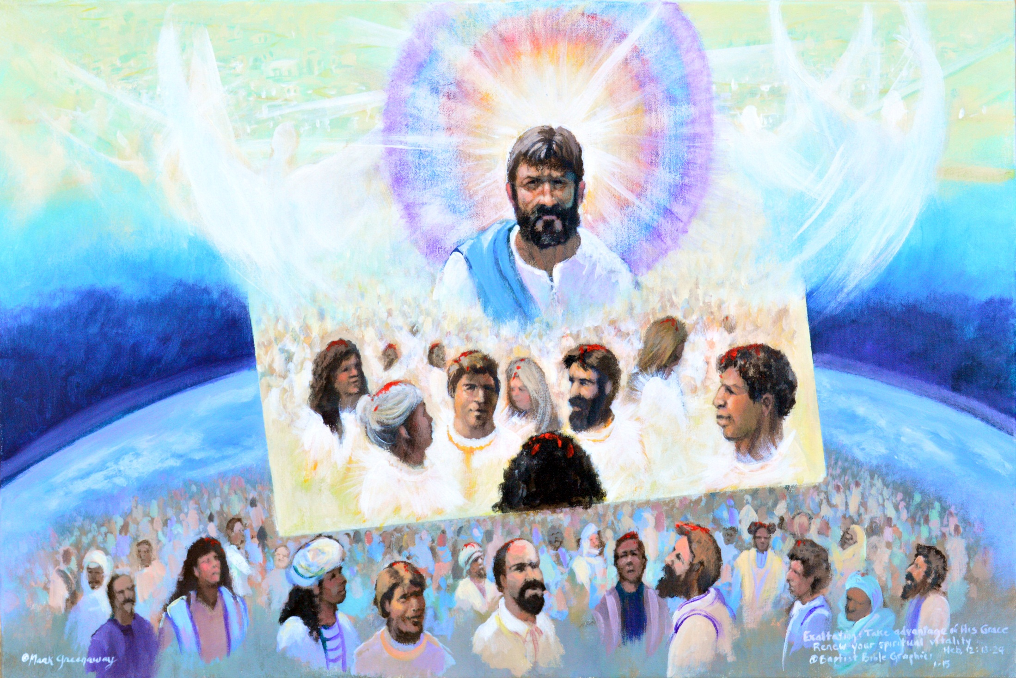
Faith to look unto Jesus for power to live the Christian life, Heb 12:1-3. Jesus pioneered the path of faith, we as companions should follow. Men of faith have gone before us, God having planned something better for them and for us. Partakers: 1:9; 3:1, 14; 6:4; 12:8. We share with that cloud of witnesses the life of faith. Hence we ought to run with patience the race that is set before us lest sin entangle us and deprive us of our joy.
Copyright 2016. Reprinted from Baptist Bible Graphics. www.biblegraphics.com

Slide 32
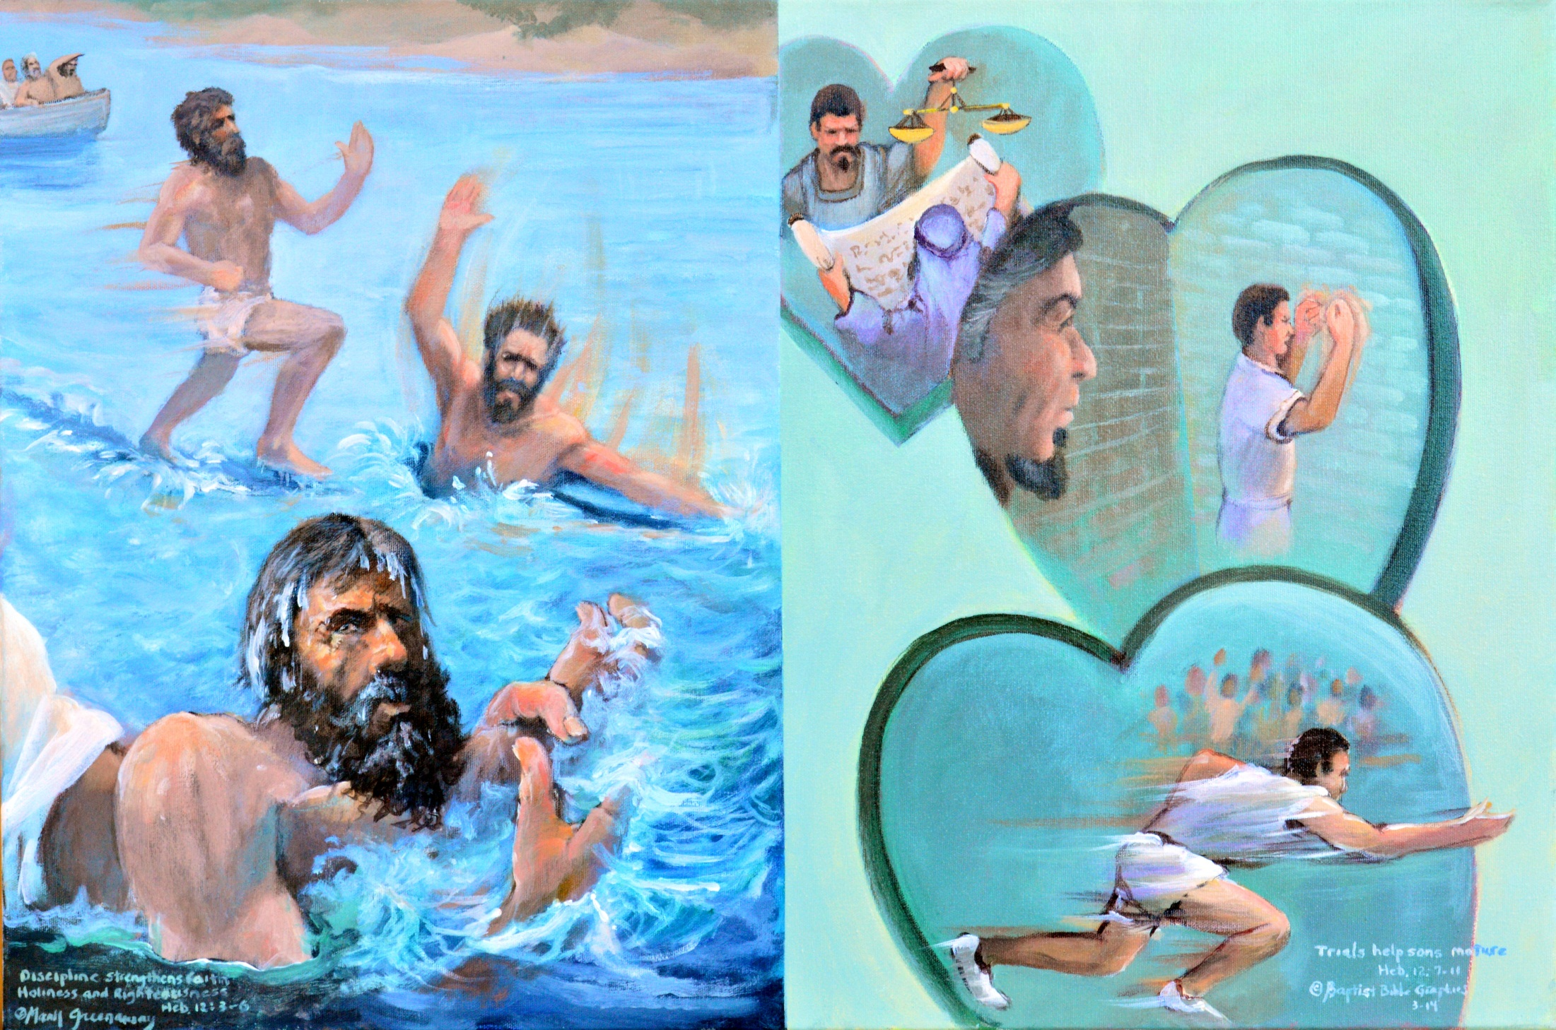
Chastening strengthens faith, 12:4-11. All go thru trials, so did Jesus; he tests his disciples. Peter: Took his eyes off Jesus and went down Mt 14:22. Faith is not a one time look but a life long looking. Hearts Divine chastening is evidence of divine love. Scripture: His chastening hand is controlled by his loving heart. I’ve got your back. Only sons are corrected. Race: Discipline conditions us to fix our eyes on the goal; pursue righteousness.
Copyright 2016. Reprinted from Baptist Bible Graphics. www.biblegraphics.com

Slide 33
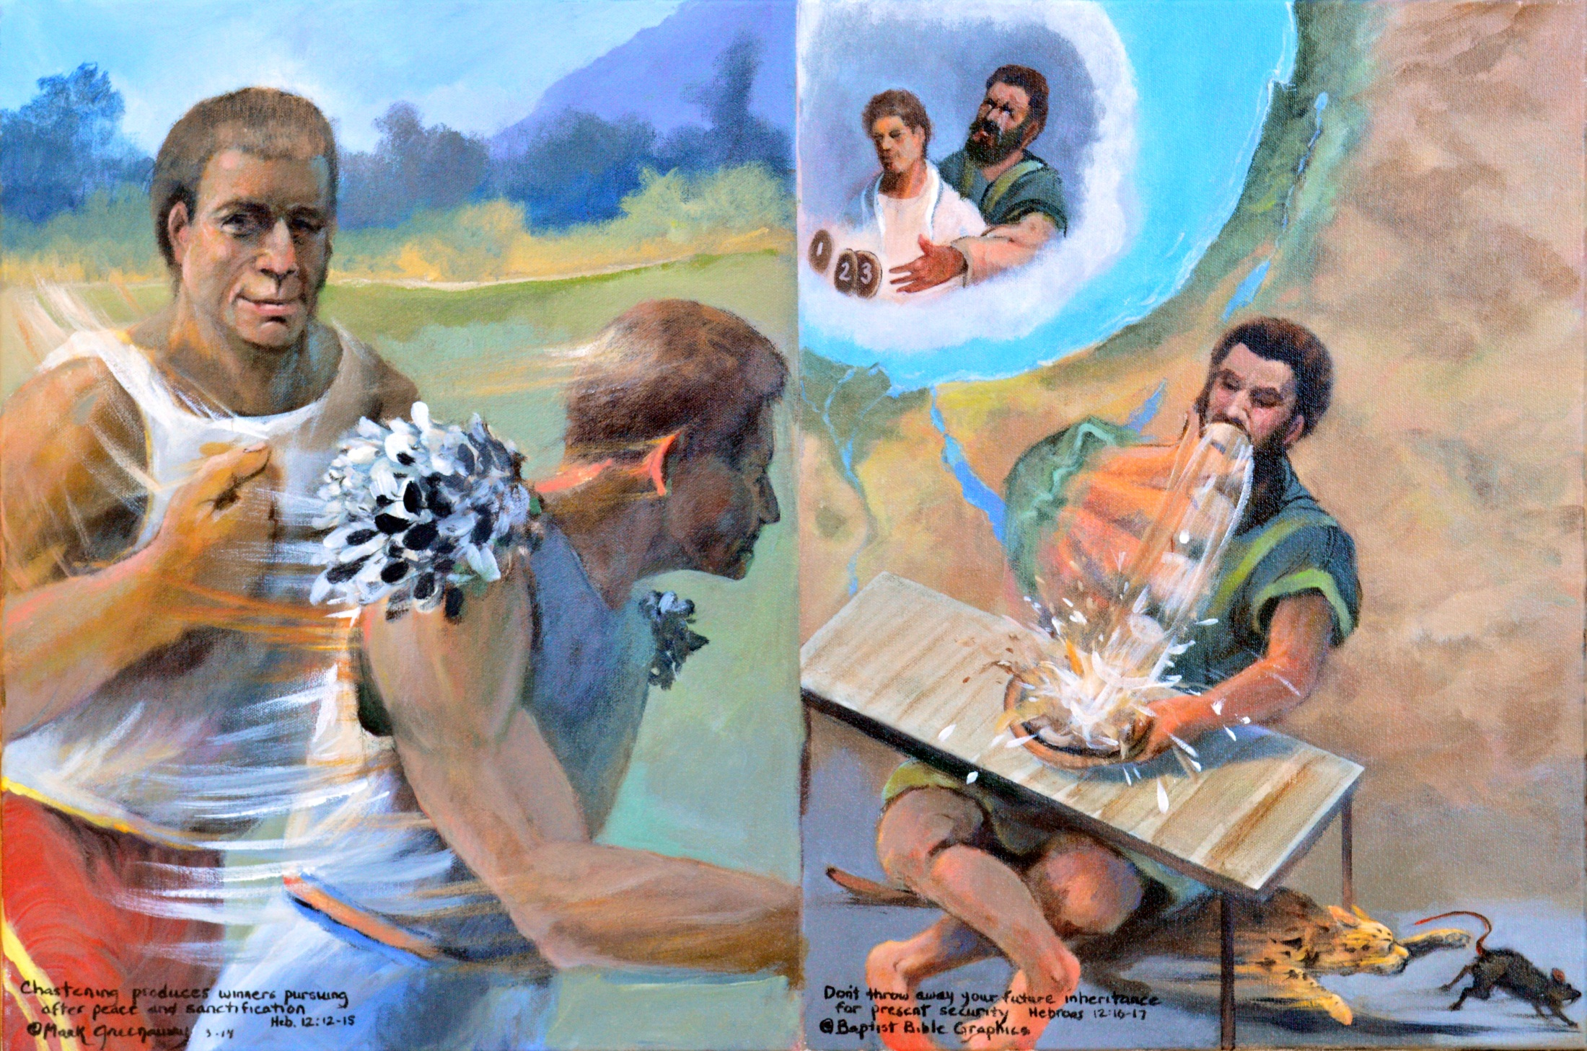
Discipline gives direction in the life of faith, 12:12-17. I’m in control vs God’s in control. Runners: Cast off the weights, sin, strengthen your hands and knees, seek level paths for your feet as you pursue peace and holiness Esau Example of an undisciplined man worldly and materialistic. An insatiable appetite, shaky arms and swollen knees were just the outward manifestation of the lack of inward godliness. Cat & rat: Esau didn’t repent; his bellyaching was all show.
Copyright 2016. Reprinted from Baptist Bible Graphics. www.biblegraphics.com

Slide 34
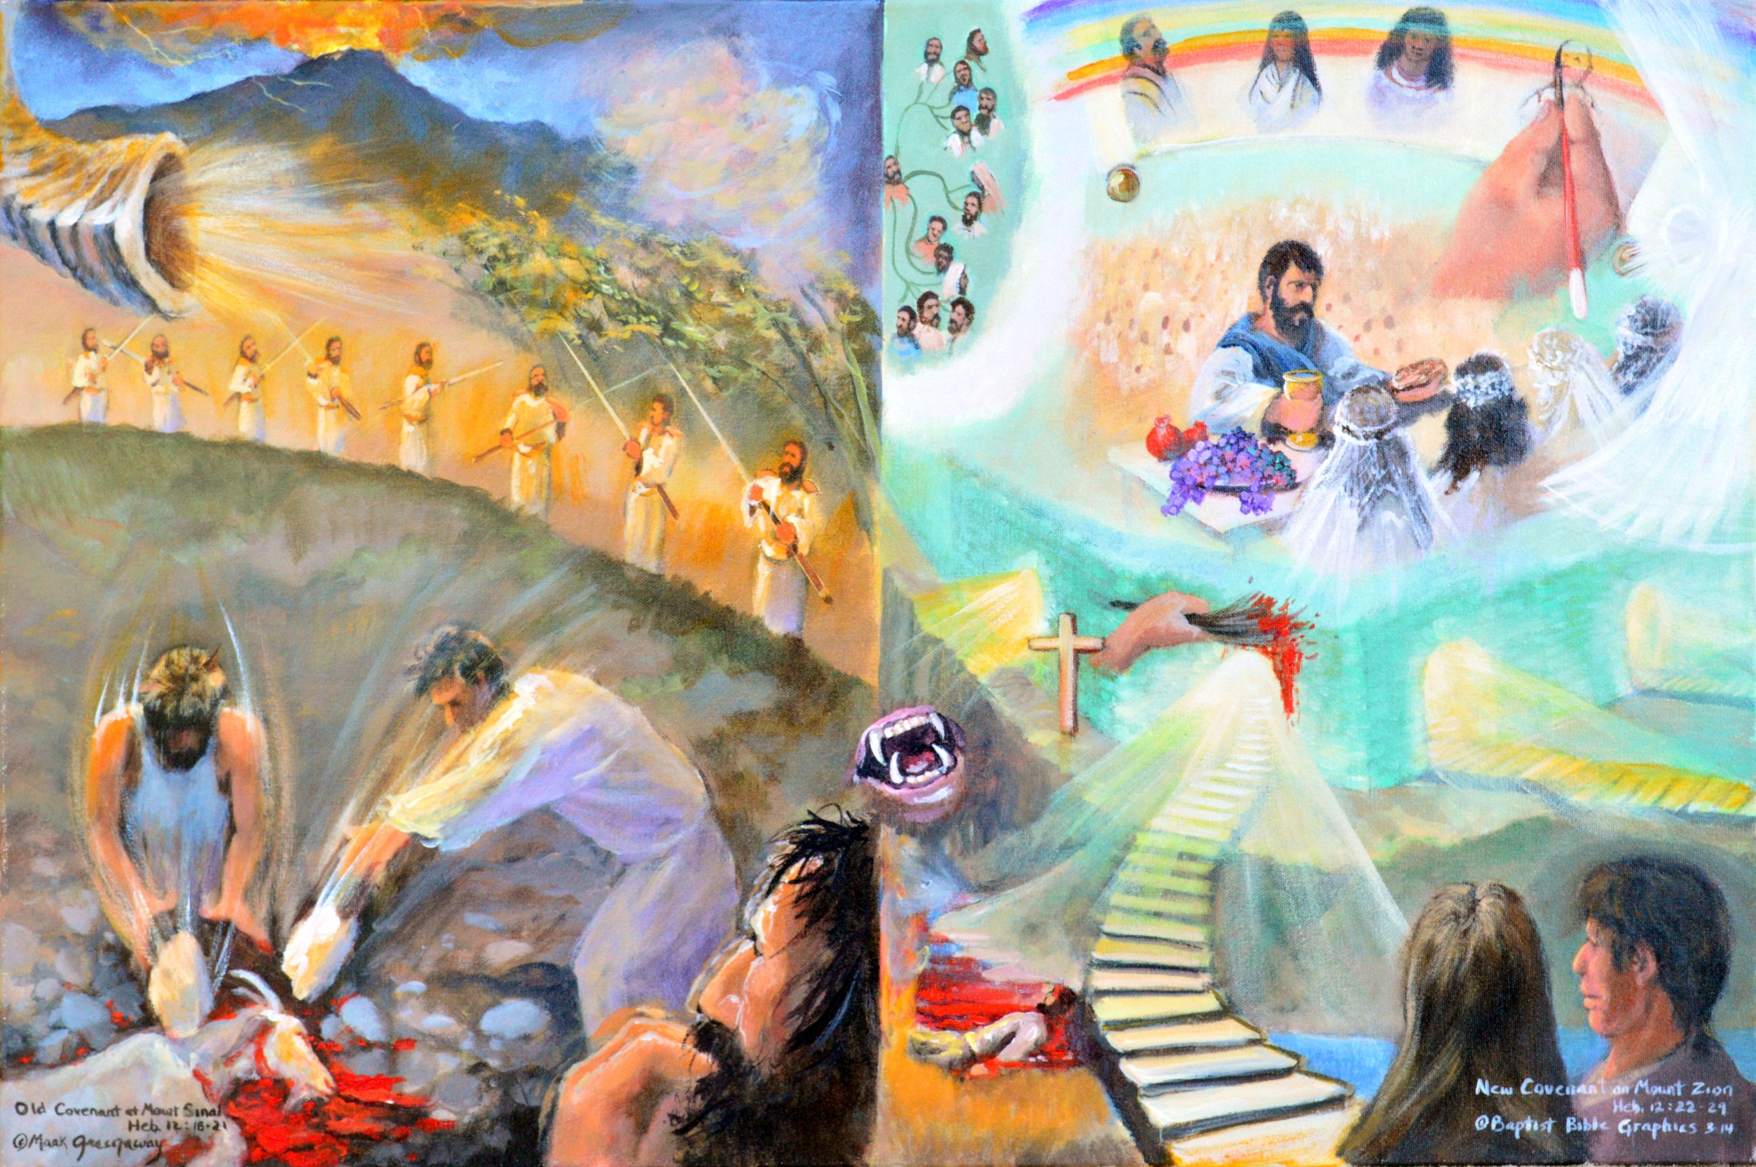
Faith to keep going when its tough, Heb 12:18-29. Leave the old covt and Mt Sinai behind. Look up to Mt Zion and the new covt. Mt Sinai: Earthquakes, lightning, fire, wind, a blasting ram’s horn terrified the people. They only wanted to hear the voice of man and not God. Mt Zion: There’s the heavenly city that can not be shaken, angels, table spread, tribes of Jacob, but most of all there’s Jesus. Abel’s blood cries out for justice.
Copyright 2016. Reprinted from Baptist Bible Graphics. www.biblegraphics.com

Slide 35
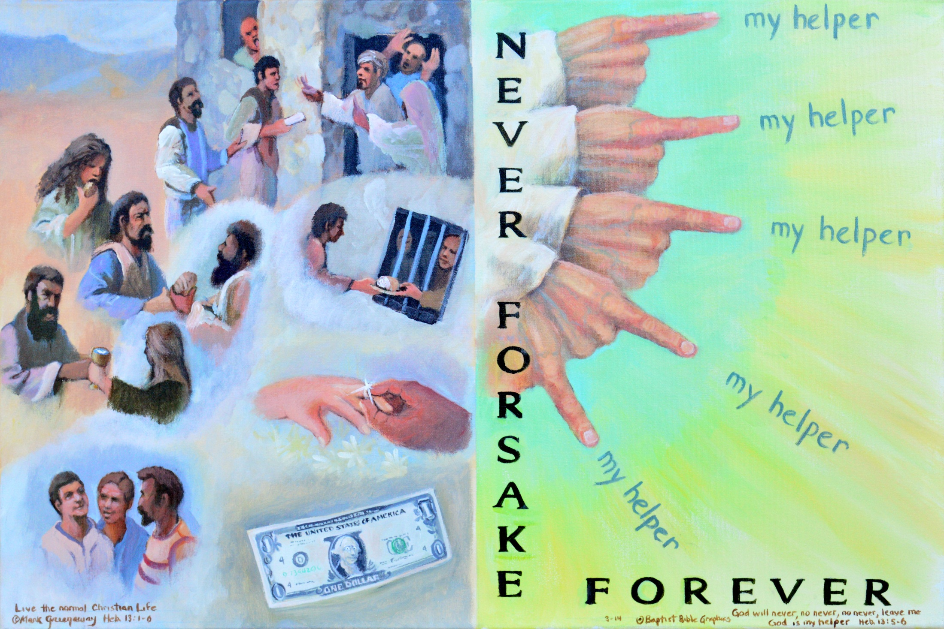
Faith to love as God loves, 13:1-8. Reach out to others just like God reaches out to us. Look around: Practice brotherly love, do good to strangers, prisoners; love at home; honor your marriage, don’t love the almighty dollar. Five Hands: God will never, no never, no never forsake us, 5 negatives. Jesus the same yesterday, today and forever. Don’t be anxious; we have the Lord and his unchanging help. Fear God and fear no man.
Copyright 2016. Reprinted from Baptist Bible Graphics. www.biblegraphics.com

Slide 36
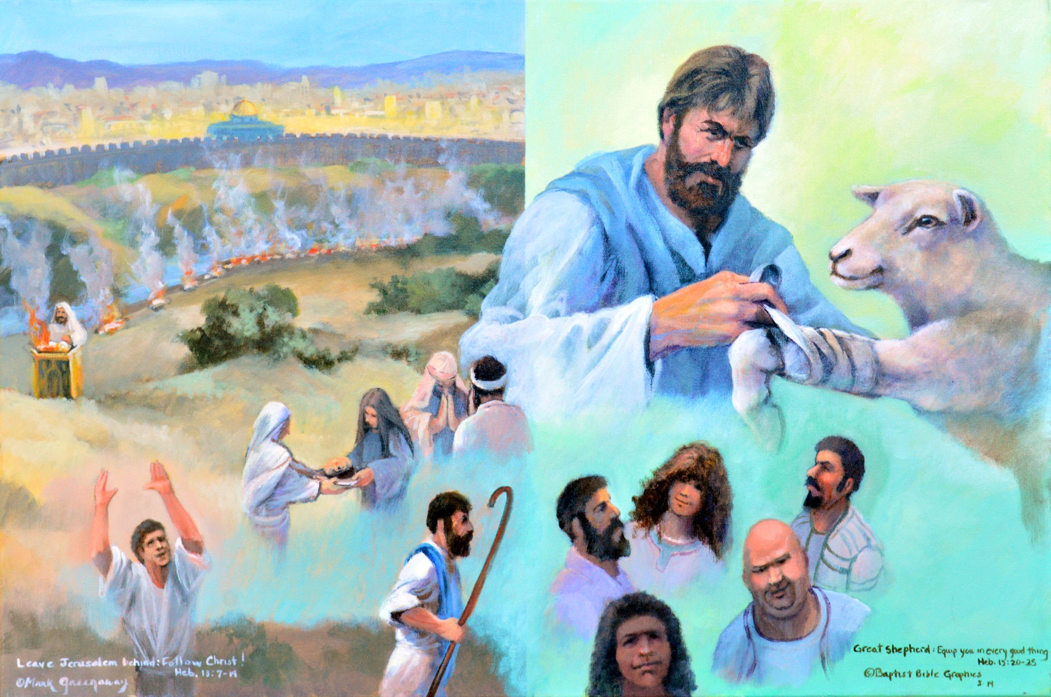
Faith to live, 13:9-25. Leave Jerusalem behind and follow the great Shepherd of the sheep,. Altars: Let go of dead religion. We have an altar eternal in the heavens. Staff: Abandon the camp of Judaism bearing his reproach. Three sacrifices: Praise, sharing and prayer. Church leaders: Obey and submit. Binding: May Jesus our Lord equip you in every good work. Take care of the spiritual side of life and the physical will find its place.
Copyright 2016. Reprinted from Baptist Bible Graphics. www.biblegraphics.com

