Slide 1
Jonah
Introduction

Slide 2
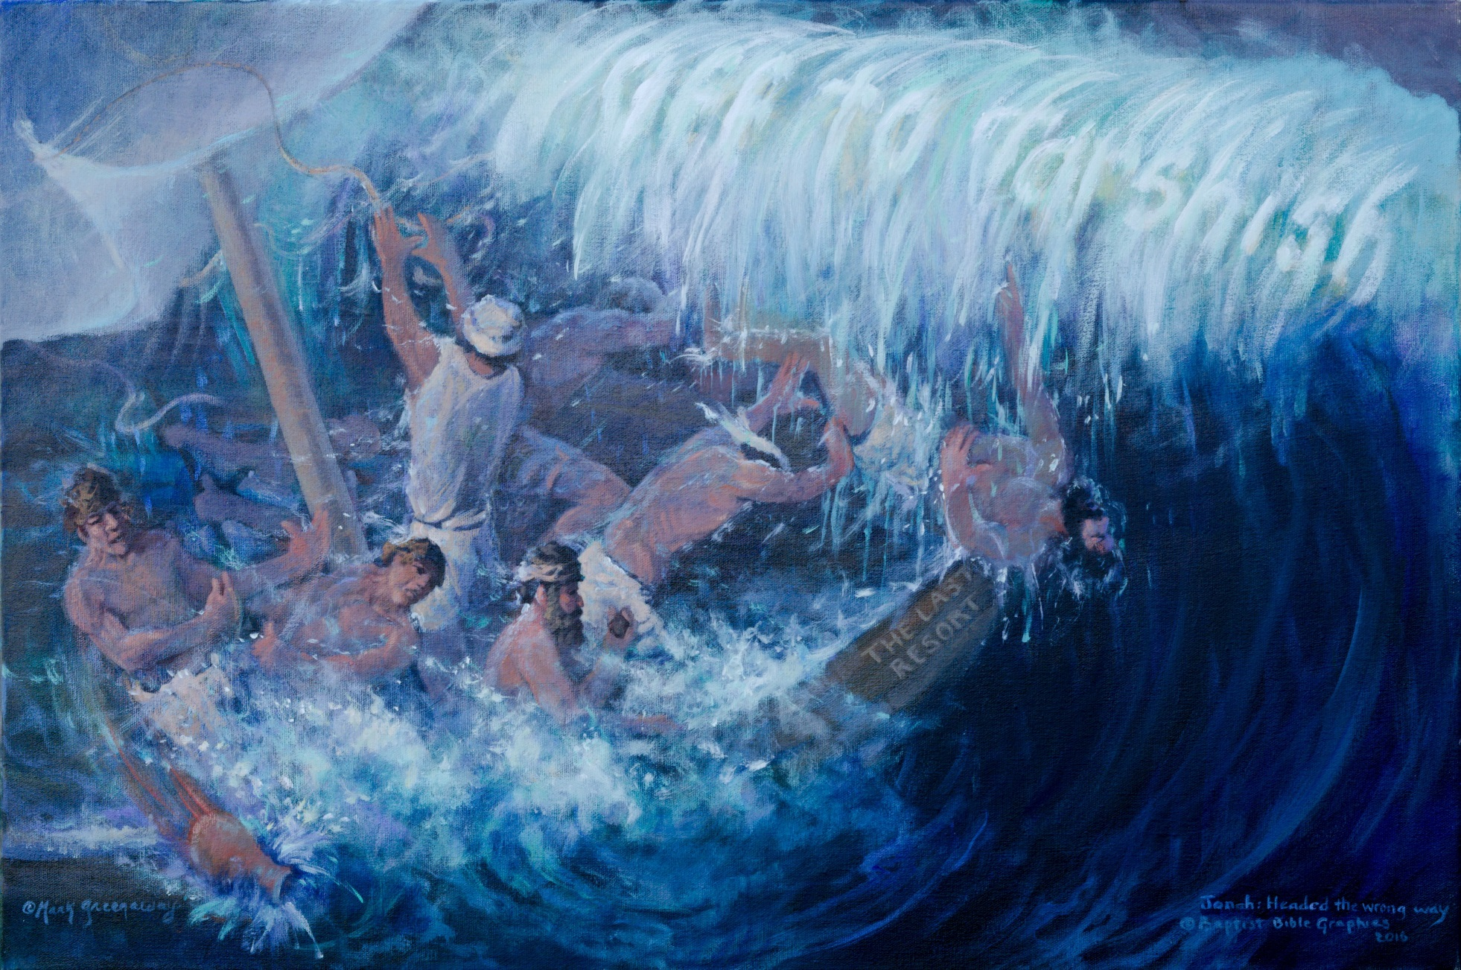
1
Fr:11. C.

Slide 3
2
From God in Heaven to God-Man on Earth, 1:1-4:11. Christ is the king of the Jews as demonstrated by His genealogy, His birth, His worship by the gentile magi, His forerunner, baptism, and temptation.

Slide 4
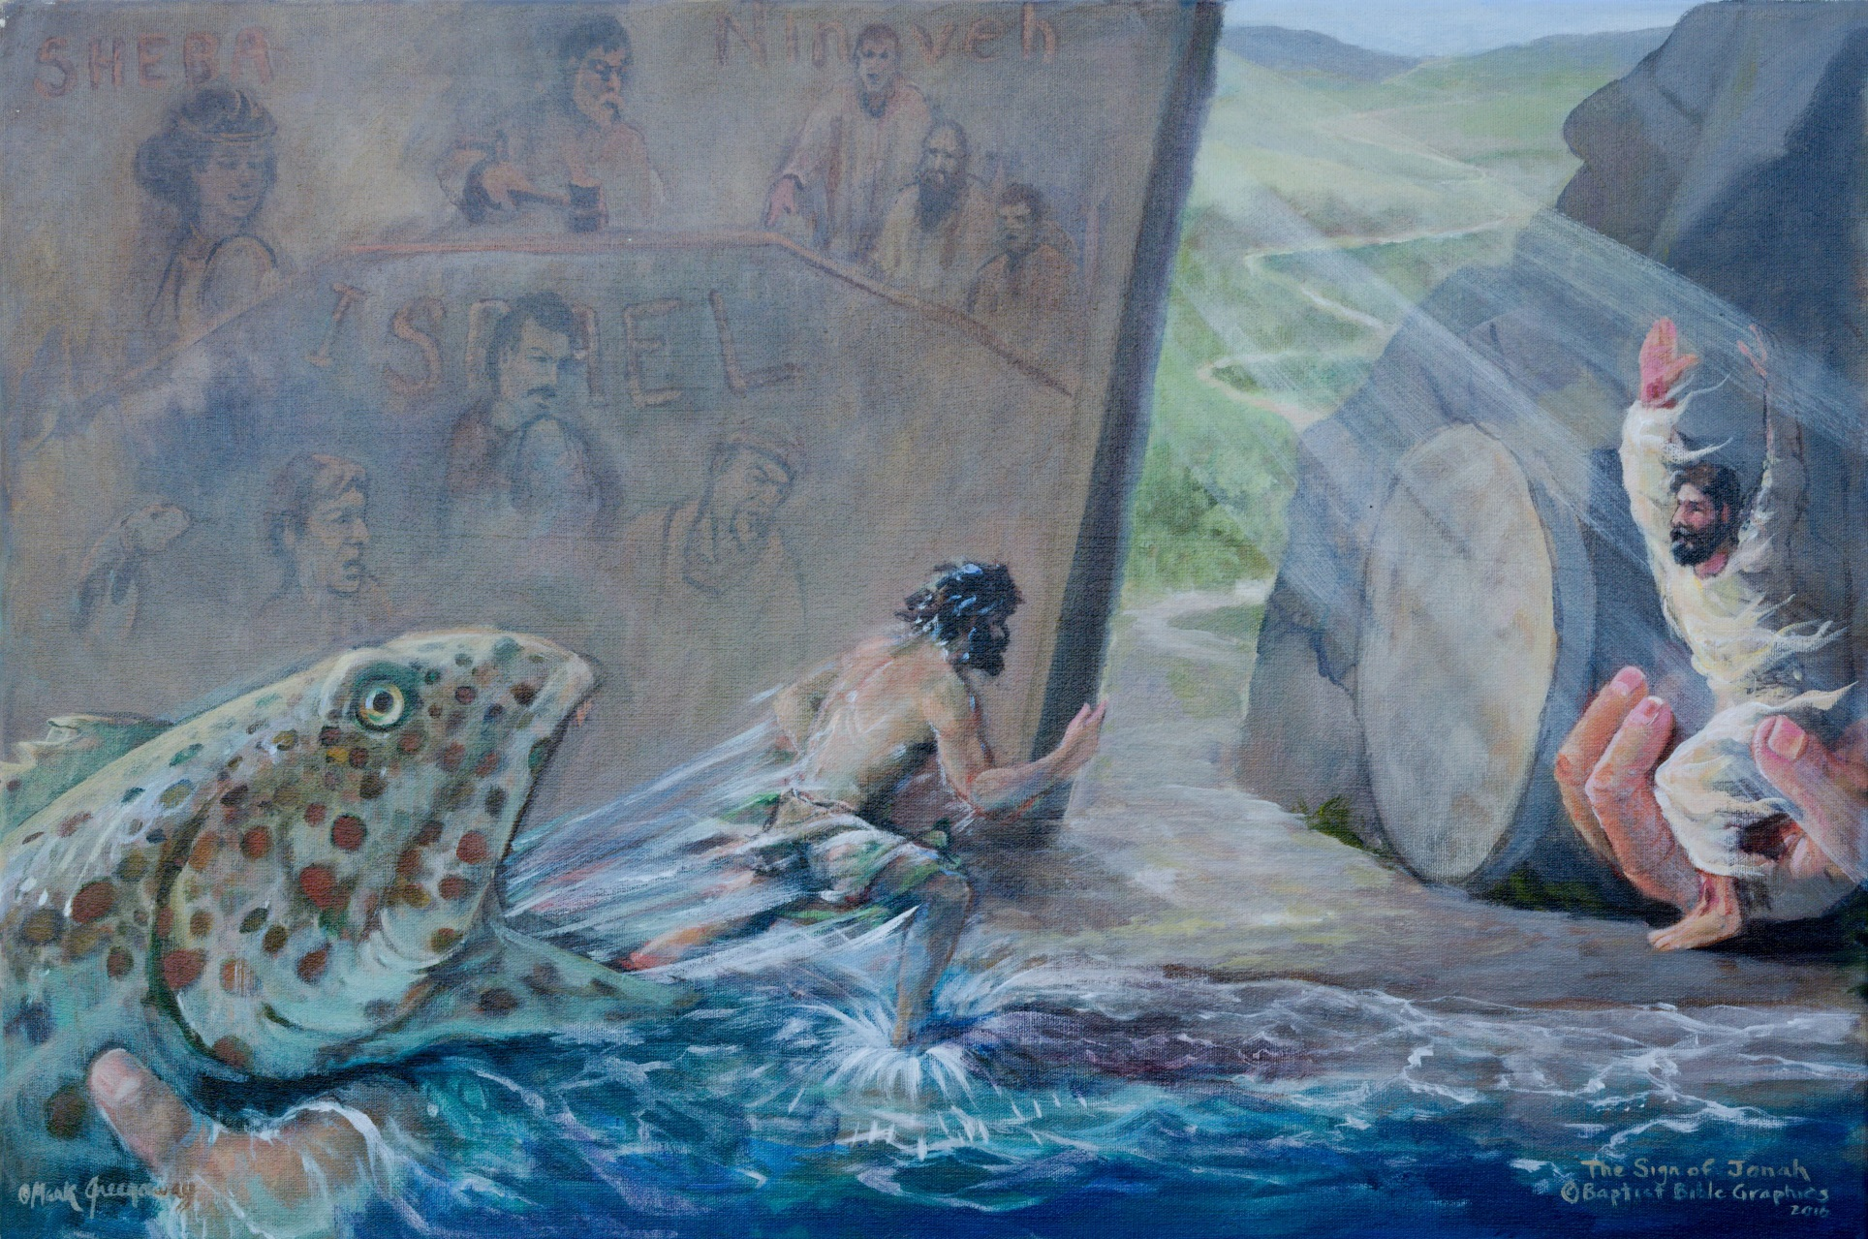
3
From God in Heaven to God-Man on Earth, 1:1-4:11. Christ is the king of the Jews as demonstrated by His genealogy, His birth, His worship by the gentile magi, His forerunner, baptism, and temptation.

Slide 5
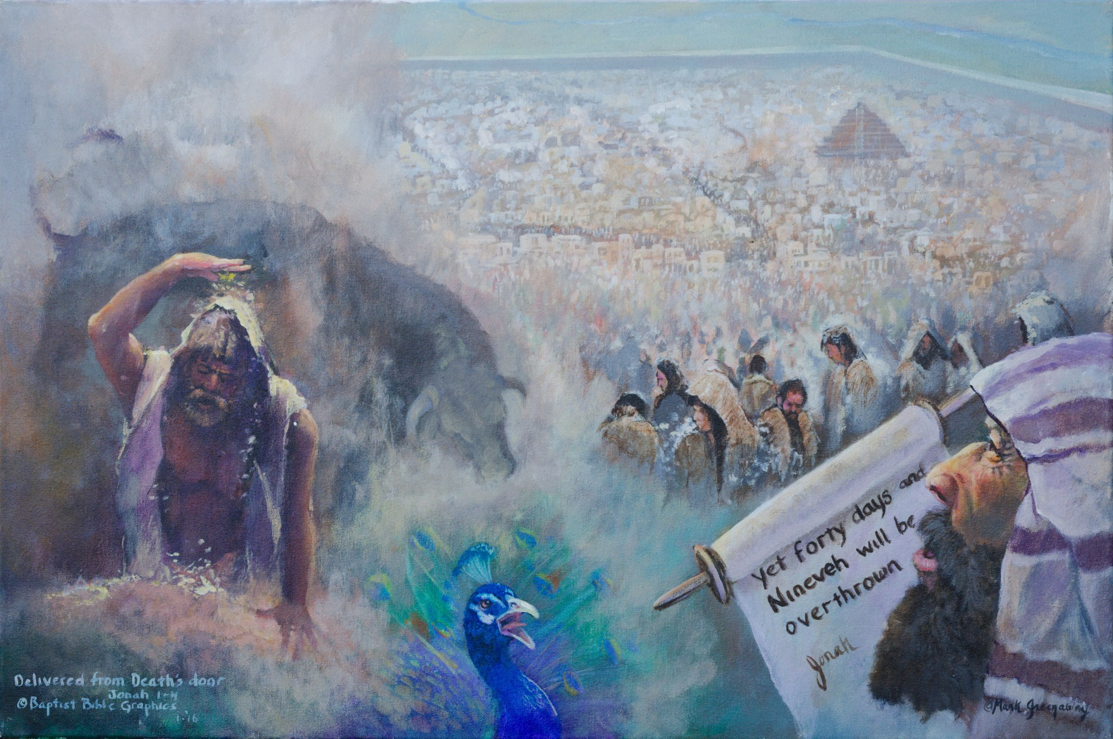
4
From God in Heaven to God-Man on Earth, 1:1-4:11. Christ is the king of the Jews as demonstrated by His genealogy, His birth, His worship by the gentile magi, His forerunner, baptism, and temptation.

Slide 6
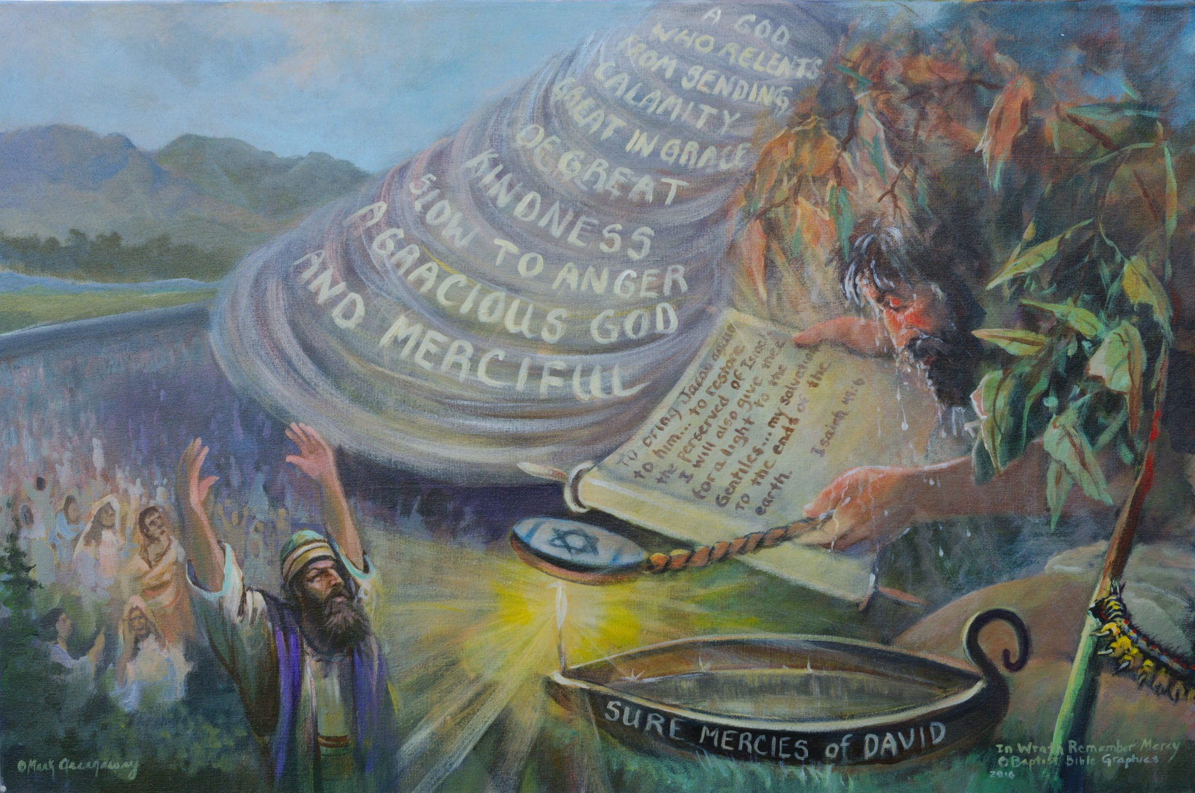
5
From God in Heaven to God-Man on Earth, 1:1-4:11. Christ is the king of the Jews as demonstrated by His genealogy, His birth, His worship by the gentile magi, His forerunner, baptism, and temptation.

