Slide 1
Keys for the book of Hebrews: The artist is Mark Greenaway. Thank you Mark & Andrea for your Christian love and fellowship. Listen My Children: God Has Spoken is designed for fathers to teach their children the Scripture Ps 78. Keys partially explains what’s in each picture, how the 32 pictures illustrating the plot also form a single unit. Each composition is built on parallelism like Hebrew poetry and on dispensational theology. The ascent Psalms 120-134 are a gold mine. The tabernacle is the bedrock to visualize the plot. All the Bible furnished nuggets especially Exodus, Leviticus and John. His Gospel is the Holy of Holies of the New Testament, ATR, Word Pictures, ix. John emphasizes belief and Hebrews faith. They both apply the need to trust Christ, to be justified by faith when we believe. We also live by faith every day. There are two narratives in Hebrews, a Christ is superior narrative and a faith narrative. The two narratives unite in Heb 11. The faith narratives serve to toughen the individual’s faith, to strengthen his resolve to live by faith, to mature in Christ. They are not warnings that Christians can loose their justification salvation. Hebrews was written to Jewish believers who were tempted to revert to Judaism. The superiority of Christ is the theme. The suffering Savior is the example of living by faith. I memorized Hebrews on the ranch in my youth. Thank you dad & mom, a Gideon. That your joy might be full: Robert James Franklin, SCD.
Outside the camp, pictures #1-4, Heb 1-2. First picture Heb 1:1-3: As I wander through the wilderness of this world, I hold a book in my hand pressed against my heart. It calls my attention to the Majesty seated on high. Hebrews teaches the superiority of Jesus Christ and thus of Christianity. Second picture, scroll, Heb 1:4-14: The Jews lived in tents for 40 years camped around the tabernacle. The Law was given to Moses through the ministry of angels who have an important part in history but Christ the Son is superior to the angels, according to Scripture. Third picture, throne, Heb 2:1-4: The first of five faith narratives removes all doubt that the final victory over all enemies belongs to God’s king. Pay attention. You’re on the victory side! Fourth picture, scroll, Heb 2:5-18. Though angels continue their ministry today, only Christ will be rewarded dominion over the world to come when he sits on David’s throne in His kingdom. According to Scripture, Christ the Man is superior to angels.
In the courtyard, pictures #5-8, Heb 3-6. Fifth picture, Heb 3:1-6. Moses lived near the entrance. He put guards at the gate to ensured the Law was enforced when sacrifices were offered on the brazen altar. John captured the symbolism: Moses, giver of the Law Jn 1:17, and lifting up the serpent Jn 3:14. Christ is superior to Moses. Sixth, Heb 3:7-4:16. Aaron washed in the laver. There was no chair to sit down and rest. There was always more to do. The faith narrative opens the way for Christians to come to Jesus to satisfy their thirst. John connects satisfaction and coming to Jesus with water and light and life Jn 5-8:12, concepts we have applied to life today, Ps 124. Seventh picture, Heb 5:1-10. Aaron is the model for a priest. Christ is superior. Eighth picture, ABC’s, Heb 6:1-20. Mature or you’ll never be able to receive sound doctrine. The faith narrative has shades of John: eating, drinking, reading, hearing, teaching, action scenes meant to mature our faith. All the faith narratives are set in today’s context. Keep your nose in the book. Live by faith!
Going up to the sanctuary, pictures #9-15, Heb 7-8. In Jesus’ day the worshipers went up to Jerusalem. Arriving at the temple they lifted up their sacrifice unto God, then went up a stairway to the temple precinct. Assent unites these pictures. Ninth, tenth and eleventh, Heb 7, the breastplate jewels are parallel to Christ lifting the worshiper to higher ground. Twelfth and thirteenth, Heb 8:1-6 the hand reaching up clutching high priest Aaron is parallel Christ’s superior priestly ministry reaching down to earth, a summary of chapters 1-7, and reaching up to heaven as mediator of a better covenant, a summary of chapters 8-10. Fourteenth and fifteenth, Heb 8:6-13 lifting up the Old Covenant vs lifting up the New Covenant. The Old gives what we deserve, justice, following Stephen’s indictment in Acts 7. The New gives us what we don’t deserve, mercy, in Romans and Galatians. The New Covenant is founded on superior promises and blessings.
Glimpses into the sanctuary, pictures #16-22, Heb 9-10:31. The worshiper couldn’t get any closer to the Holy of Holies because of sin. We’ve come along ways but are stopped short from getting any closer. Each picture of 16-21 presents the reasons why tabernacle worshipers were barred from getting any closer to the earthly sanctuary. The sinner was always encumbered with the shortcomings of human limitations, failure and death. Such frailties caused the true worshiper to long for something better to come. The open red curtain presents that which is better, the Person of Jesus Christ. Know the Person. Scenes from the Gospels and Acts accentuate God’s better way and final way of cleansing from sin. Picture 22, Heb 10:19-36. If we go on sinning willfully, their remains no other sacrifice for sins. His way into the inner sanctuary was by bearing our reproach. The Mosaic Law put us in debt to God with sin Col 2:14. This debt Christ cancelled when he nailed it to His cross. Without the sacrifice of Jesus Christ we get what we deserve, justice, like the people on the left. But in Jesus we get what we don’t deserve: mercy, abundant life, eternal life, God forever.
In the inner sanctuary is a Person who is the object of our faith, pictures 23-27, Heb 10:32-12:2. Picture 23, Heb 10:37-39. Faith is not a blind faith, not a leap of faith from fact to fiction, not dialectical superhistory, Whitcomb, The World that Perished, 95-139. The world in the background reinforces that living by faith is historical. They trust in a historical Jesus, the Man of Sorrows, who withstood the wicked forces of evil, endured the cross and rose victoriously from the grave. Men of faith are Sinners for who Christ Died, SCD. Saving faith is reliance upon Christ, Ryrie, Basic Theology, 377. They are the ones in God’s Hall of Faith, Heb 11. Picture 24, Heb 1:1-16. We begin with Abel whose faith assures a future for those who trust God, right down to today’s world. Picture 25, Heb 11:17-31. We pick back up with Abraham whose faith rewards those who diligently seek Him. Picture 26, Heb 11:32-12:2. Faith is victorious, even for those who are hammered, summoned and beaten for their faith, from Abel to Gideon to Jesus and beyond. Men of faith do not suffer in vain. God will right the wrongs. Christians do not take vengeance in our own hands. Picture 27, Heb 12:1-6. The object of faith is Jesus Christ Heb 12:1-2. All whom the Father has given Me will come unto Me. You have not chosen Me but I have chosen you. Jesus is receiving those who come unto Him, “God be merciful to me a sinner.” The rainbow is complete, the two narratives unite in Christ.
Living by faith outside the camp, pictures 28-32, Heb 12-13. Picture 28, Heb 12:7-11. Accept trials and chastening as from God. There’s not a problem that the Object of our faith can’t resolve. Pictures 29, Heb 12:12-17. For Jacob, living by faith makes difficulties in life not as bad as they may seem, but Esau gets carried away. Picture 30, Heb 12:18-29. Leave the fear of Mount Sinai behind and step up to the promises of Mount Zion. Picture 31, Heb 13:1-6. Love is the driving force in life. The faithfulness of Jesus stabilizes the believer so he can live the normal Christian life. Picture 32, Heb 13:7-25. Faith equips us for every good work. So leave earthly Jerusalem behind with it’s temple sacrifices and bear Christ’s reproach outside the camp. The great Shepherd of the sheep mends broken hearts Ps 51:16-17. Oh Timothy Heb 13:23! Grace be with you.
Notes:
Thyat You

Slide 2
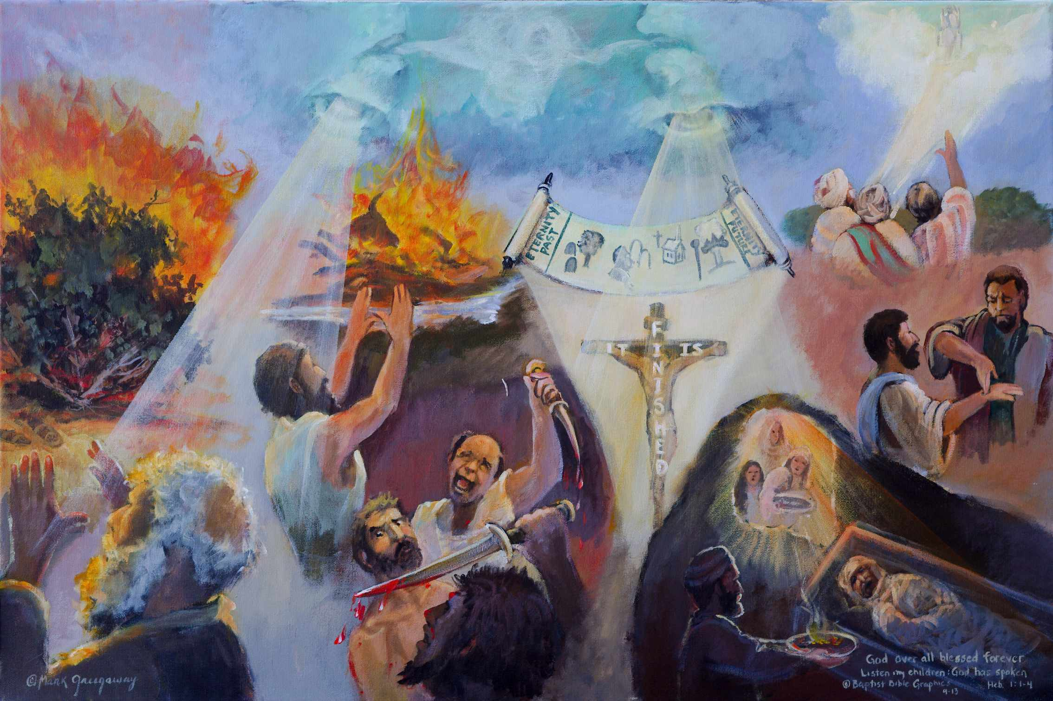
2. Tongue: God spoke to our fathers, burning bush, fire falling on Elijah’s altar. Radiance is descending on Moses and Elijah. The left side of painting is a summary of the First Commandment, no other god’s before Me, in addition or in opposition to Me Ex 20:3. God is placed in a class all by Himself.
1. God has spoken Heb 1:1, Pictured is a voice in heaven Heb 12:25-26, coming out of a mouth on the left, which spoke long ago to Moses and Elijah. Mouth on right side, God has spoken in His Son. Don’t refuse him who is speaking from heaven. Why two mouths? To show God will speak once more in his coming kingdom Heb 12:26-29. Whom He appointed heir, Hebrews exhorts Jews what to believe about Christ Heb 1:2-3; 13:22. Contrasted is faith vs unbelief, the faith of Moses hearing God at the burning bush and Elijah on Carmel as opposed to the doubt of the Israelite caught drifting Heb 2:1, between two Jews of Baal. Also contrasted is the faith of the women looking in the tomb with the unbelief 3:12, of the man offering incense as though the tomb wasn’t empty. God has spoken and he does not stutter.
11. Nail prints, ascension, seated in heaven: Jesus arose the third day, was seen alive for 40 days, appeared 17 times or more, then ascended back to heaven where he sat down at the right hand of the Majesty on high. The writer has opened with a faith narrative
3. Moses before the burning bush: When Moses was 80 years old, God said, “Take My people out of Egypt” Ex 6:13. It was easier to take the people out of Egypt than to take Egypt out of the people, to advance from Egypt to Caanan. Hebrews was written to Christian Jews who found it difficult to advance from the Mosaic Old Covenant to the New Covenant, to accept Christ as superior to angels, Moses, Aaron and animal sacrifices. Though they were partakers of the rest found in Christ Heb 3:14, they still found it alluring to return to Mosaic ritual. The epistle to the Hebrews places Christ the Son in a class all by Himself. Jesus Christ is God who spoke to Abraham in a bodily theophany Jn 8:56.
10. Heb 12:25 Jesus is looking aghast: “Where’s your faith in Me and my words?” Grave clothes still bind him. After three days in the tomb, an angel rolled away the stone from the door. The women looking in, see a man offering incense, a companion to the Baalites. He doesn’t believe in the supernatural or miracles. He believes that Jesus rose from the dead but the tomb wasn’t empty. The scene is a parody on neo-orthodoxy, at all those influenced by rabbinical lore, by Barthian and existential thought. He’s not only sitting in darkness, he is darkness, religious but lost Eph 5:8. He shall perish Ps 1:6. Knowledge of philosophy, science and theology does little good if Christ’s bodily resurrection is denied. Hebrews was written to willfully immature Heb 5:11-14, Christians Heb 6:4-5, who had tasted 2:9, were enlightened 10:32, and were partakers Heb 12:8. They had the faith of the women looking into the tomb, not the scoffer’s unbelief.
4. Sandals in front of bush: Moses drew near to see the bush that was on fire. I AM WHO I AM, spoke the ever living God. “Remove your shoes. You’re standing on holy ground.” In biblical history, God was especially active in authenticating by miracles his prophets during the times of Moses and Elijah. When Israel sank down in sin Ps 78; 106:43, the uniqueness of God was challenged Ex 20:3. Thus don’t be like teenager Esau who threw away his future inheritance for present security Heb 12:16.
6. Pictured is a befuddled, indecisive Israelite standing between two prophets of Baal. He can hear Baal’s prophets screaming in his ears but he can’t hear God speaking by Moses or Elijah, Dt 6:4. He’s at a fork in the road: either choose the LORD or go serve Baal. He’s trapped in a cross fire of idolatry, his faith wavers, can’t stand as a man, is compromising his faith by not accepting, receiving and believing all that God has spoken.
7. Tongue: Heb1:2-3. The right side of the painting is a summary of Christology. God, who spoke to our fathers, has spoken to us by his Son. The Son in the Bible is God’s spokesman to us today. God will yet speak from heaven, Heb 9:28; 12:26.
Scroll: The heir who made the ages, from eternity to eternity: the Tree of Life with tombs, Abraham, the law, cross, church, kingdom, scepter and crown on the Tree of Life. God planned it!
9. A light of revelation is shinning across the scroll to the cross 1:3, where our sins were purified, into the open grave, giving life and immortality to all who believe. It is finished is written on the cross.
5. Elijah standing on Carmel, hands raised up, fire from heaven consuming the ox, the wood, the altar and the water all around: The LORD is God, he alone 1 Ki 18. Baal is a false god and his prophets lead the curious astray. God is jealous, he wants our whole hearted devotion. He allows no completion or compromise. Destroy the 400 prophets of Baal.
Notes:
S

Slide 3
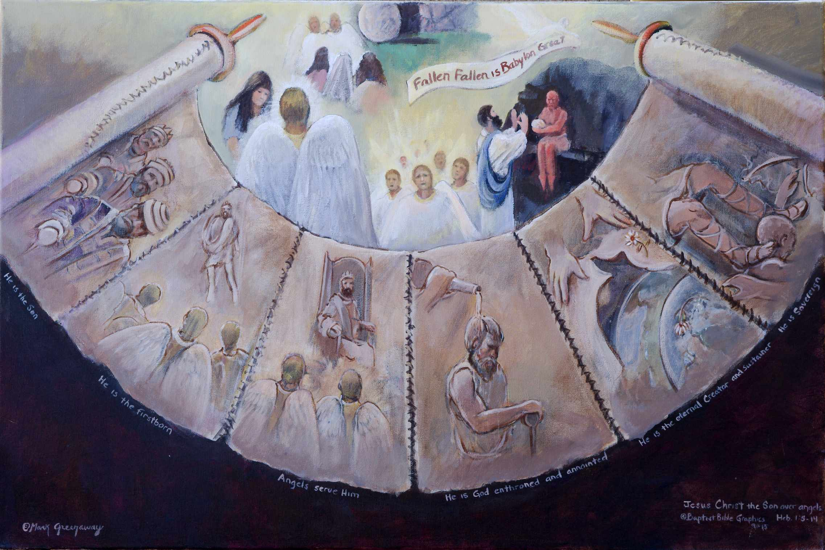
1. Based on, Heb 1:4-14. Christ the Son is better than the angels. Jewish tradition placed authority on the activity of angels. As a result Christian Jews were being washed away from Christ Heb 2:1. The author asserts that, like Abraham, our authority is anchored in the very being of God as revealed in the Bible Heb 1:2-3; 6:13-20. Thus the main feature of the painting is a scroll. The writer to the Hebrews cites Scripture, not experience, as authoritative in refuting the Judaizes. He explains six ministries where Christ the Son is superior to the angels. That’s why the scroll has six vellum skins sewn together. Angels are ministering spirits Heb 1:14. On the top of the picture, encircled within the scroll, are four appearances of angels serving the Son. That angels are present is exciting but their presence and activity is subject to the authority of Christ the Son. That’s why the angels are confined within the limits of the scroll. What we know about angels we learn from the Bible, not human reasoning or experience, Ryrie, Basic Theology 137ff. The Son has spoken and his word is final. He does not stutter.
2. An angel serving Mary at the Son’s First Coming Lu 1:34-35.
3. The angels ministering to the Son when tempted by Satan, a fallen spirit being, Mk 1:13.
4. Two angels comforting the fearful women at the empty tomb Lu 24:1-10.
6. Dark void: In the Bible is recorded objective truth on angels. Human knowledge can only be speculation and subjective experience is not accurate nor reliable information. Off the scroll, to the sides and below, are grey areas and black void, man’s curiosity, groping for inaccurate explanations about angels. Even Satan sits in the dark, not being omniscient, only crafty.
5. At the Son’s Second Coming, an angel having great glory will fly through the sky exclaiming, “Fallen, fallen is Babylon the Great,” Rev 18:1-2.
12. Heb 1:13-14 citing Ps 110. Only the Son who sits at God’s right hand is sovereign. The king is sitting with his foot firmly planted on his enemy’s neck, face down, grasping, his bow and arrow just out of reach. All enemies are dispatched including pain, weeping, death and Satan Rev 21:1-8. The angels are not in the picture because they are servants, not sovereign rulers. They minister to those who will inherit salvation. The sovereign conquering Son is superior to servant angels.
7. Heb 1:4-5 citing Ps 2 and 2 Sam 7:14. But to which of the angels did he every say, “Thou art my Son?” Jesus inherited the name Son, adding to his other names, King and Anointed. So the picture shows Jesus wearing three hats: in back he has a crown on his head, in the middle the anointed covering, and in the front the Son’s turban. The King is the Messiah and the Son. Thus a scepter, a symbol of royalty, is placed in each right hand. No angel is ever called “the Son.” As the Son, he is superior to the angels.
11. Heb 1:10-12 citing Ps 102:25-27. The Son created the earth good and now he sustains it. But this earth is wilting like a flower and wearing out like a well used vest because of sin. In the fifth vellum the Son’s hands hold a new vest which is covering the earth, unspoiled by sin. A beautiful daisy flower serves as a buttoner. The front earth is painted with a sullen-eyed face in the Garden of Eden, staring at the wilted flower. The earth is running down. She is wearing out. Entropy is taking its toll. It has seen its better days until the Second Coming of Jesus Christ when all things will be made new. In the midst of change the Son is unchanging. But angels are mutable, changing like earth. The immutable Son is superior to the mutable angels, some have fallen and are unholy.
8. Heb 1:6 citing Dt 32:43. He alone is called the first-born of God, the first to descend from heaven to earth. No angel has ever been given the honorary title “First-born.” Rather, angels serve and worship Him, Ps 97:7. The second vellum shows the Son descending to earth, the angels worshipping him. Angels are spirits, without bodies, though they can appear as man. His title is superior to the angels.
9. Heb 1:7-8 citing Ps 104:4 and Ps 45:6-7. Only the Messiah was born a man and only he rules over all creation, Ps 45:6-7. Angels are created spirits without bodies who often blend their mutable natures with wind or fire, Ps 104:4. The third vellum shows the Son ruling on a throne, angels bow before Him. His birth is superior to angels.
10. Heb 1:9 citing Isa 61:1, 3. Anointing with the oil of gladness speaks of the final triumph of the messianic king. The fourth vellum shows the Son holding a scepter, anointed without angels present. He shares the joy of his kingdom with his companions or partakers Heb 3:1, 14; 12:28-29, not the angels. Angels do rejoice but the Son’s righteous triumphal joy is greater.

Slide 4
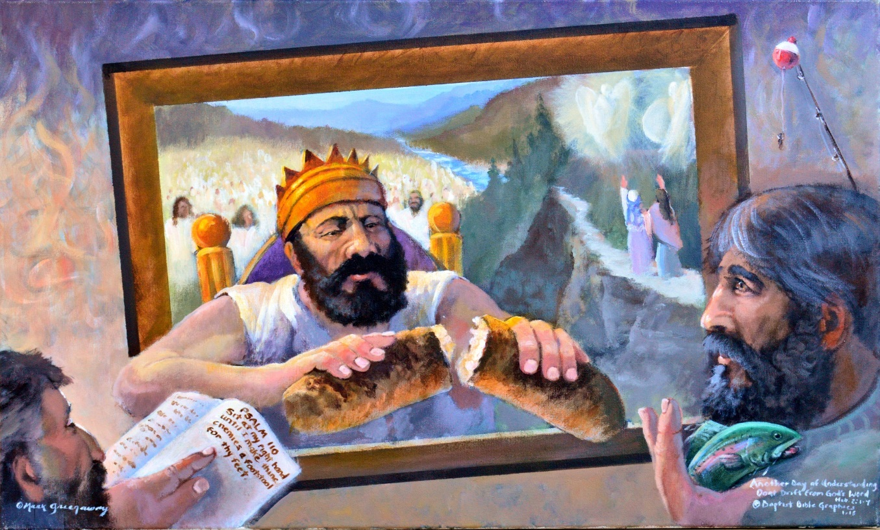
1. Based on Heb 1:13-2:4 and Ps 110. Quoting Psalm 110 reminded the author of Christ’s ministry to us from heaven. The Son is sitting in heaven sharing with his companions the Father’s kingly authority Ps 110. He is distributing through the Holy Spirit spiritual gifts to equip his church Heb 2:4. Knowing the gift and the person, the two men in front have asked and received eternal life Jn 4:10; 6:27. They were darkness like those pictured outside the kingdom, on the left and top Eph 5:8. Though in the world, they are inside the king’s domain like the two on the road to Emmaus, on the right. Breaking bread with his companions illustrates that they are sharers in his kingdom where angels render serve as ministering spirits. In front and behind him are his companions who were not washed away in crossing the river. They are in his presence sharing his superlative joy, their inherited salvation Heb 1:8-9; 3:1, 14; 12:28. The king is final in what he says and sure in what he does Heb 1:1-3.
8. His propitiated brothers Heb 2:17, led by their Captain Heb 2:10, on life’s pathway across river to glory. Their great high priest sympathized with their weaknesses. They received mercy and found grace to help in time of need Heb 4:14-16. They're singing Worthy is the Lamb Rev 5:12. The king’s partakers have attained their inherited salvation Heb 3:1. So great salvation has reached its climax in the millennial presence of his glory. They see the consummation of their redemption in the Messianic kingdom. His servant kings are reigning with him. When we’ve been there ten thousand years, bright shinning as the sun, we’ve no less days to sing God’s praise than when we first begun, Newton
2. Heb 2:2-3 Oh the retribution of those sinners drifting in this existential world because they neglected so great salvation. They failed to count the cost. They’re pictured outside the place of blessing, on the left. Surrealistically, their praise is drifting wild, just entertaining their own senses. They experience an abstract glimpse of doubt, an intoxicating depression, a withdrawal from the Bible in the hand of the brother. The writer to the Hebrews employed two narratives to convey his message.
1st. Christ is Better- Most sections in Heb 1-10.
2nd. Faith is Better – In four sections:
Heb 2:1-4, Faith to Hear (fellowship with
Christ) so great salvation.
Heb 4:5-12, Faith to Rest (trust in Christ) no
matter the circumstances of life.
Heb 5:11-6:20, Faith to Grow (advance with
Christ) in Christian maturity.
Heb 10:19-39, Faith to share (in remembrance)
with Jesus Christ’s sufferings.
3rd. The two narratives resolve into one:
Heb 11-13 Faith in Christ is better.
Right arm: Transcendent yet immanent. The reader and the fisherman are paying close attention to their Lord who is reaching into their world. The world cosmos is the realm of Satan’s domain, Ryrie, Basic Theology 172.
7. Heb 2:1 Gk/Eng Lex; ATR. Wash away, drift away. Cliffhangers are an example of living by faith. Two disciples are walking on a perilous path to Emmaus Lu 24. Then Jesus joined them. Their doubts vanished when fixing their eyes on the risen savior and the empty tomb, pictured with guardian angels above them. Then they recognized Jesus in the breaking of bread. In our painting, inherited salvation is just down the road. There is nothing uncertain about their ultimate destination. Their salvation is secure. They will not get washed away or swept along in the river. The next faith narrative develops entering into God’s rest despite the circumstances of life Heb 3:7-4:16. Heb 2:4 ends where 3:7 starts, the Holy Spirit.
6. Heb 2:3-4. Jesus teaches us to hold the fish rather loosely Jn 21:15-17; Tit 1:9. I get excited, like when fishing, but I keep from drifting by keeping by mind fixed upon Jesus Col 3:2. My challenge is to let the Holy Spirit lead so I do not hold too tightly to this world and thus let circumstances determine what I do. Absent in the picture are signs and wonders, the Holy Spirit regarding these powers for the coming Age, the millennial kingdom Heb 2:4-5; 6:5. The Spirit uses Scripture to instruct me in all things pertaining to life and godliness Tit 2; 2 Tim 3:16.
3. Bible open to Psalm 110: The Psalm states that the Son is preeminent in his kingdom. He is central and foremost. Yet the king willingly shares his authority with his servant kings. The writer to the Hebrews admonishes his readers to not get washed away, drift or slip from their inherited salvation. Rather, stand firm and rest in Christ Heb 3:7-4:16.
4. Heb 2:4 Breaking bread: He gave gifts when he sat down on his throne Eph 4:7 (M Couch Handbook Acts, 154.) He revealed who he really is, the bread who came down out of heaven Jn 6:51. Whether offering bread Jn 6:27 or water Jn 4:10, the two men know about the gift and the person. Faith is the channel to ask and receive eternal life, Ryrie, Basic Theology 374-378.

Slide 5
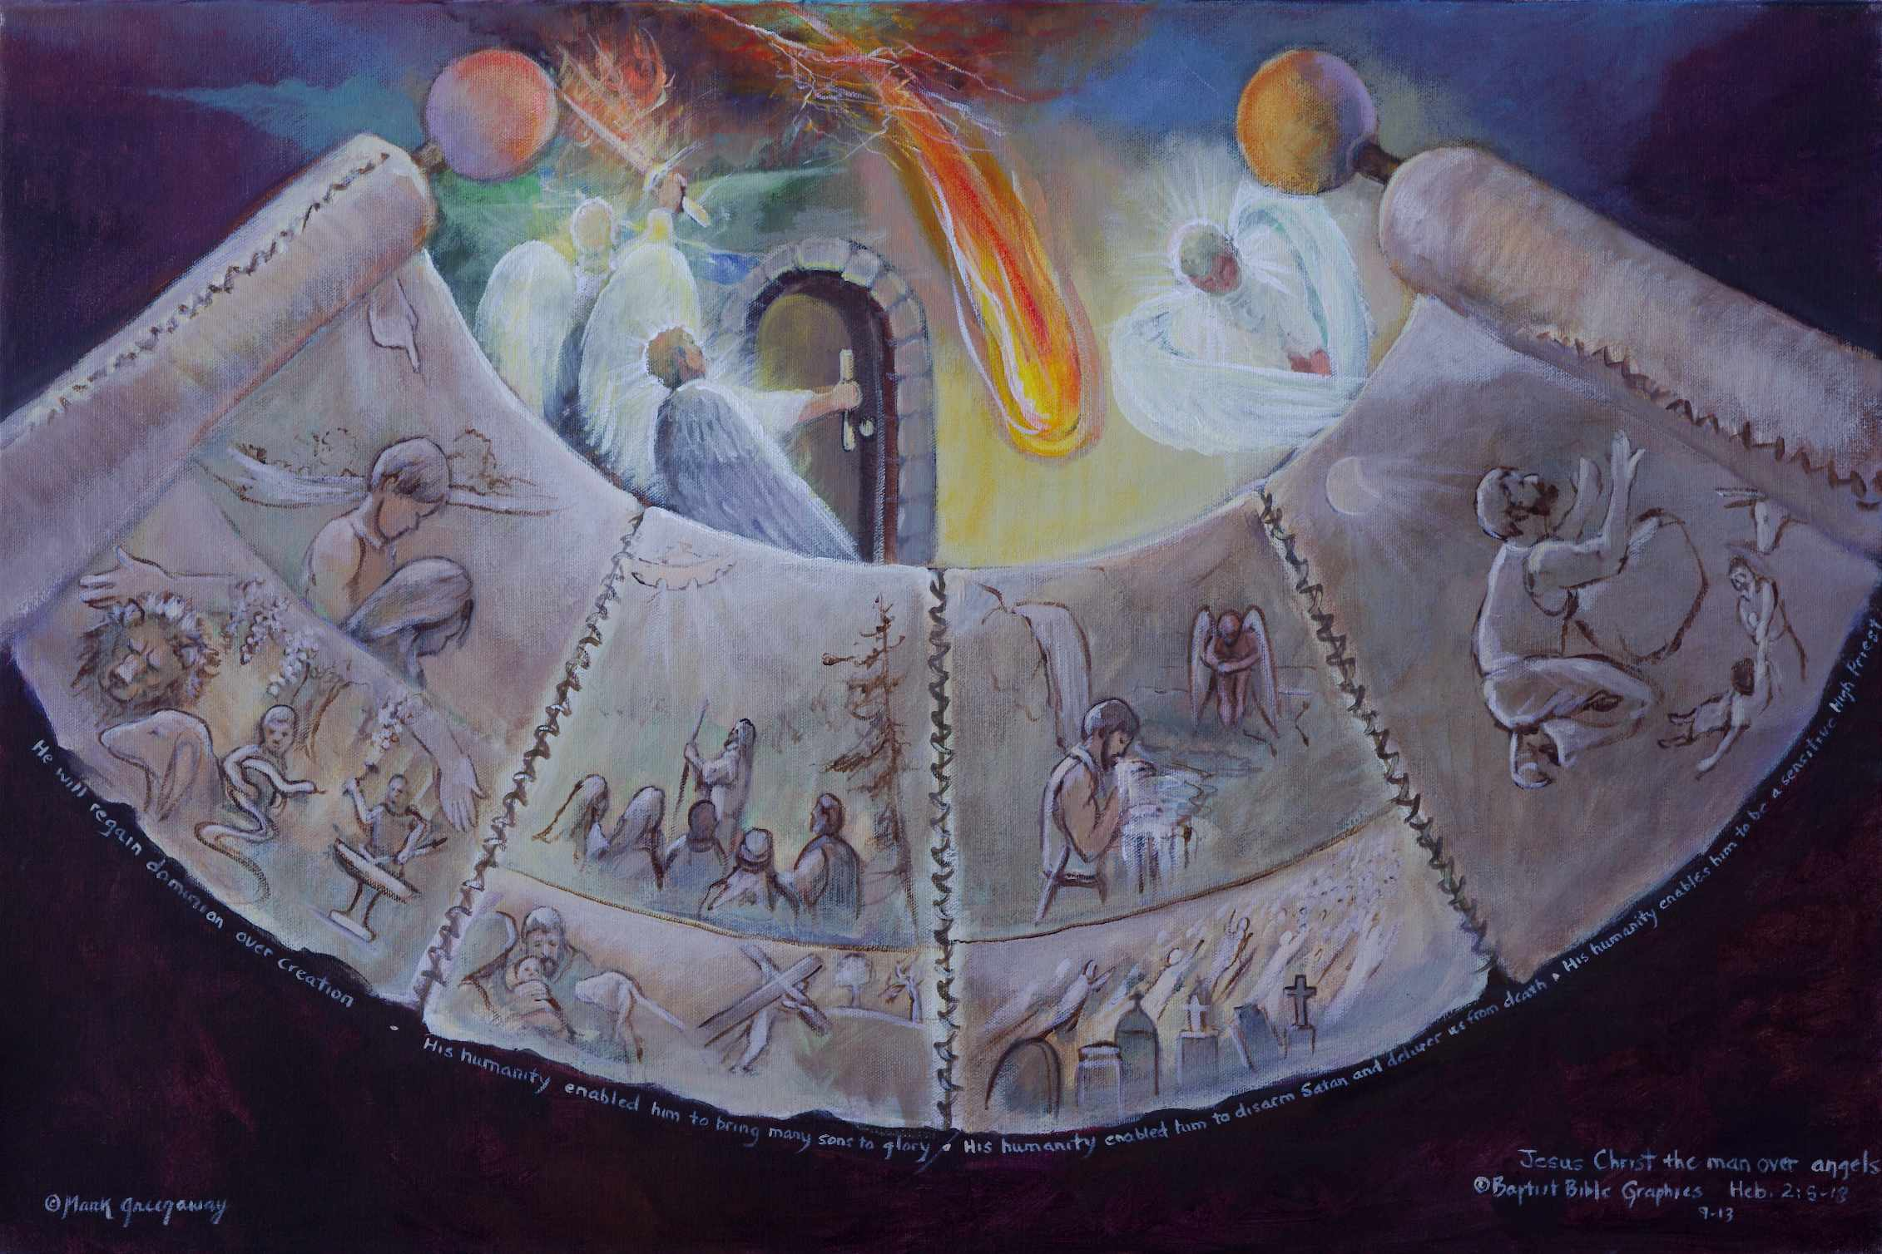
1. Based on Heb 2:5-18. Christ the Man is better than the angels. The author of Hebrews was led by the Holy Spirit to return to the subject of angels. Angels are real and their appearances are very persuasive. The only reliable authority on angels is Scripture, not apparitions of angels. So in our painting their activity is confined within the poles of the scroll. Outside the scroll is void and darkness meaning that man can be deceived by fallen, unholy angels (demons). The four vellum skins illustrate the four examples cited by the author of Christ the Man being superior to the angels. Each page shows how the Son’s humanity enabled him to be superior to the angels. Above each page is displayed the subservient role of angels.
13. In contrast, angels do not know the suffering of humanity. They can only stoop to observe and seek to learn more of God’s grace, 1 Pet 1:12. Pictured is an angel with folded wings, majestic in beauty, but finite, limited, struggling to understand more of God’s grace.
2. Heb 2:5-8 citing Ps 8:4-6. His humanity enabled him to regain dominion over creation. Adam and Eve’s sin brought decay and death to man and all creation. In the top left is God’s hand pointing the way out of the Garden. Now Adam and Eve, heads bent low, must toil in sweat, sorrow and suffering.
12. Heb 2:17-18, His humanity enabled him to be a sensitive and sympathetic high priest unto men and faithful unto God. He brings help when it is needed to his brothers. It was the custom to sacrifice a burnt offering together with a grain offering on a rock Jud 13:19. Jesus is pictured on a rock, God’s sacrifice for sin, hands raised in praise, with the fruit of his lips the grain offering, illustrated by the good Samaritan helping the needy. Top left is the moon, Jesus praying late into the night Lu 6:12; 22:41. These are also our sacrifices with which God is pleased Heb 13:15-16.
3. All creation groans because of man’s sin Rom 8:22. Becoming a Man enabled the Son to restore what Adam lost. In the painting God’s arms placed over creation become the branches from which hang down the bunches of grapes. Within reach appear a Lion with a lamb, a child holding a viper, a man behind an anvil beating a sword into a plow shear and all under the vine and caring hands Isa 2; 11
11. There is no redemption or resurrection for unholy angels. Defeated Satan will fall from heaven like lightning Lu 10:18. Pictured are bolts of lightning in heaven with a fire ball falling to earth. Satan is a defeated foe and his end is certain.
4. The Restorer is superior to the guards. Pictured above the page are two angels with flaming swords guarding the river leading to the Garden entrance. Christ in his humanity is superior to angels.
10. The Son’s humanity enabled him to gain victory over death. He was the first to rise from the grave. Pictured below are graves opening, the dead rising, the bodily resurrection of the redeemed.
5. Heb 2:10-15 citing Ps 22:22, 25; 18:2; Isa 8:18. His humanity enabled him to bring many sons to glory. He is the only door to the Father in heaven. He is pictured as the captain, staff in hand, leading the way for others to follow. Through the clouds is pictured an opened access to the Father in heaven.
7. His humanity is expressed in His miraculous virgin birth. On the left is a manger scene, Mary, Joseph, and baby Jesus. By His death he prepared men for glory. In the middle is His crucifixion. Because of sin the law put us in debt to God Col 2:14. This debt Christ cancelled when he nailed it to His cross. By his sacrifice he makes many sons holy Ps 22:22. Behind is a green tree and a dry tree Lu 23:31. He is the door by which sinners enter into heaven. O the sorrow for those who reject the door to heaven. Like a dry tree left behind, they are fit only for the fire Lu 23:31.
8. In contrast angels can’t die to save lost sinners. They can’t lead the way to heaven. They can’t even budge open the door. Pictured is an angel struggling to open the closed door. The Son in his humanity is superior to the angels.
9. Heb 2:14-16; Ps 110:7. Jesus’ humanity enable him to free us from death, disarm Satan and strip him of his power. Pictured above is water coming out of the rock. Jesus is drinking from the stream along the way, a scene which speaks of victory so His sword is sheathed. Satan appears left behind, defeated, wings folded, no darts in his arsenal.

Slide 6
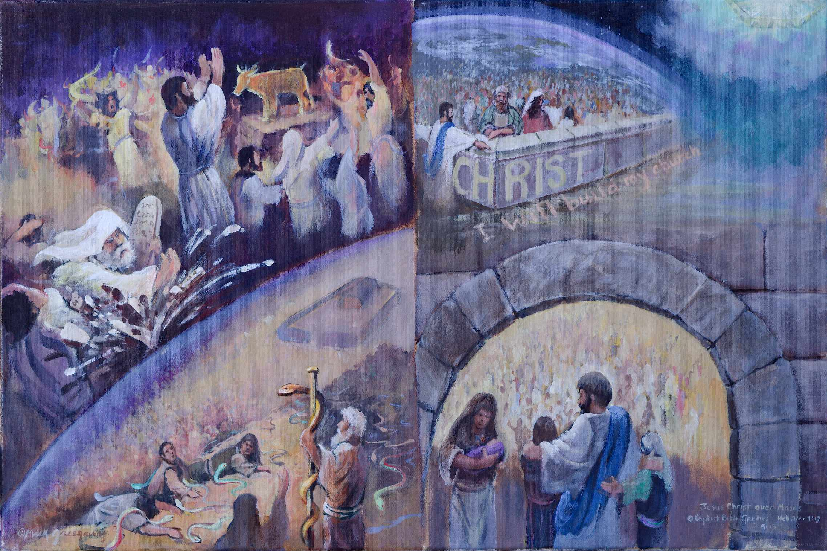
1. Based on Heb 3:1-6. Why is the picture divided between Moses and Christ? And why does the eye run off the page beneath Moses or lead up to God? Because the author has just told us that sin breaks normal relations with God and the law is unable to restore sinners Heb 2:17-18. Jesus our high priest removed sin by expiation, restored the relationship and comes to our aid when tempted. Moses is seen pitching the Ten Commandments right at the bitten people but the law bounces back, shattered. The law was rendered powerless to help them. The door of the tabernacle kept the needy out. What the law could not do God did in providing the remedy for sin by having Moses lift up the serpent outside the camp. Here it was assessable for all to see. Top right: Jesus is likened to the raised serpent Jn 3:14. Jesus the Apostle is pointing the way to God for all to see. He is the way. Coming to him are the thirsty from all nations. Bottom right: Jesus our High Priest is receiving all that thirst. The entrance has no door because Jesus is the door. He lets everybody in who come to him by faith. Both Jesus and Moses were faithful but Jesus is superior because he comes to our aid. Don’t let your evil heart lure you back to Moses and fall away from the living God Heb 3:12.
2. Heb 3:1 Partakers of a heavenly calling. Top right: From our perspective the heavenly calling appears far off and distant. But Jesus looms large in our confession. Jesus the apostle sent by God the Father is pointing the way for holy brothers to participate in the future joy and dominion in his kingdom. God made provision for the nations to be blessed Gen 12:1-3; 22:17. They are coming from all over the globe to be placed as living stones in his house. “Christ” is written on the corner stone because he is the only sure foundation on which to build, 1 Cor 3:10-17. “I will build my church” is written in the path because it is in the church that the holy brothers fulfill their priestly duties in God’s house. Below, Jesus is welcoming the thirsty at the gate Isa 55. The baby is nursing. Jesus is holding fast women and children, those who others were prone to brush aside as insignificant Lu18:16. The least in the kingdom are the greatest. They are holding fast their confession with confidence for Jesus is holding them tight. They share as his companions being partakers of the heavenly calling. Their hope is firm until the end. Inside the door are the many who have been reconciled to God. The heavenly calling appears close at hand.
5. Heb 3:6. Christ was faithful as a Son over his house, whose house we are. The author to the Hebrews has much to say about leaving the tabernacle and it’s feasts in the distant past Heb 5:11; 7-10. The tabernacle appears in the picture but set way off on the backside of Christ. The building without a capstone is no longer in the forefront. Though Moses was faithful, he failed to lead then into the promised rest Num 20:12; Dt 12:9; Josh 21:43-45. Failure to enter the promised rest has kept Judaism very busy keeping the feasts but never able to satisfy God’s commands. Christians who keep the feasts today are reverting back to a house without a capstone. They are casting away their boldness in of the shed blood of Christ. Their confidence in the finished work of Christ has washed away. They are disbelieving the Word because of hardness of heart.
3. Heb 3:2. Both Jesus and Moses were faithful in God’s house. Jesus was faithful to the One who appointed him. He is the Apostle sent forth by God to reveal the Father and point the way to heaven. And he is the High Priest who restores sinners and represents them before God. He is the door into God’s presence. Moses was faithful too. He stayed God’s judgment against sinners when he shattered the law. Sin made the law go to pieces, to fail. Moses was faithful in lifting up the serpent. All who looked lived and were saved from certain death. Moses was faithful in doing what God told him.
4. Heb 3:3-5, Jesus the builder of God’s house was more worthy of glory than Moses the servant. To illustrate top right, a well laid cornerstone makes for a solid construction and a glorious Builder Mt 16:18; 1 Cor 3:11; Eph 2:20. And bottom right, the capstone in the arch signifies the Builder was able to complete the house and give his people rest Mt 11:28. Jesus has more honor than the house. Moses’ house, the tabernacle, prefigured Jesus and prepared the way for the coming of faith Gal 3. As a testimony the shattered rock and the pole with the serpent point past the tabernacle to Christ. The unbelievers who don’t look descend out of the picture into bondage and death Rom 7.
5. Heb 3:5-6 Now Moses was a voluntary servant in God’s house. Out of faithfulness he carried out God’s instructions. He served as a prophet and on occasion a priest Ps 99:6. But he never was a high priest. Aaron was the high priest. Jesus is the great high priest. Inside the entrance is pictured a great multitude of redeemed servant-kings over whom the Son is presiding. They have entered into that perfect future rest Heb 4:9-10.

Slide 7
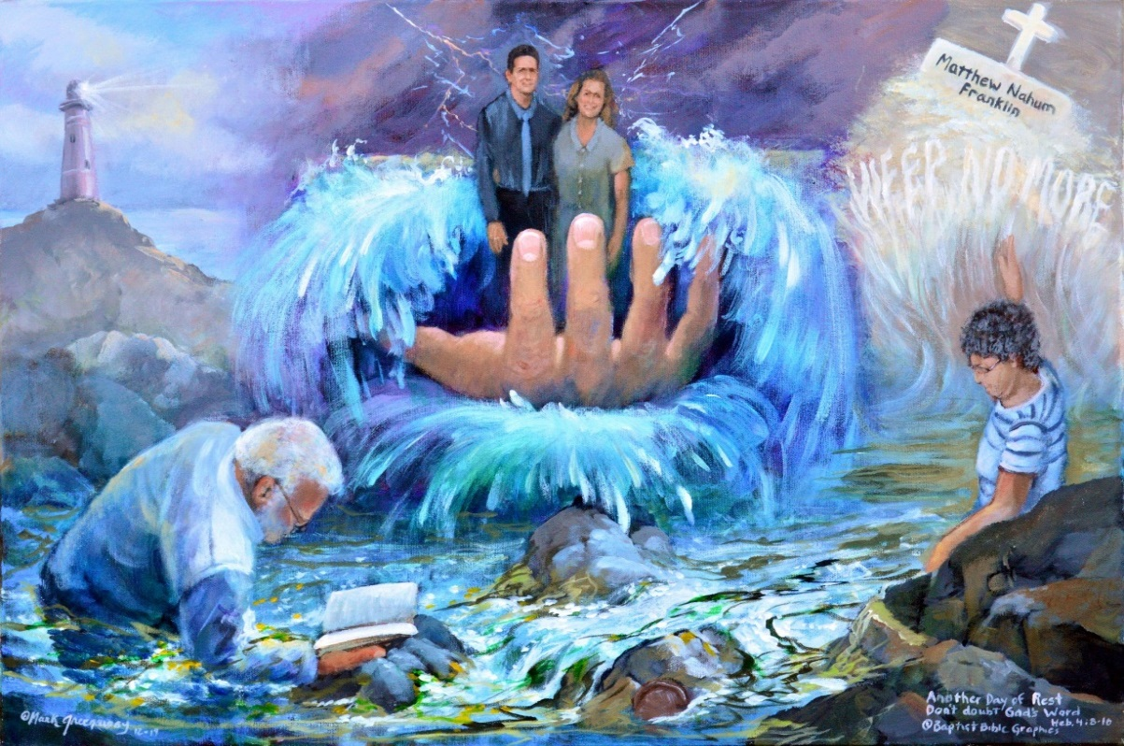
1. Based on Heb 3:7-4:16; Ps 95; Isa 55; Jn 4. Another faith narrative, the point of view is that we are partakers participating in the rest God has for each of us as believers. Our faith in our great high priest is the channel by which we enter into rest, not signs and wonders Heb 2:4-8. We haven’t thrown overboard eternal security because of circumstances but hold fast with hope firm until the end Heb 3:6. Each thirsty individual is drinking, not collectively like in Reformed and Roman covenant infant sprinkling. Assurance comes from Christ, not from the evidences of regeneration in my life. In the painting are five active words that express my assurance and thus rest: Shining from the rock Ps 95:1; Kneeling in the tide pool Ps 95:1-6; Standing in His hand Ps 95:4-11; Leaning on the rock Heb 3; Resting in resurrection power Heb 4:9-10. Jesus sent the Comforter to enable us to rest in still water as well as during the pounding of the breakers. Not that life is always quiet or stormy, but that the Holy Spirit is always present, illuminating our true conversion experience, Heb 6:4; 10:32; 2 Cor 4:3. Weeping endures for a night but joy comes in the morning. Grandma is pointing to Weep no more written below the tombstone and the empty cross.
7. Heb 4:11-16. The writer to the Hebrews does not end this faith section with Jesus Christ on the cross but on the throne of grace. The empty cross, fixed like a beacon on the tombstone, speaks of work successfully completed Heb 4:9-10. Jesus is seated in the heavens. The Word of God is doing it’s work to bring us to the heavenly throne where our great high priest is graciously and mercifully making intercession for us. Be at rest O my soul!
2. The Rock of our Salvation, Ps 95:1, Shining: Light is a figure of God. My great high priest feels the reality of my trials much as a rock bears the brunt of a raging sea Heb 4:14-16; BKC. The word rest is in the plural, the light is shinning all the time, CHS, Treasury, Ps 116:7, Edersheim. The Holy Spirit shines in my heart, Jn 1:9; 2 Tim 1:10; Heb 6:4, testifying with my spirit that I’m a child of God Rom 8:16; Eph 1:18. The lighthouse testifies that the divine method of justification never fails Rom 8. Manna and miracles could not satisfy Israel Ps 95:8-11; Jn 12:37. Neither would they be content with God leading them to the land of milk and honey Heb 3:7-13. And they missed God’s rest because of unbelief Heb 3:14-19. Therefore let us hold fast our confession Heb 4:1, 14; Jn 12:35.
6. Resting in resurrection power Heb 4:9-10. The waves of time can’t erase the hope of rest Dan 12. Know the Lord and enter into His rest Ps 132:8, 14. No matter how short or how long I live on earth, I will live forever in God’s kingdom enjoying the sense of satisfaction and repose that comes when my life work is ended and I cross the swelling tide. The name Nahum connotes rest, comfort and salvation and reminds us of the death of death in the death of Christ. God will wipe away all tears Rev 7:17; 21:4. Pain with its crying and death with its mourning are past. The ever present why is best answered with the ever present Who, Hab 3:1-3 BKC. I know I’m heaven bound because of Jesus who promised to raise me from the grave. Oh to have that grace to help in time of need. Matthew Nahum, we’ll see you some day in heaven. Rest in assurance of faith in Jesus’ resurrection power.
3. Worship God, bow down, kneel Ps 95:1-6, Kneeling before my Maker. I need quiet times like in a tide pool to believe God’s promises as a basis for assurance. As a partaker, I know I’m saved because the Bible tells me so. The Bible shows me that the promises of assurance are found in Christ, not in me and in my obedience. I see God’s power in tide pools as well as in crashing waves and rolling thunder. But I hear his voice in the Bible, where all truth is found. I don’t close the Bible and pray for faith but in studying the Word I get faith, Hab 3; Wiersbe. Though I don’t always meditate, I rest assured that God’s Holy Bible is perfect, more to be desired than gold Ps 18:30-31; 19:7-14.
4. Sheep of His hand, Standing: In his hand is the earth, the hills, the sea and dry land Ps 95:4-7. It is not God’s way to hold Sinai thunder over our heads as a motivation to trust him but to assure us that he holds us in his hand as a shepherd his sheep. As partakers we know we are secure because He holds us in the hollow of his hand Heb 12:18-24. The unbelief of that generation that perished has no hold on us. So we stand firm and worship the LORD our Maker. In each picture setting, assurance doesn’t come from the way we respond to circumstances but from Christ: first, His light, His Bible, now His hand, next His rock and finally His resurrection power Phil 3:10.
5. Supported by the Rock, Leaning on Jesus: Today, while you still have opportunity, completely rely on God’s promises Heb 4:5-9. I don’t take my eyes off my Rock of Ages! I worship the LORD even in times of sorrow. Bereavement is often harder to withstand than the storm. So I rest on God like one who leans on the hand of another 2 Ki 5:18; 7:2; Prov 3:5-6. I’m grounded and settled, not moving away from the hope of the gospel Col 1:23. Though the out look elicits tears the up look instills trust. As a partaker, I know I’m secure because He’s my Lord, my God, my rock, my fortress and my salvation Ps 18; 46.

Slide 8
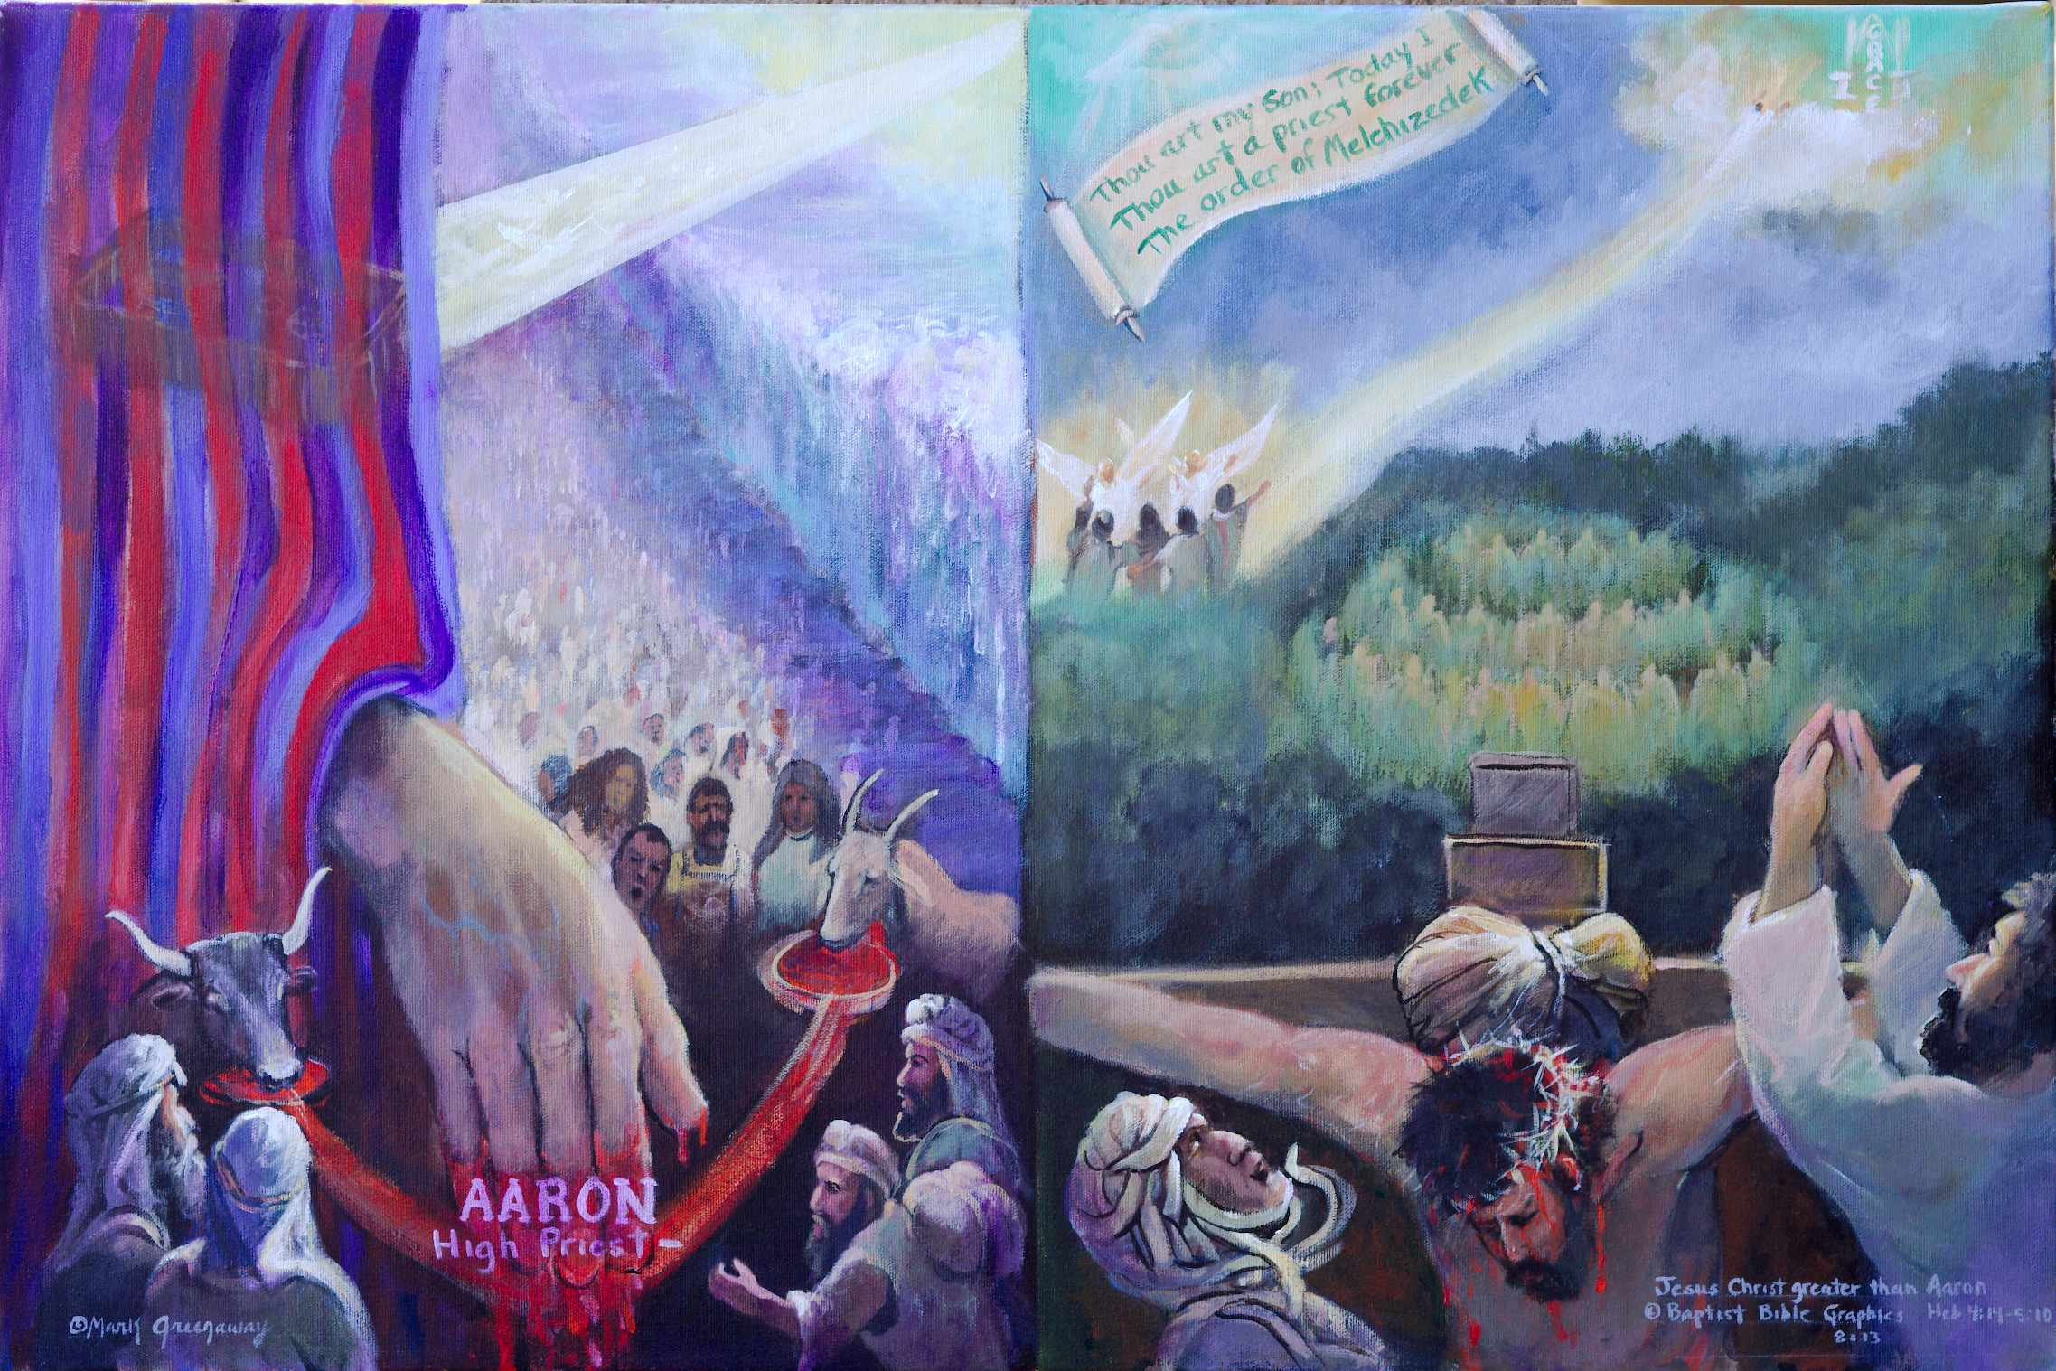
1. Based on Heb 5:1-10. Does Christ have the qualifications necessary to fulfill his priesthood? On the left are Aaron’s qualifications, on the right Christ’s. Know human sympathy Heb 4:14-16. Aaron as intercessor, sinned with the people vs Christ who knew our weaknesses but sinned not. Selected from among men Heb 5:1. Coming up out of Egypt on his way to Canaan vs Jesus coming out of burial on His way to heaven. God appointed him to offer gifts and sacrifices Heb 5:1 Aaron sprinkling animal blood vs shedding his own blood on cross. Dealing gently with the ignorant Heb 5:2. Aaron’s two remaining sons trembling before the bull vs with tears praying for others “Father forgive them”. Offering for his own sins Heb 5:3; 7:27. Aaron made to offer a bull vs no corresponding sacrifice as Jesus was sinless. Offering for the people’s sins Heb 5:3. A goat dying for sin vs Jesus dying for sin. By divine appointment, not to honor himself Heb 5:4. God shinning down on Aaron in tabernacle behind veil vs Jesus lifted up to heaven to draw all men unto Him.
2. The Son’s call to priesthood Heb 5:5-10. God declaring Jesus after the order of Melchizedek Heb 5:5. A mouth is speaking above the scroll. He is Davidic heir whose destiny is to rule the nations Ps 2:7. Crown above the cross. God declared Him a Priest forever according to the order of Melchizedek Ps 110:4, The text written on the scroll. The Son was made perfect, yet he learned obedience. Hands, cross, eyes, crown, ascension focused on heaven. He gained deliverance from and victory over all enemies Heb 5:7-10. Jesus breaking the bonds of death. He is supremely qualified to be a high priest forever after the order of Melchizedek.
3. Know human sympathy Heb 4:15. Aaron was a high priest who interceded with a god of Egypt, the golden calf, shown raising his hands in a previous picture. Our great high priest intercedes with God in heaven, pictured bottom right with his hands raised in Gethsemane, his head bowed on the cross praying for sinners. He knows the reality of our temptations and sympathizes with our weaknesses. His deity was united with his humanity enabling Him to bring people to God and to bring to people all that God has for them. Jesus Christ our great high priest is superior to the high priest Aaron.
9. Of whom we have much to say Heb 5:11; ATR. Jesus meets all the qualifications to be our high priest in his likeness to Melchizedek Heb 7:1-28. So what is Jesus now doing in heaven on behalf of sinners? The author’s readers are not ready for the answer to this question because they are willingly immature Heb 5:11-14. So the writer continues the faith narrative to increase his reader’s faith and prepare them to receive truth difficult to understand Heb 6:1-20. The writer then explains to them the heavenly ministry of Jesus Heb 7-10.
8. By divine appointment, not to honor himself Heb 5:4. The sacrifice was willingly offered as a libation poured out before God Num 28; Isa 53:12. Above the cross, assembled in the shape of a crown, are men contrite of heart and broken of spirit Ps 142:2. Jesus made himself of no reputation, obedient unto death. The picture shows that he wore the crown of thorns before he wore the crown of glory and honor.
4. Selected from among men Heb 5:1. Aaron was a man taken from among men to be a high priest. He knew slavery, kept the Passover and crossed the Red Sea. Pictured is the Red Sea. Jesus was a man who knew our weaknesses when he was appointed high priest on the cross Heb 5:7 BKC. The writer to the Hebrews never invited the rabbinic detractors to sit down with him for a discussion. But like the Jerusalem council (Acts 15) and like Paul in his Epistles, the Word of God and the leading of the Holy Spirit set the perimeters for doctrine and practice 2 Tim 3:16-17. Pictured is the scroll, the Word of God settled in heaven Ps 119:89.
5. Appointed to offer gifts and sacrifices. Aaron offered the ashes of a heifer and sprinkled animal blood. Jesus offered his own blood for the transgression of my people, which blow was due the sinner Isa 53:8; D Baron, Rays 109. Pictured is Aaron behind the veil sprinkling blood on the mercy seat. But Jesus is lifted up on the cross, for all to see, central and foremost in history and prophesy.
6. Compassionate, dealing gently with the ignorant and misguided Heb 5:2. Like the disciples, Aaron’s sons found out that the spirit is willing but the flesh is weak Lev 10; Mt 26:41. Though feeling the lose of his sons, Aaron had to control his weeping. Pictured is Aaron before the veil that separated men from God. Pictured is Jesus on the cross uniting men with God.
7. Offering for sins Heb 5:3. Aaron made the necessary sacrifices, a bull for his own sins and a goat for the sins of the people. His hand is central. Jesus did not offer a sacrifice for his own sins as he was sinless. Forgiveness for sins is by accepting the death of Jesus as the atoning substitute. Rome requires absolution pronounced by a priest. Jesus Christ’s death on the cross without a priest is central in the design.

Slide 9
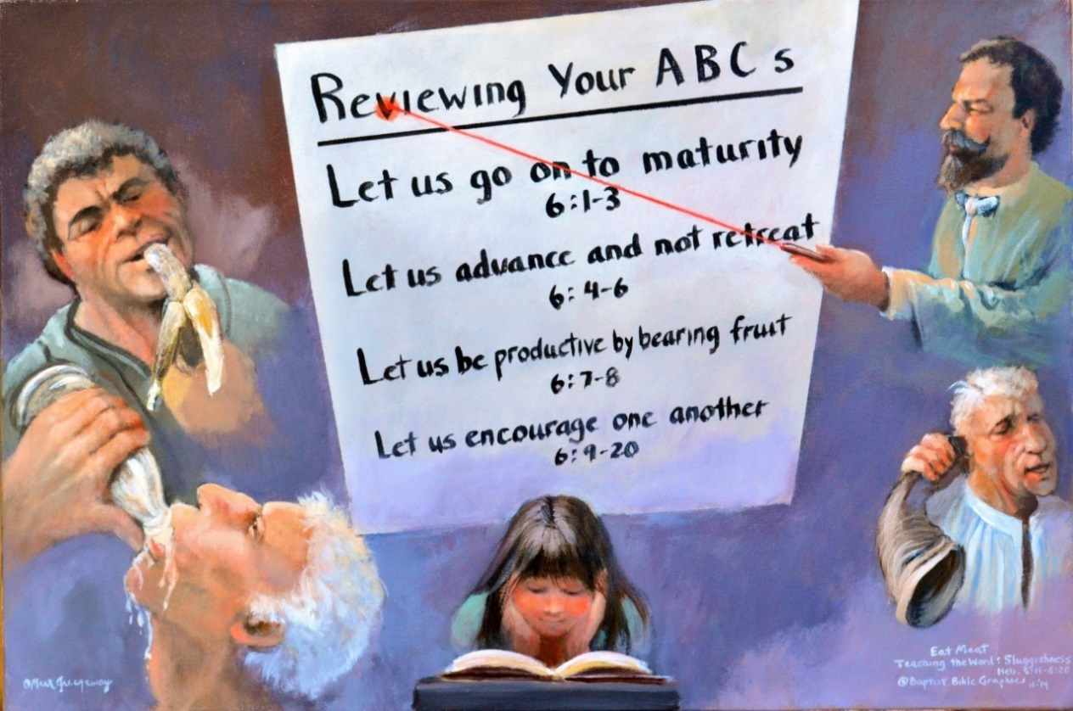
1. Based on Heb 5:11-6:20. A sever verbal chastening for adult sons. Gathered around the ABC’s of spiritual progress are two mature believers, a teacher and his daughter, and three willingly immature believers. Each hold an object which is indicative of their character. The screen shows that the topic is maturity, not loosing your salvation. Eternal security is consistent with believers who are partakers of the Holy Spirit. Let’s illustrate: A man goes into a clothing store, looks through the suits, finds one he likes but it doesn’t quite fit. He goes ahead, buys it, and asks the store’s tailor to make the necessary adjustments. He has the receipt as proof of purchase but he doesn’t take the suit home. Later he returns to the store, presents the sales slip as proof of purchase and claims his suit. So it is with true believers. Christ owns us having purchased us with His blood. But we are not yet living with Him in heaven. However, Christ holds a seal of ownership, the Holy Spirit 2 Cor 1:22. The Spirit is the seal, the proof of purchase, who guarantees our final redemption Eph 1:13-14. Hebrews is written to sealed Christians who are partakers of the Holy Spirit Heb 6:1-6. With tough talk he rallies them to fruitfulness Heb 6:7-8. He follows with encouragement by citing God’s promise made with Abraham and the oath which rests on the very being of God Heb 6:9-18. The hope of entering within the veil anchors the soul Heb 6:19-20, to Christ’s priesthood Heb 7:19, illustrated in the next picture. The teacher is my grandfather, Abraham Gustof Claassen.
2. Heb 5:11-14. Each faith narrative is designed with a central theme and five active responses. Faith involves cognitive knowledge. The teacher has a laser understanding of the Hebrew Christian’s trials. The girl shows that maturity is perceived in the mind and heart by examination and meditation of the Bible, not by the senses alone. You don’t have to be mature in years to advance in the Lord Jesus. The three immature men don’t get it because their senses alone can’t grasp truth. One’s senses are dulled, his choices are out of taste, he prefers to mull a rotten banana. Another finds solid food hard to stomach. Chewing on the Word is not for him but sucking a baby bottle is his taste. Another is using a ram’s horn in his attempt to push in the sound of that which is hard to explain, ATR. What he is hearing just doesn’t sink in. All he wants is applause that he is in the majority. What they all get is a sever verbal chastening from a Father who loves them!
8. Heb 6:13-20 Teacher with laser understanding. How does a teacher get non-motivated, immature students to learn a difficult subject? Rely on the Holy Spirit. Follow harsh words with strong encouragement in the faithful God of Abraham. Immaturity is overcome when promise is retrieved out of history. Education is the pursuit of holiness resulting in wise partakers who are fruitful in every good work, no matter their age, gender or race.
7. Heb 6:9-12. Hearing aid. He can hear ok, it just doesn’t seem to register. He’s like Little Faith in Pilgrim’s Progress. The teacher has been harsh to his readers. Now he encourages them: God remembers your work. He isn’t unjust Heb 6:10. So shrug off the sluggishness that hinders maturity Heb 6:11-12. You don’t want to be lazy. Any dead fish can float down stream. Imitate the example of father Abraham Heb 6:13-20. Promise is the key that opens the door to hope, to great expectations.
4. Heb 6:1-3 Banana man. Go on to maturity. You don’t need to go back to the beginnings of your Christian faith. You would be returning to dead works. Get your mind in gear and pick up where you are right now. You already know the basics of Christianity. Now go on! Returning to dead works would be like peeling a banana and waiting until it’s rotten to eat it. You don’t lack information but haven’t learned to put the teaching about righteousness to effective use.
5. Heb 6:4-6. Baby bottle feeder trying to relive his infant days. Advance, don’t retreat. You are enlightened companions of the king, have tasted and are partakers of the Holy Spirit 2 Cor 1:22. But you are still wavering in your faith, reverting back to infancy. It’s impossible just like an adult sucking a bottle. Acting like an infant just makes you appear to have fallen from your sanity. You can’t be spoon fed all your life. Press on my man! Pursue holiness. The pursuit of experience is the fallacy of neo-platonic, modern education that results in change for the worse (Bolton Davidheiser, Evolution and Christian Faith, 107.)
6. Heb 6:7-8 My mother meditating. She is soaking in the Word just like the dry earth soaks in rain. Her life is beneficial, blessed of God, bearing fruit in others. Her time spent in the Word isn’t wasted, worthless, cast out, to be burned. Her faith is based on historical observation. None of the apostles rested their faith on fiction. She is remembering her Creator in the days of her youth and has no pleasure in the philosophy that wayward youth who later return have a wonderful testimony more fruitful than a child who is obedient from her youth. Pictured in sharp contrast is her maturity in the faith “my father taught me” verses the immaturity of the three adults. In a book about better, older is not better!

Slide 10
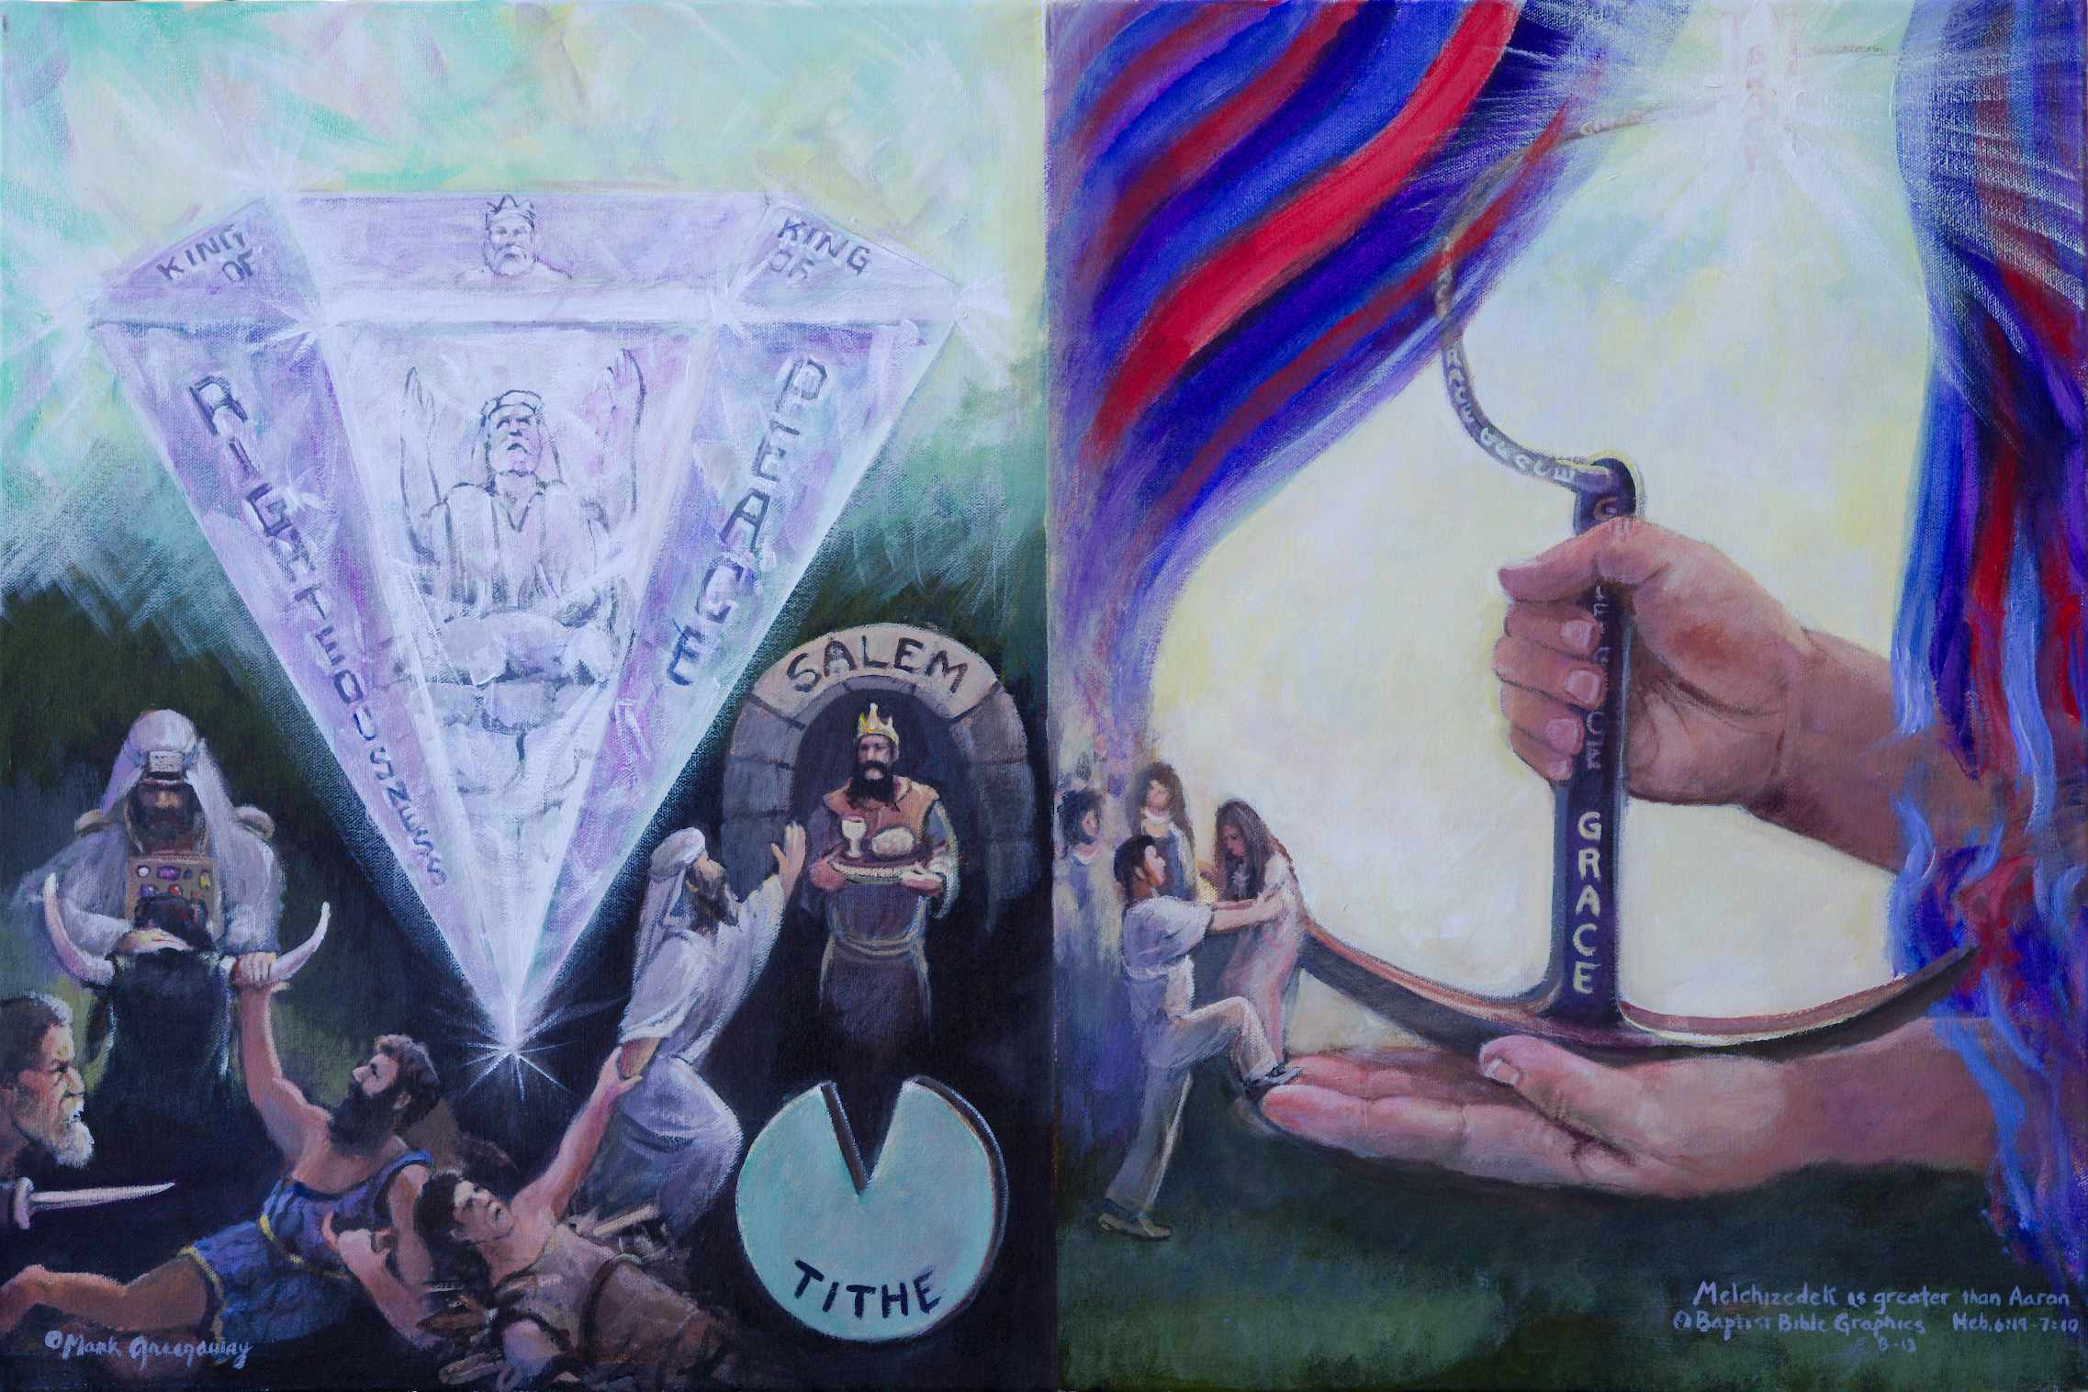
1. Based on Heb 7:1-10. Stone: Engraved on the eyes-facets TWOT 1612, is crowned king-priest Melchizedek and priest soon to be king Joshua Zech 3:8; 6:12, who reflect king-priest Jesus. Each facet reflects the inner beauty of Jesus. Abraham: Aaron, Levi, Jacob and Isaac are in Abraham who is paying a tithe to Melchizedek of Salem. Anchor: To consecrate for priesthood literally means to fill the hand Lev 8:27; 1 Ki 13:33 Delitzsch p 209. The anchor in God’s hands ties promise Heb 6:15, to a better hope Heb 7:19. Christ is before the throne of grace reaching out to all men Tit 2:11. Reach out to Jesus, he’s reaching out to you. Veil: Scenes on earth prepared God’s people for scenes in heaven. There was no veil to hide Melchizedek from Abraham. The veil appeared during Aaron’s tenure Ex 26:31, was torn in two when Jesus died Mk 15:38, and opened when he arose Heb 5:5-6. Chain: God’s love descends to earth, by grace thru faith. Look, climb a board, we’re anchored in heaven.
9. Jesus Christ is our forerunner, one who has gone before so that others might follow Heb 6:20. The diamond points to earth. Christ has gone within the veil which draws us into the presence of God. The veil is rolled back so that whosoever will may come, Rev 22:17. Climb on board. Hold steadfast to Christ. The faith narrative promises that we will obtain and enjoy what God has promised if we diligently apply ourselves to the development of our spiritual life, Heb 6:1-20; 12:1-2.
.
2. Why a stone? Because God doesn’t picture a neo-platonic, existential dream world but one that is truth, centered in a Person, Jesus Christ. The LORD’S righteous Servant is called a multi-faceted stone Zech 3:9, whose reality is reflected in king Melchizedek on the top facet, his titles on the side facets. Jesus is a king-priest after the order of Melchizedek. On the front facet is Joshua Zech 3; 6, the last Aaronic high priest in the Old Testament, who were never kings. But Joshua’s dirty priestly robes were taken off, he was dressed in clean robes and crowned king, foreshadowing the coming king-priest, Jesus the Branch Zech 3:8. The stone lifts up our eyes unto the LORD from whence comes our hope. The Shekinah glory dazzles above this darkened world here below. The top of the stone is surrounded by a reflective light as opposed to the splendor of heaven shinning from the throne. The teacher wants his readers to long for heaven. Surely now they realize that the greatness of Christ’s priesthood is superior to any Levitical institutions.
8. Open veil: The veil serves to reveal the majesty on high. It used to conceal. Now it reveals our great high priest who forever lives to make intercession for us. Our high priest is holy, innocent, undefiled, separate from sinners and exalted above the heavens Heb 7:26. Absent is the necessity of daily sacrifices.
7. People: The writer to the Hebrews ties chapter six to chapter seven. Instead of going back to the first principles they are reaching out to Jesus. They6 are following through, climbing on board. The bottom hand shows He is able to safe to the uttermost, completely, forever those who draw near to God thru Christ Heb 7:25. We have fled to him for refuge. The top hand shows that they are secure, he does not loose his grip Rom 8:38-39. My anchor holds!
6. Anchor: God has dropped an anchor from heaven that is both sure and steadfast. His hands are consecrated, promise and hope are inseparable from His priestly ministry. The chain remains fastened to the inner sanctuary, anchored to the throne of grace. The veil is open for all to climb on board. God’s grace provides a direct line to heaven that can not be shaken loose. Let us come boldly before the throne of grace, Heb 4:14-16. The links in the chain reaching to heaven repeatedly spell grace.
4. Melchizedek gave wine and bread to Abraham and blessed him. The one who gives the blessing is greater than the one who receives the blessing. Out of ordinary life comes an extra ordinary story to motivate Jewish readers to seek after Jesus Christ.
5.Tithe: Aaron gave a tithe to Melchizedek. Levi was still in the body of his ancestor when Abraham paid the tithe. Pictured is Aaron with his hands on the head of a bull Lev 16:11, who came out of Levi holding a dagger Gen 49:5. Levi came out of Jacob who wrestled with God Gen 32:25. Jacob came out of Isaac who is tied down on the altar Gen 22. And Isaac came out of the loins of Abraham. Abraham acknowledged that the one who one who receives the tithe is superior over the one who gives it.
3. Melchizedek appearing at Salem city gate: There isn’t any record of his genealogy, birth or death. He seemingly came out of no where for Abraham to receive a blessing and pay him a tithe. Melchizedek belonged to a superior priestly order in which there was no end to his priesthood. He is a prototype for Christ’s priesthood in heaven Gen 14:18.

Slide 11
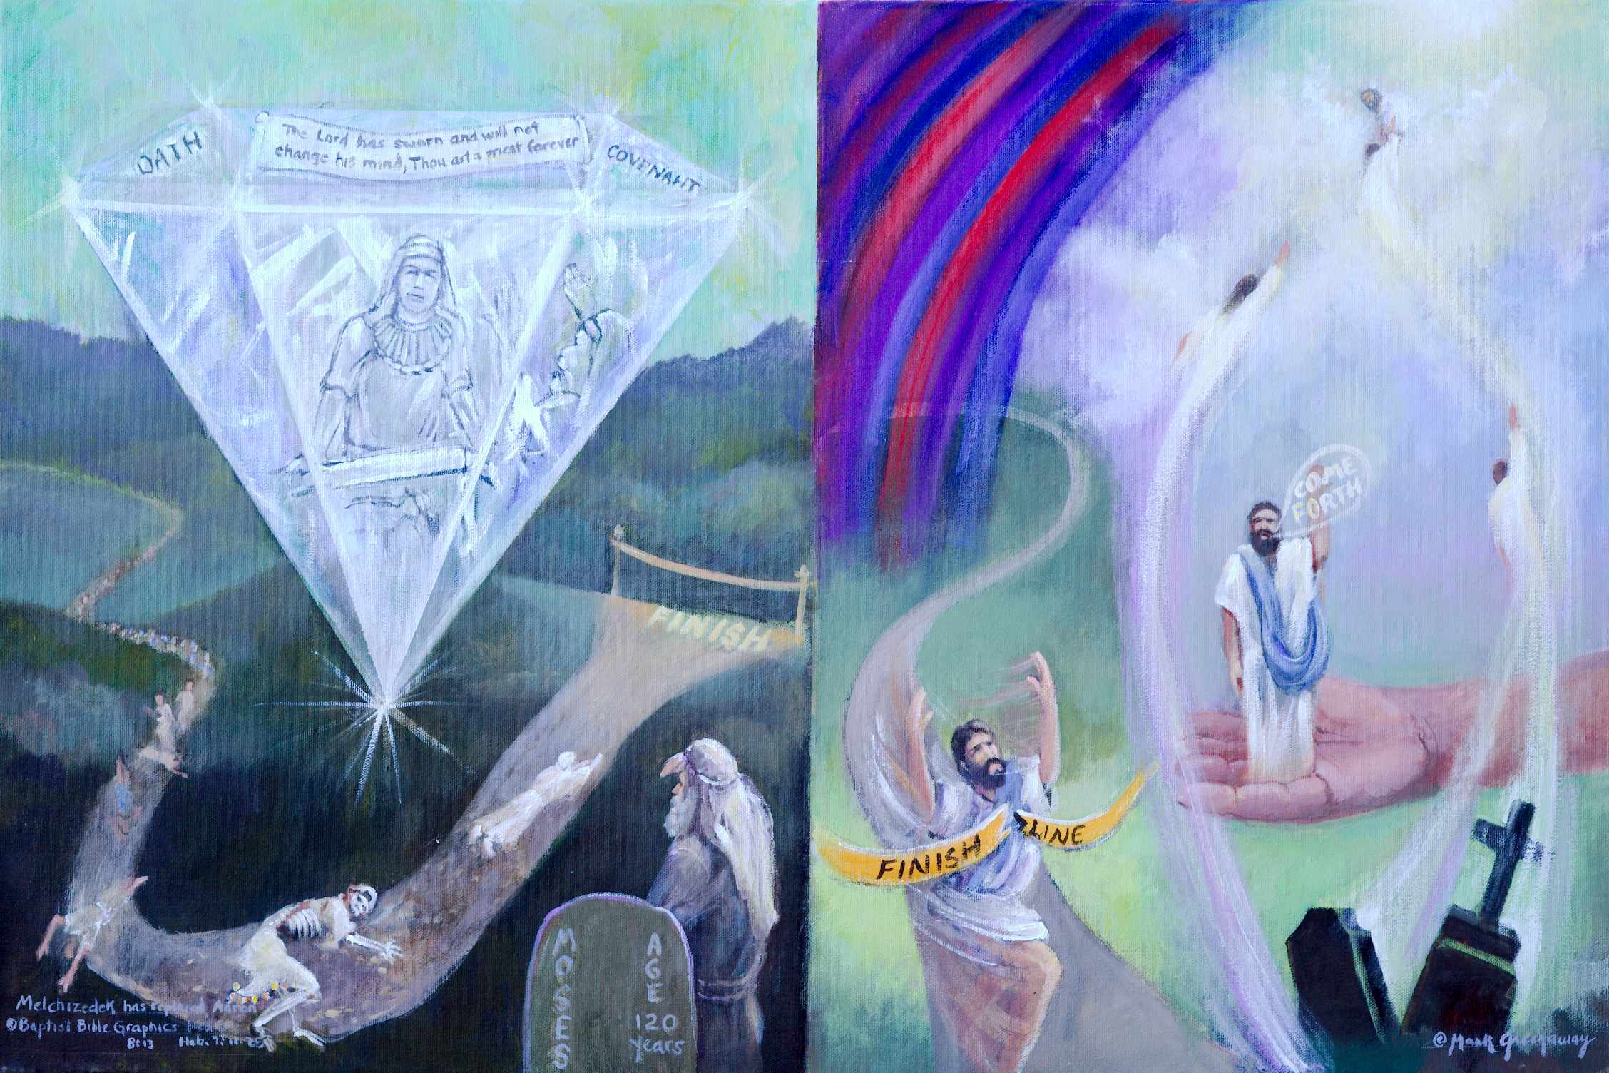
1.Based on Heb 7:11-25. The old Aaronic priesthood order was inadequate. It had to be replaced by something better. Stone: Not only is Melchizedek greater than Aaron, but he has replaced Aaron. Top facets, an open scroll is announcing a priest would arise belonging to a new order Ps 110:4. A new priesthood based on a better oath and covenant would supersede the old because the old was imperfect. Front facet, Aaron is laying down a closed scroll, the whole legal system had to be changed. Side facet, Aaron is waving goodbye. Finish line: The old Aaronic priesthood was imperfect because everyone died before having completed the necessity of sacrifice. Moses is observing everyone dying before they were able to cross the finish line. The tape broken: A priest from the tribe of Judah ended the law. How? He lives forever. Resurrection and ascension: Now he gives us a better hope by which to come unto the Father in heaven, the power of eternal life. Veil open: The hand that held the anchor now lifts the resurrected to Heaven. The resurrected Christ is positioned between the grave and the throne.
7. Heb 7:19 Sinners drawing near to God. Christ is standing between the grave and heaven. The veil is wide open, giving complete access to the Father. Jesus Christ is able to save to the uttermost, completely and forever. The Mosaic Law has been fulfilled by One who lives an indestructible life. Well done good and faithful servant. Enter into the joy of your master.
2. Stone: The top facet announces that Jesus Christ is a priest forever. He is the eternal Son of God who lives by the power of an endless life Heb 7:16. The old priesthood was imperfect because it did not give the people complete communion with God Heb 7:11-12. And they all died before the necessity of sacrifice was finished. So Aaron is pictured closing the scroll, laying it down and waving goodbye. Now we see Jesus only. The stone rises out of the despair of death. Every facet reveals the promise of new life, endless life, eternal life.
6. Heb 7:19 Standing in God’s hand. Christ is lifted up between the grave and the throne. The power of his endless life is a better hope for drawing near to God then what Moses is seeing on the other side of the page. What a contrast, an endless life as opposed to those who have fallen in the way on the other side of the finish line. All that Christ has done is accredited to our account. Those who climbed on board in the previous picture are being raised with Christ from the power of the grave to an endless life in the heavenlies Eph 1:3. Pictured are tombstones rocking out of the way while the former occupants respond to Come Forth Jn 11:43. In bodily resurrection they fly away to shine brightly like the brightness of the expanse of heaven.
3. Heb 7:15-18. Moses sees that everyone serving under the Aaronic order have fallen short of the finish line. That’s because the Law pertained to people of flesh who died. Death took them all Heb 7:23. Death made necessary a new priestly order. Contrasted is Christ who broke the tape by his endless life. He did everything necessary to draw near to God.
4. Heb 7:19, Two tables of the Law leaning on a tombstone. The Aaronic order was imperfect but so was the law. The law made nothing perfect. The animal sacrifices could not give the worshipper a perfect standing before God Heb 10:1-3. The priests received their authority from the law and the priesthood has been changed. The writer to the Hebrews then concludes that there must be a change in the law, making the law obsolete Heb 8:13. The Mosaic system of divine law had to go. It was a temporary measure added to serve as a schoolmaster to prepare the way for the coming of Christ Gal 3:19-4:7. The law was the best that God could do without the coming of Jesus Christ.
5. The coming of Jesus Christ: Under the law every priest came from Levi. But Jesus came from the tribe of Judah Heb 7:14. No problem because there has been a change in Moses’ law. It was fulfilled in Christ and taken out of the way Col 2:13-14. Pictured is Christ breaking the tape and taking it out of the way Rom 10:4. He crossed the finish line in his resurrection, Rom 10:4. The believer in Jesus Christ is set free from the Law Gal 5:1-6, and is dead to the Law Rom 7:1-4. Jesus is pictured with his hands up in the air, enjoying every moment of victory. He did not come to earth out of compulsion nor did he run the race because of inward constraint. Rather he enjoyed doing his Father’s will. And we his disciples serve him for the same reasons 2 Cor 5:14; Eph 6:6. Going back to Judaism is trying to run the race Jesus already completed.

Slide 12
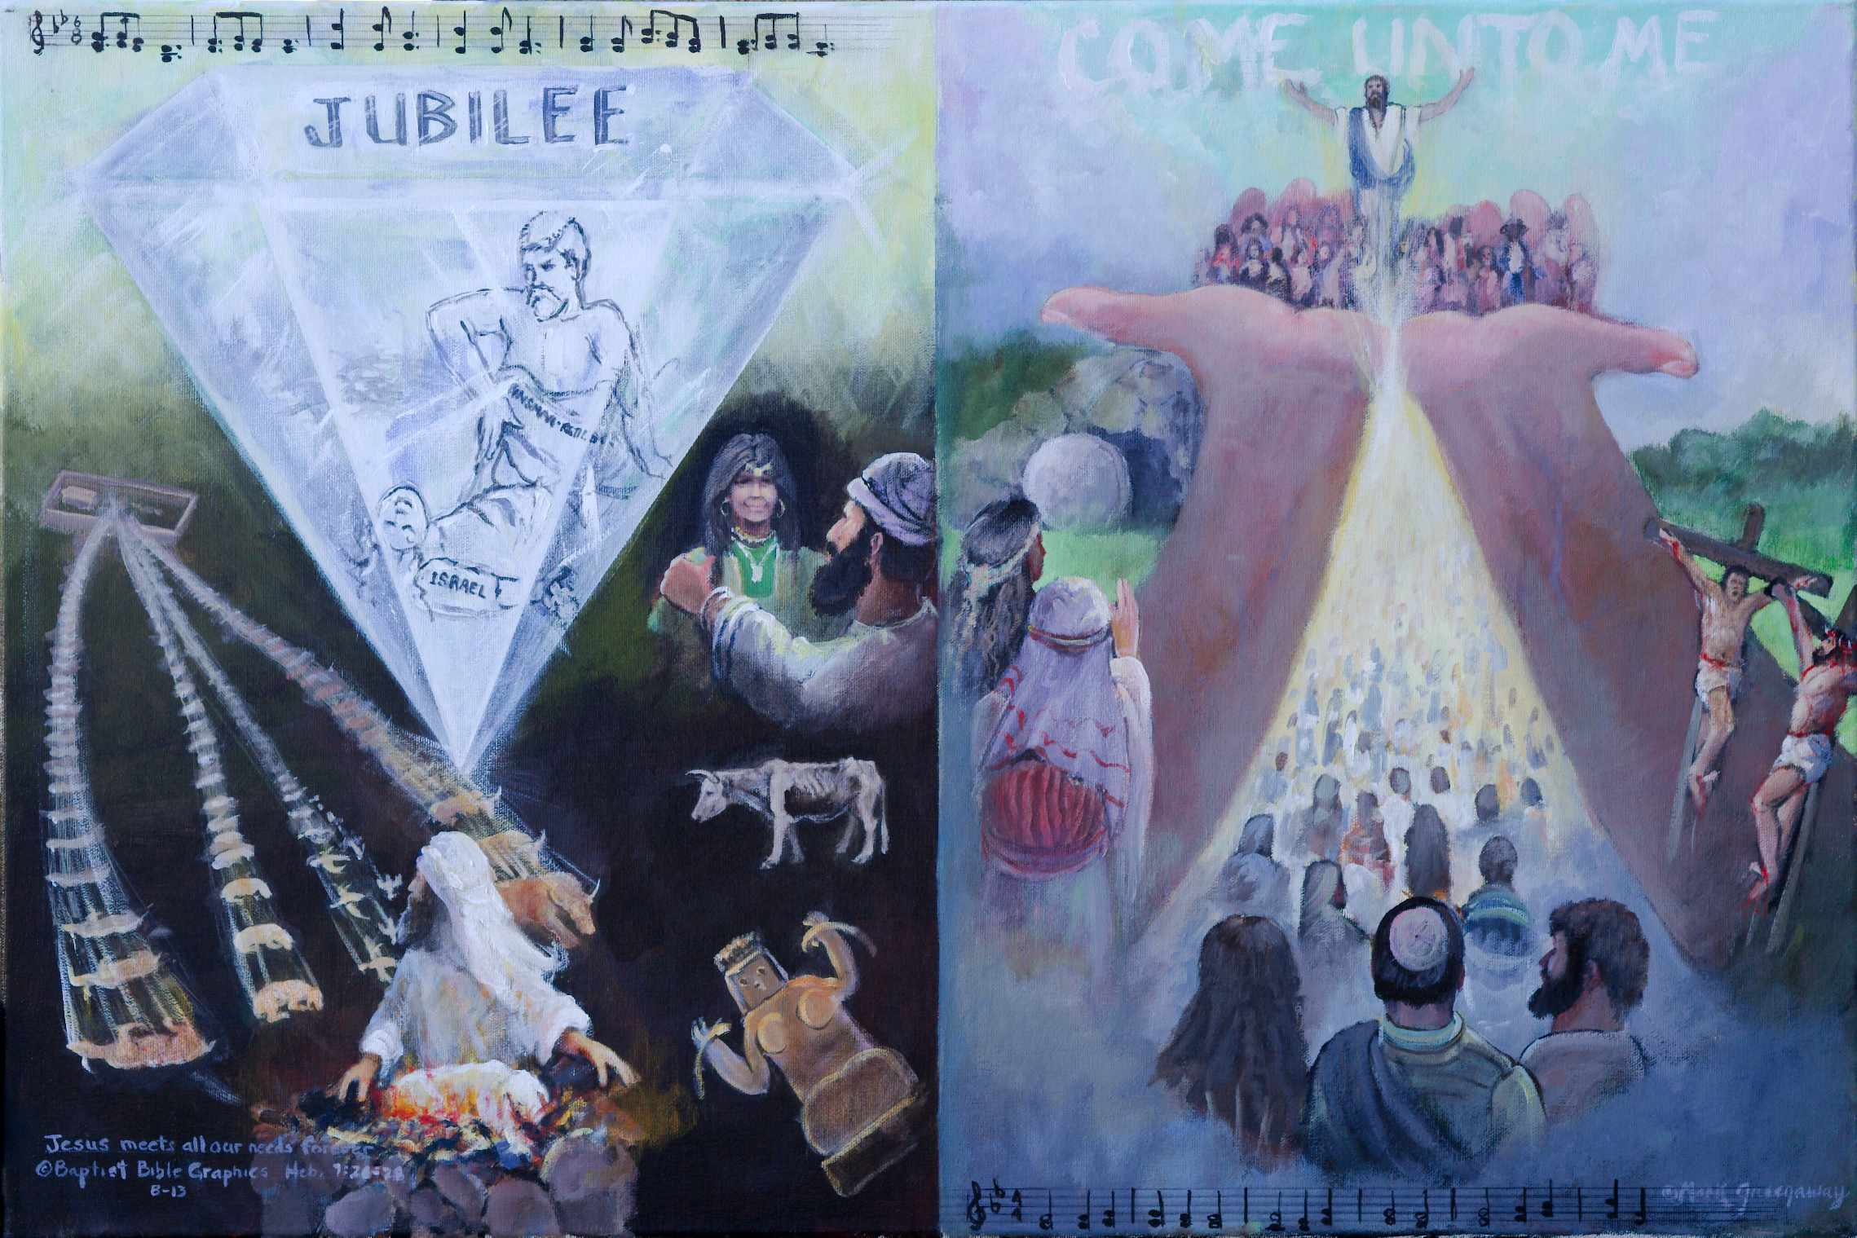
1. Based on Heb 7:20-28. An oath made the new Priest greater than the Levitical priests. Stone: A better covenant. Front facets: Kinsman-Redeemer. Top facet: Eternal Jubilee, the release from bondage. Music: The expanse of the sky is not sufficient to record His blameless character, Silent Night. Below: Priest at the altar is looking back, reminded of his past sins, never escaping death. He was a sinner, beset by many temptations including idolatry, accepting blemished animals and adultery. Right side Christ in heaven: The new Priest is superior. He ever lives and his ministry is in heaven Heb 8:1. A great multitude on earth: The redeemed on earth have a high priest in heaven. Open hands: He has raised the redeemed up to sit with him in the Beloved. A new song: The word of the oath appoints a Son who is made perfect forever. Crosses: He was separate from sinners, yet he died among sinners. Women at the empty tomb: He ever lives. Hymn: Up from the grave He arose. Written in the sky Come unto Me: Christ receives sinful men.
5. Heb 7:28, Come unto Me: He is the kind of high priest who meets our need. We are not removed from historical reality. There is no neo-orthodox dichotomy but a unity in Christ. There is no veil in this picture. Heaven is wide open for the redeemed sinner to enter God’s presence thru Christ. The once for all sacrifice of Christ has given the believer a perfect position before God where he is not weighed down by the guilt of sin Heb 10:1-4. So why return to Judaism just to line up alongside legalistic worshippers when we have such an adequate great high priest who meets all our needs Heb 6:1-6? As Christians we do not need to keep the feasts and offer the sacrifices of the Old Covenant. Christ is all in all.
2. Heb 7:22-6. Stone: The new Priest is greater than the Levitical priests. Front facets: He is of a better covenant. Our Kinsman-Redeemer lives forever to draw men near unto Him. He neither slumbers or sleeps. His intercession is unceasing. He arises up to meet the needs of the sinner laying at his feet. He holds abundant grace in his hand to cover all who feel the chill of death and come unto him. We wrote Israel because Hebrew Christian is not a contradiction. Top facet, The redeemed sinner is raised up with him to be exalted above the heavens in an eternity of JUBILEE Heb 7:25. Music written in the sky: Holy men of old and church saints join holy angels in the heavenly choir praising Him who is holy and innocent. His perfections were announced at his virgin birth, “Silent Night, Holy Night…” Heb 7:26.
3 Heb 7:27-28. Priest at the altar looking at the past: He sees the many years of daily and annual sacrifices since the Law was inaugurated, bulls for his own sins then for the sins of the people vs Christ offering Himself once for all. The sins: They worshiped lifeless tottering idols. A scrawny bull: The Law appointed men as high priests who were weak, accepting a blemished bull for Himself Mal 1:6-8. Flair for strange women. Many Aaronic priests didn’t have a heart for the job, they were born into it without an oath Heb 7:20-21. What was needed was a new priesthood instituted with an oath whose sphere of service was in heaven Heb 8:1.
4. Heb 8:1 Jesus exalted in heaven: Jesus was ordained into a new priesthood whose sphere of service is in the heavens. A great multitude: The redeemed on earth have a high priest in heaven. He has blessed them with every spiritual blessing. In our picture, they are also holy and blameless in Christ’s open hands in the Beloved Eph 1:6. The song of the redeemed: We extoll the Son who is made perfect forever by his death, burial and resurrection. On the right, he is pictured crucified among sinners. On the left, the three women are looking into the empty tomb. At the bottom are the written notes of the hymn Up From the Grave He Arose.

Slide 13
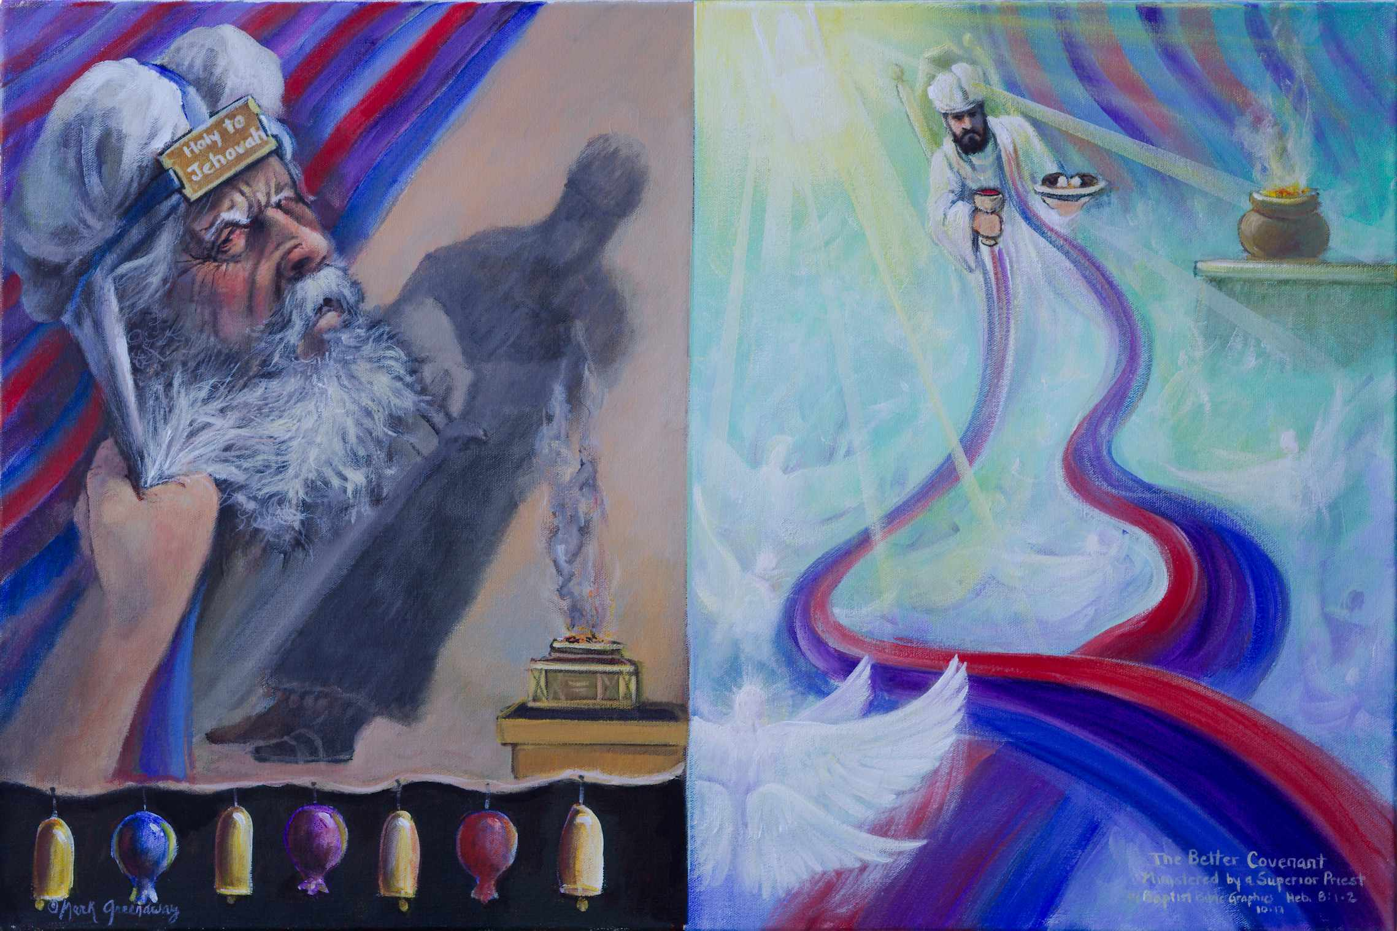
1. Based on Heb 8:1-3. Having proved the superiority of the new priesthood Heb 7 (three pictures), the author establishes Jesus’ superior priestly ministry Heb 8 (four pictures.) Non-assessable vs assessable: Hand grasping Aaron from behind the veil vs High Priest exalted in heaven in front of veil. The Jews didn’t want to let go of the Aaronic priesthood even though it was veiled, behind closed doors and not assessable to the worshipper. We have such a high priest who is assessable, who meets our needs and who serves in the heavenly sanctuary of the true tabernacle. Work never finished vs Work completed: Aaron’s shadow vs Son Shine. The shadow reveals that Aaron was always standing, he never sat down, his work never done. Christ is sitting down, his work done. Beauty of Holiness Concealed vs Beauty Revealed: Pomegranates and bells vs Priestly Train: The copy of the tabernacle on earth had it’s beauty no one could see. But the Lord pitched the true tabernacle in heaven to reveal, not conceal, the glory of His ministry. Pictured is a unity in Christ in the Beloved in heaven Eph 1.
7. Heb 8:3, Extended lapels. It is necessary that Jesus have something to offer. The lapels on a robe announce His credentials, His expertise, what he has to offer, red for theology, blue for instruction-Torah. Jesus specializes in intercession, in meeting the needs of His people. The train causes the worshipper to see Jesus only, to focus upon Him. He is the real. He is the object of our worship. Worship the Lord Jesus Christ and Him alone! Not the angels, not the gifts and sacrifices, not the robes, not the ritual, worship God! But our fathers worshipped at this mountain where the tabernacle was pitched and you Jews at Jerusalem where the temple is. Jesus answered that when we know the Person we worship in spirit and in truth Jn 4:24. And when we know the person who is interceding for us, all these things, the cares of life, will grow faintly dim in the light of His glory and grace. He is able to meet all our needs. Yes, Jesus Christ is a better priest and he ministers in a better sanctuary.
2. Heb 8:1 The point of what we are saying is this. The author summarizes what he has been teaching them. Hand reaching back grasping Aaron who is standing behind the veil: Don’t be tempted to hold on to the Mosaic regulations to the detriment of your spiritual progress. The ministry of the Aaronic priesthood was veiled, behind closed doors, out of sight and not assessable to the people. It was the best that God could do without sending Jesus Christ to earth. When Christ came he brought in a new order Heb 9:11-10:18.
3. Heb 8:1 Our High Priest is exalted in heaven as retrospective and prospective ATR. Retrospective, previous three pictures. Third picture: From the throne of grace Jesus provides an anchor, His hand, a firm foundation wherein we stand. Second picture: By the power of His endless life he calls us and raises us up to seek those things which are above. Previous picture: With exceeding great joy he presents us in His presence in heaven. Prospective on the right side: We have such a High Priest who is assessable to all who come unto God by Him. Praise God from whom all blessings flow. Praise Him all creatures here below. Praise Him above ye heavenly hosts. The blessings are pictured flowing down amid upraised wings. We enjoy fellowship with the Father and with His Son Jesus Christ, 1 Jn 1:3-4.
6. Pomegranates, bells and incense. There was great artistic beauty on earth that reflected heavenly glory. The design of the tabernacle, its coverings, furnishings, colors, type of material, aroma and fragrance, all very enchanting. But out of sight of the common man.
4. Shadow: God’s holiness in concealed. Aaron is behind the veil. His shadow reveals him standing, his work was never done. The shadow also casts a dynamic for Israel that none of the animal sacrifices provided for a finished salvation Heb 10:1.
5. Majesty in the heavens. The picture is from the perspective of we who are standing in His Hands in the previous picture. We are on earth but we are in the Beloved Eph 1:6. We are in the realm of heavenly possessions and experiences made possible by our High Priest. The God and Father of our Lord Jesus Christ has blessed us with every spiritual blessing in the heavenly places Eph 1:3. The beauty of the heavenly tabernacle is not the furnishings but Christ Himself. It’s the Majesty of our High Priest who ministers on the basis of a better covenant. He has taken His seat at the right hand of the throne of the Majesty in the heavens. All creatures here below and in heaven above are praising Him who is ordained for his ministry. Let us worship and bow down. The Levitical priests were never ordained but assumed their ministry by divine regulation, serving the way the law spelled it out. We have such a high priest.

Slide 14
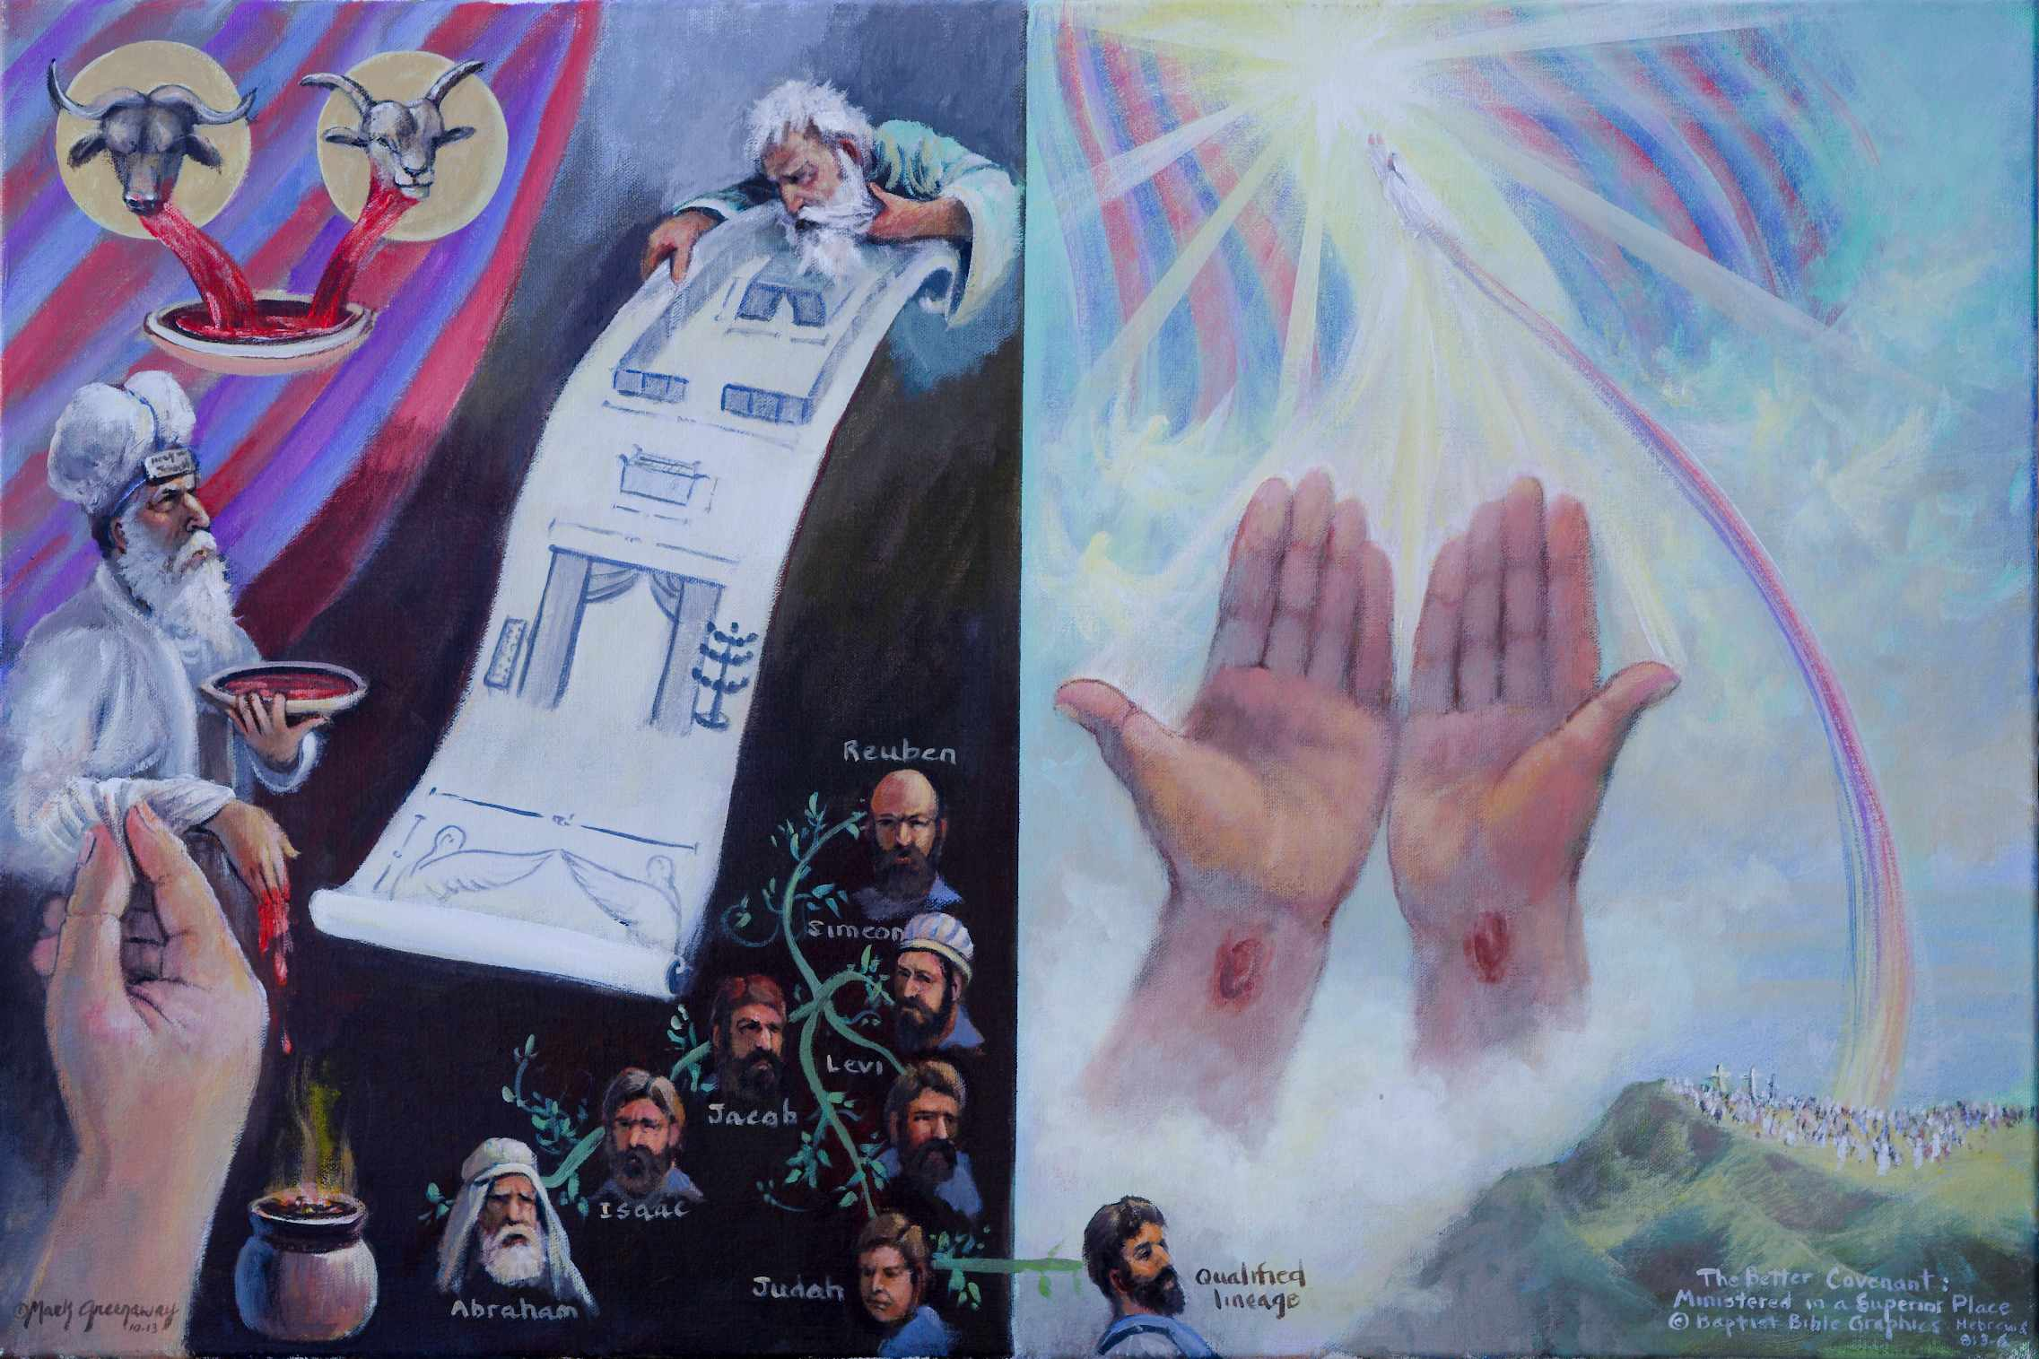
1. Based on He 8:3-5. The summary continues using new terms BKC, both retrospective and prospective. His ministry involves a superior sacrifice in a superior place. Aaron sprinkling blood vs Jesus’ sprinkled blood. Hand reaching up pinching his priest’s sleeve: Keep on going, our life depends on you. vs Up lifted hands, Jesus paid it all. The blood of bulls and goats vs Jesus’ own blood. Sacrifices on earth vs Jesus’ sacrifice carried to heaven. Blood being caught in a bowl vs no bowl because once applied - always applied. The genealogy of Aaron vs the genealogy of Jesus. Aaron a descendant of Levi ministered in an earthy priesthood regulated by the Law Heb 8:4 vs Jesus a descendent of Judah ministered in a heavenly priesthood where the order of Melchizedek functions Heb 8:1. The copy of the tabernacle constructed by Moses on earth vs the original heavenly tabernacle raised by Christ in heaven. Moses eyeballs the blueprint with its measurements to set the stage for Aaron’s ministry vs Christ ascended to heavenly realms where his priesthood after the order of Melkizedek functions.
9. Heb 8:5. Tabernacle between the open veil. The sanctuary in heaven where Christ ministers is superior to the copy on earth. Why continue to accompany the Jerusalem temple sacrifice which is a reproduction?
2. Aaron sprinkling blood near the burning incense. A hand is reaching up, pinching the priest’s sleeve. When the author wrote to the Jews, the temple was still standing in Jerusalem. They could experience the ministry of the priests, observe the ritual smell the incense burning. The writer is encouraging the Jews to abandon the visible for the invisible. Their life depended on mortal man, frail beings, subject political intrigues and unfaithful ministry Heb 8:28.
8. Moses eyeballing the blueprint. By it’s very nature a blueprint is a copy. He is sizing it up from top to bottom. The measurements are recorded so Moses could follow exactly what God wanted. Aaron served in a copy and shadow of heavenly things. In the composition the copy is positioned in the same place and the same leaning position as the shadow in the previous picture to form a practical hendiadys for a shadowy outline Heb 8:5, ATR.
7. Jesus was the descendant of Judah the fourth son of Jacob. His genealogy qualified him to be a priest in heaven and His ascension raised him from earth to heaven to minister according to the order of Melchizedek. Jesus alone has broken the threshold into heavenly realms.
3. Nailed-scared hands offering something to God. The disciples witnessed Christ’s ascension to heaven. Holy angels also bore testimony that he went up to heaven. It follows that God’s appointed place for Christ to minister is in heaven, which is superior. The duty of the high priest was to offer gifts and sacrifices. Jesus offered himself. His gifts of intercession and his sacrifice of his own blood were superior.
4. The blood of bulls and goats. The very necessity of catching the blood indicates the necessity of repeated action and unfinished business.
5. Jesus’ own blood. No blood visible, just the nail prints as the blood was shed once for all.
6. Earthly genealogy of Aaron: Aaron was a descendant of Levi, the third son of Jacob.

Slide 15
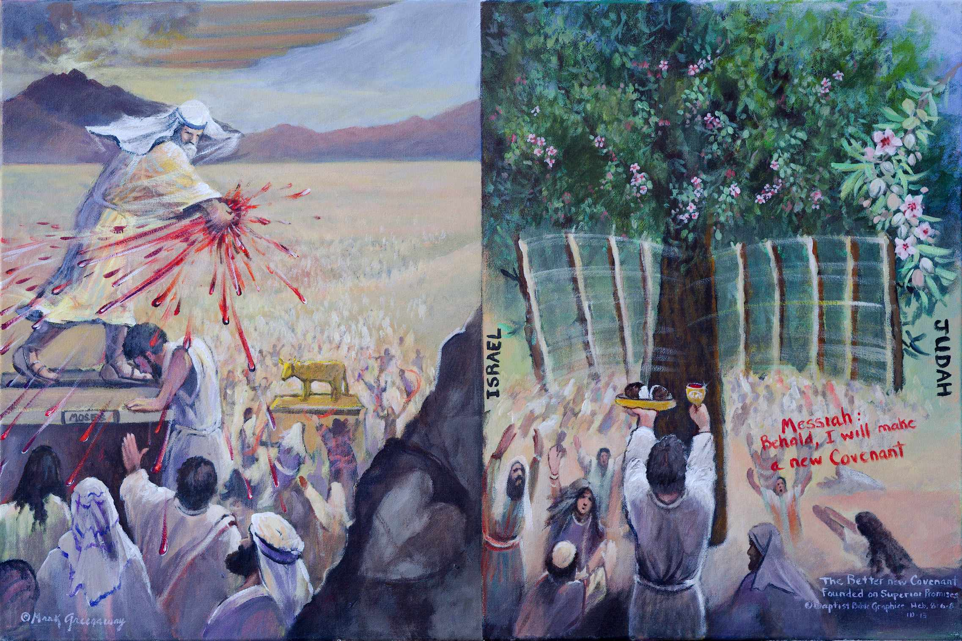
1. Based on Heb 8:6-9. Lays the foundation for the next picture Heb 8:10-13. The New Covenant is founded upon a superior priestly ministry in heaven (last two pictures) with earthly ramifications (this picture and the next.) Moses’ ministry vs Christ’s ministry. The word ministry strikes the pivotal note BKC. Moses inaugurating the Old Covenant in the desert vs Jesus inaugurating the New Covenant in the Millennial Kingdom. Jesus’ ministry surpasses that of the Levitical priests. Moses the mediator vs Christ the mediator. Moses standing on a pedestal between an eagle’s wing and the golden calf vs Jesus standing between Israel and Judah in the Millennial Kingdom. Old Covenant promises vs New Covenant promises. The golden calf: God found fault with the nation for which it had no remedy. vs The two sticks: God found fault with the nation and had a remedy Heb 8:8-12.
8. A description of the superior accomplishments of the New Covenant. These benefits find their ultimate fulfillment in the millennial kingdom. Illustrated by almond blossoms. The priests serving in the temple were ministering in a sanctuary that was actually a copy.
2. Moses ministering. Ratifying the Law by sprinkling blood Heb 9:19. Under Moses’ ministry the Old Covenant was received Ex 19-23, and ratified Ex 24. Pictured are the people shouting out, All that the Lord says we will do Ex 24:7. Later the Ten Commandments were given and the people fell a lusting after idolatry Ex 32-34. The Law was good but lacked the power to deal with sin. Pictured is the idolatry of Israel as they worshipped the gold bull.
7. The New Covenant will be made that will differ from the previous one. Promised is future restoration, illustrated by the two sticks joining together promising the uniting of the nation Ezek 37:16. The blessings that follow are similar Heb 8:10-12. Pictured is an ever bearing almond tree with buds, blossoms, immature almonds and ripe nuts on the same tree and at the same time. We picture an almond because the name means awakening.
6. Promises that failed. Fractured fellowship. That there was a promise of a New Covenant makes clear that the Old was inadequate. The Old Covenant failed because of the sinfulness of the nation.
3. Jesus Christ ministering. Written on the right, Behold I will make a New Covenant Jer 31:31-34. The announcement that New Covenant will be made is followed by a declaration that it will differ from the Old Covenant in that it was founded on better promises, his poured out blood Mt 26:28. His libation set the seal upon the sin offering of his sacrificial life.
4. Moses the mediator. Mt Sinai was a frightening experience for the people. They begged Moses to speak to them so they didn’t have to hear God speak Ex 20:18-21. Moses the mediator instilled the fear of the LORD in them, but it didn’t last very long. They soon fell into sin by worshipping the golden bull, one of the gods of Egypt. Moses interceded that they not all die. Below Moses are people worshipping the idol. Above Moses hoovering over Sinai is an outstretched eagle’s wing, symbol of mercy. Around Moses is a remnant who are reaching out, pleading for mercy. The faithful are always the few.
5. Christ the mediator. Christ ministry as mediator is better than that of the Levitical priests because it is based on a better covenant. At the last supper Jesus inaugurated the Lord’s supper saying that the cup was the new covenant in my blood which is shed for you Mk 14:22-24. Paul applied them to the church 1 Cor 11:23-27. Jesus Christ is the mediator of the New Covenant Heb 9:15; 12:24. Today the church is grafted in to the place of blessing Rom 11. At Christ’s Second Coming the branches will be united into the place of blessing.

Slide 16
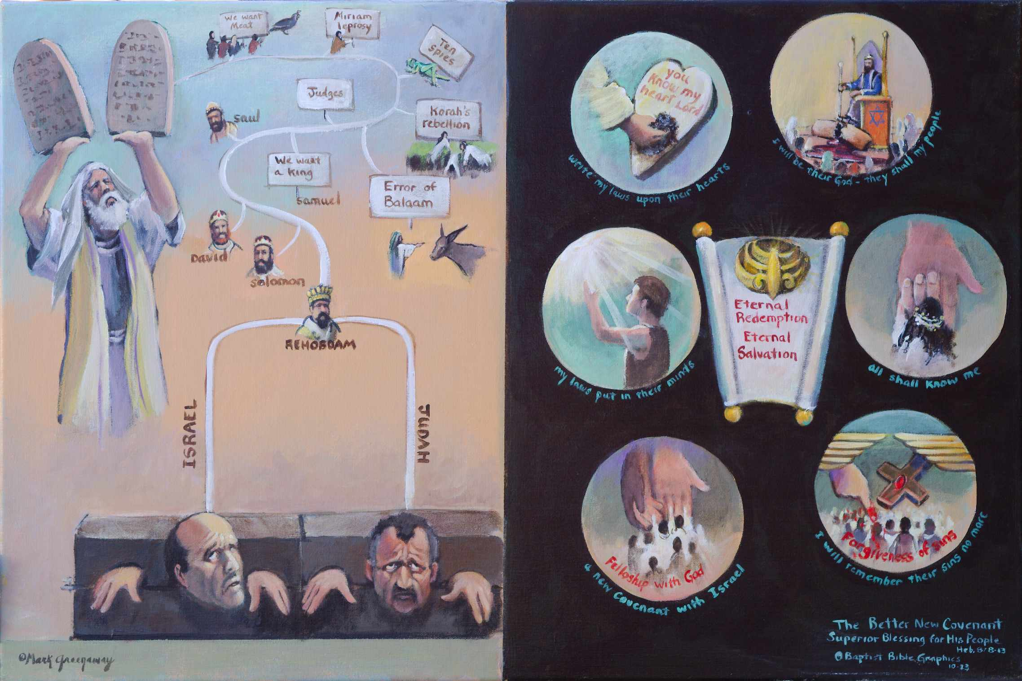
1. Based on Heb 8:7-13. The very need of a new covenant demonstrates the inadequacy of the old Heb 8:7. The left side: The Old Covenant failed because of the sinfulness of the people Heb 8:8. God announced a new covenant in a passage where He found fault with the people Heb 8:8-12; Jer 31:31-34. The right side: God by the New Covenant provides superior blessings for his people. The number of blessings vary according to the way you count. There are six I wills in the text, so we have six blessings circled. Stark contrast between the two sides: The We will of man grew old Heb 8:13. Sin never ceased. By design there are twelve we wills on the left to show that where sin abounded, grace did much more abound, on the right. There is a total disconnect between man’s inward affections vs the inward affections God will put in man. There can be no bipartisan agreement between the two sides, a better New Covenant was anticipated. The faults are arranged following the pattern of Stephen’s indictment, Acts 7. In Brazil the expression All is blue means Everything is rosy, thus the blue.
11. Heb 8:13 Ready to disappear. No doubt the Jews looked back on the good old days with fond memories. Sanhedrin: Are these things so? But those days weren’t so rosy after all. God tells us in the New Covenant that the best is yet to come, the blessings are written in blue. Our design and art express that God provides for the redemption and salvation of all men in history, Jn 3:16.
Hyper Calvinist: God secures redemption and salvation for the elect, perseverance of the saints.
Moderate Calvinist: God provides redemption and salvation for all, eternal security.
Arminian: God offers redemption and salvation for all which can be lost because of disobedience.
2. Moses up holding the Law. The people solemnly vowed, All that the Lord says we will do. What great expectations. But things started to fall apart from the beginning. And the further history played out, the more self righteous they became. Finally it became crunch time vs Grace, Hesed, here I stand.
3. Heb 8:8, Finding fault with them. The Sanhedrin asked Stephen, Acts 7:1, Are these things so? We follow the style of Stephen’s indictment:
Manna: Complained. God gave them quail to eat.
Miriam: Wanted authority. God gave her leprosy.
Ten spies: Grasshoppers. Our kids are gonners.
Korah’s rebellion: Egypt. God gave them death.
Error of Balaam: Donkey. Marry Jewish girls!
The Judges: Sin cycles. Right in our own eyes.
Samuel: We want a king like all the other nations.
Saul: The people wanted me to sacrifice.
David: Nathan said, You took Uriah’s one sheep.
Solomon: His many wives turned his heart away.
Rehoboam: Tax relief? Ha! My little finger…
Two Stocks: the Law upside down holds them tight
Heb 8:13 The Law made old, like old men, ATR.
Heb 8:8 Finding fault: Crunch time for Old Mosaic Covenant. No one can accuse the covenant from failing to hold, like in many marriage covenants. Israel, head turned, is saying to Judah, The reason we Jews haven’t disappeared in the Diaspora is the Law holds us tight. No, it’s because of God’s grace.
10. Heb 8:12. I will remember your sins no more. Forgiveness of sins is illustrated by the Day of Atonement being applied in the heavenly Holy of Holies.
9, Heb 8:11. A full knowledge of God like that between a husband and wife. Bride is clasping Husbands hand.
8. Heb 8:10. I will be their God and they shall be my people, a firm relationship with God. King sitting on throne will all enemies under his feet.
4. Open scroll and crown vs prisoners under the Mosaic Covt: The scroll refers to the Abrahamic Covenant, the crown to the Davidic Covenant. By the New Covenant God will fulfill the provisions for Israel and the universal aspects for the world. These unconditional promises do not depend upon man’s faithfulness to God but on God’s faithfulness to man. In the New Covenant the church does not replace Israel but is grafted into the place of blessing Rom 11. The one New Covenant includes benefits for Christians at the present time.
5. Heb 8:8 The author quotes Jer 31:31-34. A new covenant made with Israel provides fellowship with God. God’s hands are reaching down to provide that whosoever will might reach up and place their hand in God’s.
6. Heb 8:10 I will put my laws into their minds, light shinning on man. Seek the LORD while he may be found, call upon him while he is near. My thoughts are not your thoughts Isa 55.
7. Heb 8:10, I will write my laws upon their hearts, hand cleansing heart resulting in an inner inclination to obey God.
Notes:
:

Slide 17
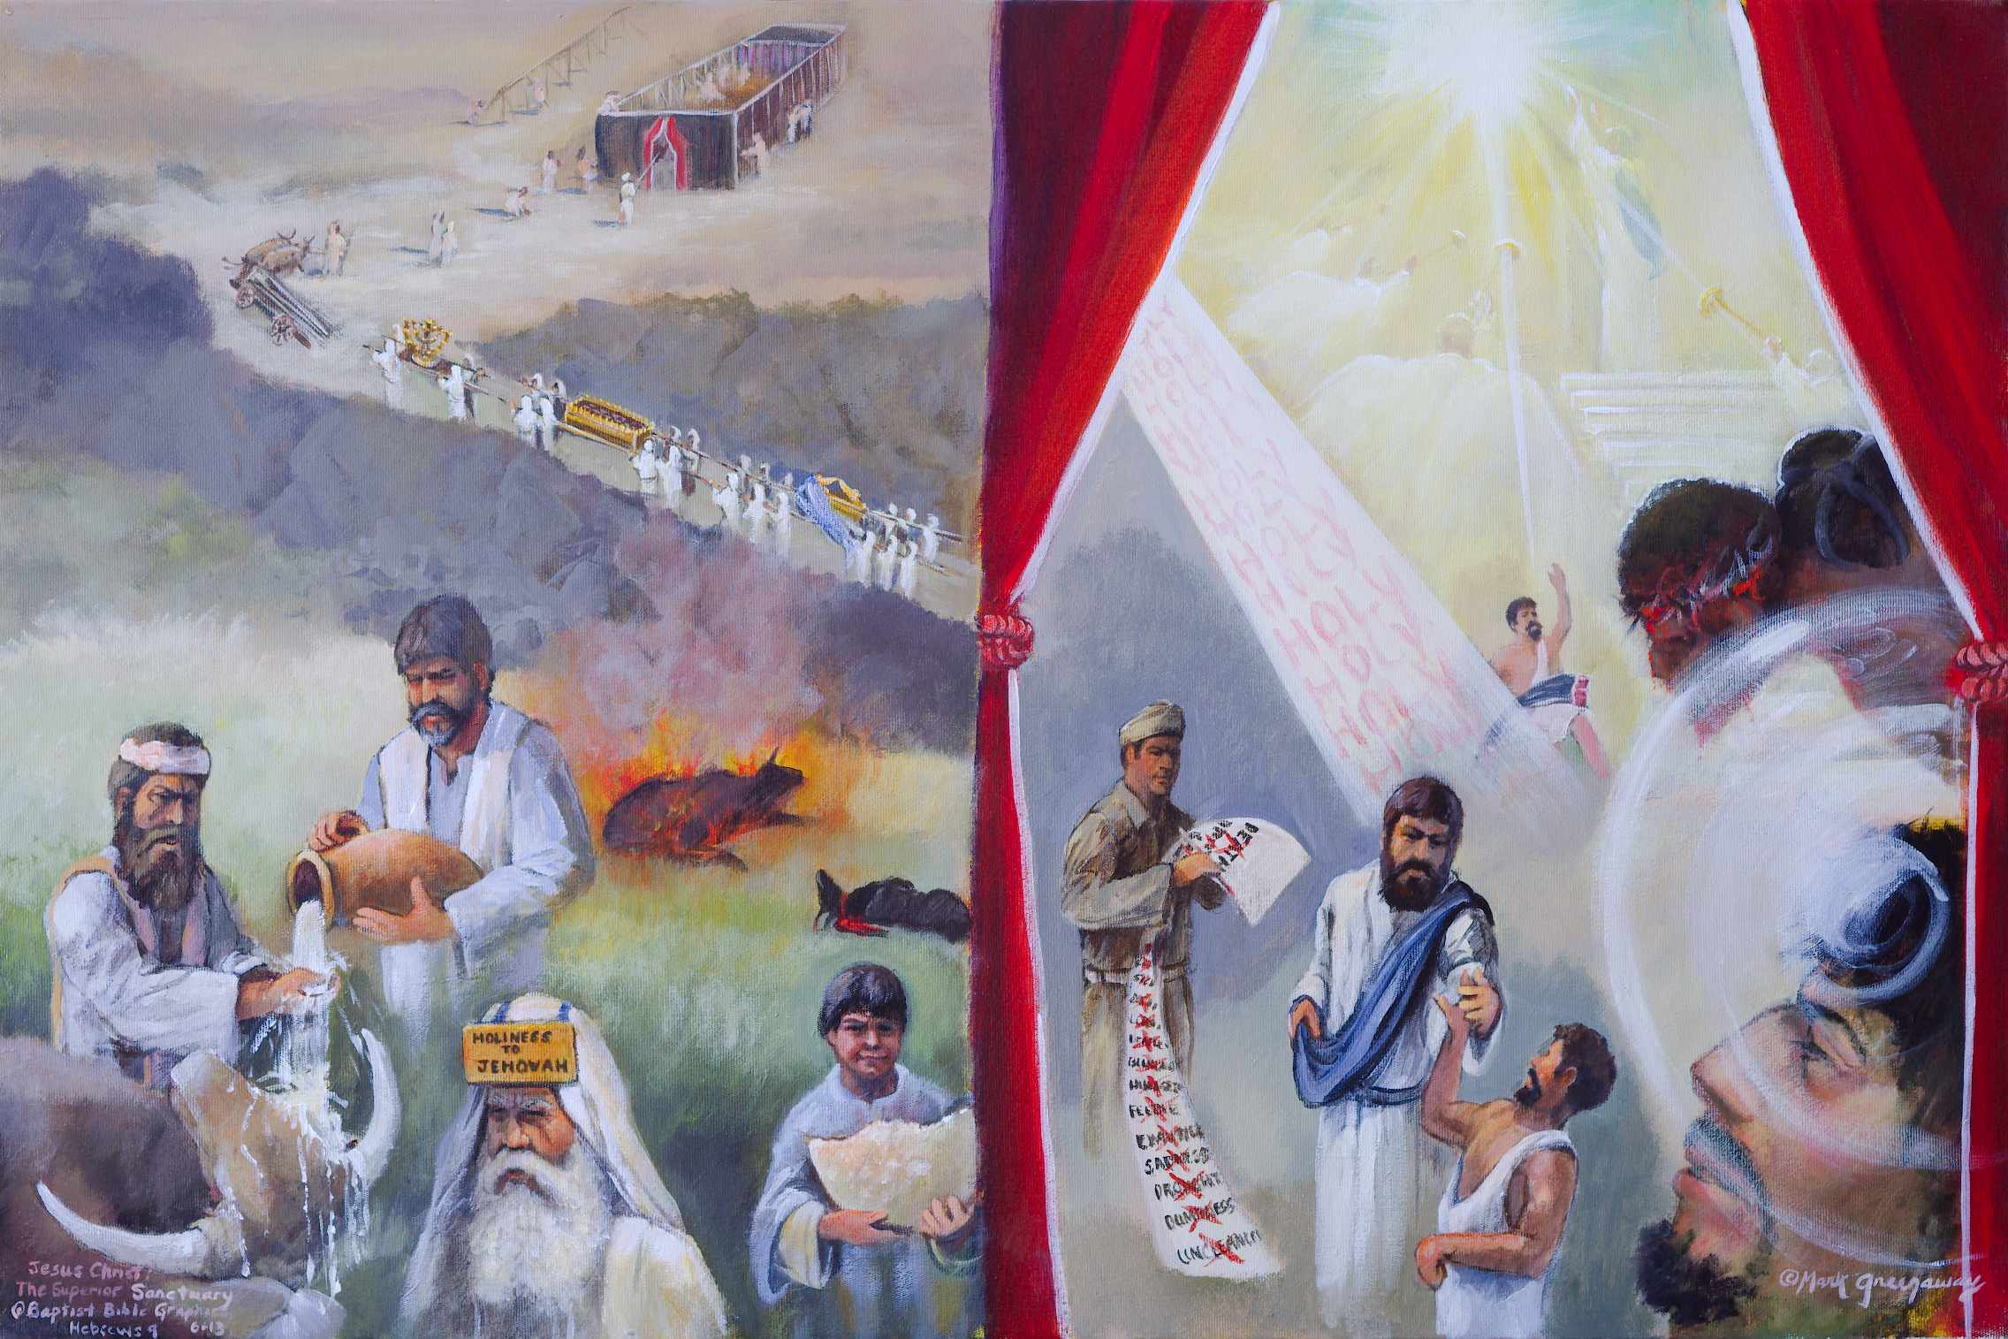
1. Based on Heb 9:1 vs 9:11. There are six pictures illustrating the superior heavenly sanctuary Heb 9:1-10:18. The Old anticipated a better New Covenant Heb 8:7-13. It follows then, we should expect that he ministers in a superior sanctuary. Hebrews 9:1-10:18 presents a detailed contrast between the deficiencies of the earthly sanctuary Heb 9:1-10 with the superior features of the heavenly sanctuary Heb 9:11-28. On the left front appears regulations governing the earthly sanctuary Heb 9:1. In the background are regulations for moving the sanctuary from place to place. All these regulations got tiring to keep, grew mundane and were a source of murmuring. By their very nature these regulations were inadequate for worship. A new covenant would replace the old. Right front: The author has already stated that Jesus entered within the veil Heb 6:19. Now he elaborates on his ministry in the heavenly sanctuary Heb 9:11-10:18. A veil appears in the following six pictures on the right side. I have supplied some Levitical regulations and biblical examples to illustrate the text.
7. Christ Jesus raising the lame man Jn 5. Through out his ministry Jesus demonstrated the things of heaven to the people. Raising the lame man was a sign that he was fulfilling the prophecies concerning his person and work. The soldier is holding the muster sheet, checking off one more fulfillment. The man who was healed is praising God.
2. Heb 9:1 The Old Covenant sanctuary was inferior because it was an earthly sanctuary. It was mundane, meaning that in it’s construction it was made by man Ex 35-39, and pitched by man from camp to camp Heb 8:2. In the background are the Levites carrying the furniture on their shoulders up the dug way. Turning the corner are the carts carrying the wood and curtains, over 100 tons. In the back the sanctuary is being pitched by men in a new location. Even though the glory of God moved in, it was still an earthly tent for temporary use.
6. Heb 9:11, Of good things to come. Jacob in a dream saw angels on a ladder, front right corner: Jacob saw the heavenly sanctuary open and the angels descending and ascending a stair way between heaven and earth Gen 28:12-18. He rose up and anointed Bethel as God’s house, the gate of heaven. We put Jacob in the picture to emphasis that the good things to come that he saw have already arrived in the person of Jesus Christ.
3. Heb 9:1 The Old Covenant sanctuary was inferior because it depended on the political and civil leaders to carry out its divine regulations. For example, an unresolved murder in the field required the leaders of the nearest town to take responsibility of the crime. A cow’s head was twisted until the neck snapped and running water taken from a flowing stream was poured over the hands of the mayor and onto the dead animal. It was a public display of the sanctity of human life created in the image of God. The city dads were responsible for making there citizens safe. As idolatry took over, the sanctity of human life went out the door and the divine regulation was neglected. The old regulation was inferior.
4. Heb 9:1 The Old Covenant was inferior, it depended on the Levites and priests to carry out its regulations. Pictured in the back is the red heifer which was burned and its ashes keep Num 19. Also pictured is a goat that had to be slaughtered a certain way Lev 16:6-10. The bread in the child’s hand also had its regulations who could eat Lev 21:22, that tied the people down, 1 Sam 21:6; Mt 12:4. Enforcement fell on the high priest’s shoulders, who could not be careless Lev 10. When idolatry surged, then enforcement slacked Micah 6.
5. Heb 9:11 The New Covenant sanctuary is superior because it is heavenly. When Christ appeared every thing changed. This is the great historic event that is the crux of history ATR. The veil is not tricolored as in the earthly sanctuary but red only. And the veil is tied back with a double knot, never to be drawn between the Savior and the sinner again. The crucified Christ is pictured beyond the veil, having entered, in connection with the greater and more perfect tabernacle. By faith we look past the tangible earthly sanctuary to see the invisible heavenly sanctuary. Pictured in blue is Jesus at the top of the stair way where angels walked Jn 1:51.

Slide 18
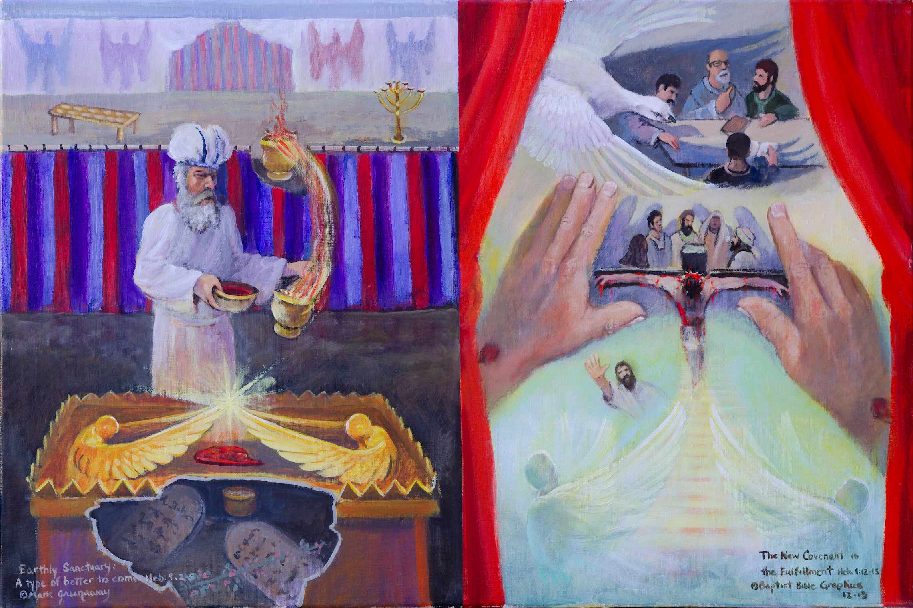
1. Based on Heb 9:2-5 vs 9:12-15. The two sanctuaries from God’s point of view: Left side: The priestly service in the earthly sanctuary on the Day of Atonement was a type of something better Heb 9:2-5. Right side: Our priest ascended into the heavenly sanctuary providing a better basis for serving the living God Heb 9:12-15. Left: The outer sanctuary having the lamp and bread; And the tri-colored veil setting apart the inner sanctuary where Aaron ministered in God’s presence. Right: There is no veil separating the outer sanctuary, where men are gathered around the written Word, and the inner sanctuary, where men are gathered around the living Word. The hands and the wings unify the two scenes in one. Ascension: A stairway is reaching from the cross to the heavenly sanctuary where stand the angels Jn 1:51. The ever living resurrected Son, with His hand in the air, ascended the stairway and entered the most holy place once for all by His own blood. Christ’s service as mediator of the New Covenant is superior to the inadequate earthly ministry of the Old Covenant.
7. Heb 9:14-15 Eternal Spirit: The good things to come are already here. The eternal Spirit, represented by a dove, is hovering over men who are studying the Bible. They are covered with his pinions and under his wings they seek refuge Psalm 91:4. Holiness in united with redemption. The restricted access into the earthly sanctuary demonstrated that a true entrance into God’s presence had not yet been disclosed. The Holy Spirit intended to communicate that the deepest need of a sinner was to have a clear conscience as he worshipped God. Once for all Christ entered the greater and true tabernacle by His own blood. His ministry is sufficient to meet our needs and continues forever in heaven.
2. Heb 9:2-5 The Old Covenant sanctuary was inferior because it was a type of something greater The inside white linen covering had embroidered purple, red and blue cherubim. The door was tied open to enter the holy place, the outer room. The second veil was tri-colored with cherubim outlined in gold thread, making a second room, the Holy of Holies. Once a year Aaron’s sons lifted up the veil allowing him to stoop under to enter the Holy of Holies where he offered incense, bull blood for the priests and goat blood for the people. The Day of Atonement was a type of Christ on the cross.
6. Heb 9:12-15 Eternal redemption by Christ’s death on the cross: We picture His hands reach out of the heavenly sanctuary to serve sinners deepest need, providing salvation to those who have obtained redemption by His blood. The price to redeem the sinner has been paid and need not be paid again Heb 7:27; 10:10. His fingers cast a shadow upholding sinners who are gathering around the cross. The good things to come are already here.
3. Heb 9:3-5 The Holy of Holies, the inner sanctuary. The incense altar stood in the holy place Lev 16:12-14 but its ministry pertained to the holy of holies Ex 40:5; 1 Ki 6:22. Pictured is the incense jar coming past the veil where rested the ark of the covenant. A cut-away reveals a jar with manna, Aaron’s budded branch, and the Ten Commandments. Solid gold cherubim are on the lid. The long feathers, pinions, are a symbol of mercy, thus called the Mercy Seat. Aaron is ministering in white robes, having changed out of his beautiful colored garments. God highlights the earthly high priest’s activities so He can contrast them with the once for all features of the heavenly High Priest’s ministry. The heavenly ministry is superior to the earthly which has faded away.
4. Heb 3:5: I will not discuss these things in detail. The author choose to limit his description to the main point. God does not look upon the broken law hidden from view in the ark. Neither does he give priority to the sprinkled animal blood. Rather, He delights in mercy and the knowledge of God Ps 51; Hos 6:6. All of the ritual is full of meaning. But when mercy is lacking, then all the symbolism and regulations go out the door. They mean nothing. The priest is doing dead works if he is not meeting the needs of people.
5. Heb 9:11-15 Heb 9:11 The New Covenant sanctuary is superior because it is effective to deal with sin. The good things to come are already here. God is in his holy temple. Down below is a sinner for whom Christ died. The reality is that we are still on earth. Does anyone care? Is the door to heaven brass? Hey up there, do you hear me? The writer to the Hebrews assures his readers that our High Priest attends to our deepest needs. He wants us to abide under the shadow the Almighty as we serve the living God Ps 91. The shadow of His fingers surround the sinners gathered at the foot of the cross.

Slide 19
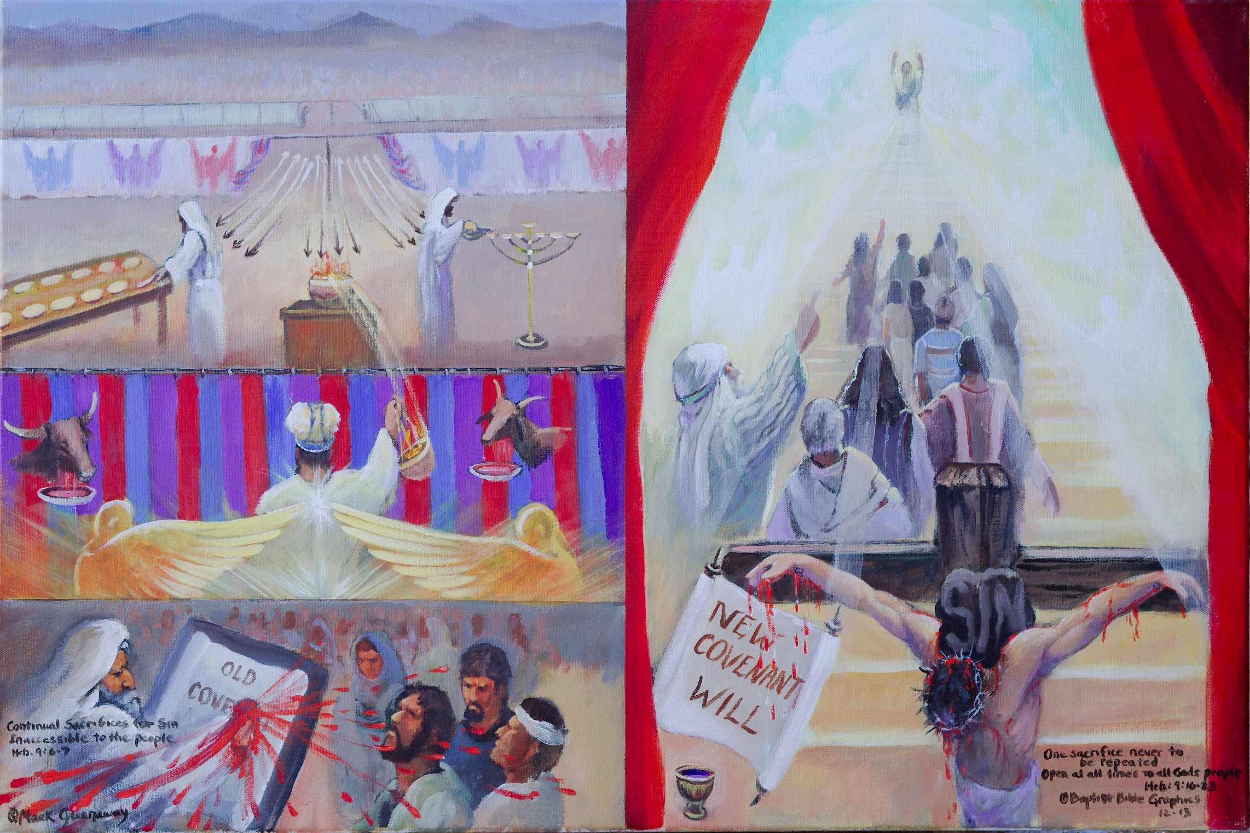
1. Based on Heb 9:6-8, 16-23. Moses inaugurating the old vs Christ the new: Each item was prepared, full of meaning and carefully planned Heb 9:2, 6. Both old and new were inaugurated by blood. So why do we need the New Covenant? Outside the camp: Only the priests could enter the holy place. The people were kept out. The way into the holy place was inaccessible while the tabernacle was still standing Heb 9:8. Pictured are the thousands of Israel, past the two tabernacles, past the courtyard, way off in the distance. Inside the sanctuary: Believers have entered the holy place thru Christ and receive the promise of the eternal inheritance Heb 9:15. Priests continually entering the holy place: Many sacrifices all the time signify that no final offering for sin was made. Besides, these sacrifices could not cleanse the conscience. Once for all: The final offering was never to be repeated and assessable to all the people. Open veil: Both the old and the new covenants required blood for forgiveness Heb 9:22. May the veil never close over our minds and hearts.
9. God in His holy temple: God is near. He is accessible. God has spoken by His Son giving access to the Father. Heb 1:2. Come boldly before the throne of grace Heb 4:16. The way into the holy place is disclosed Heb 9:8. He is performing marvels of love upon His vessels of mercy from His heavenly sanctuary TWOT 1768.
8. Open veil: Unhindered access speaks of a better sacrifice then that of animal blood on the mercy seat. It speaks of grace that does not hid itself in a tent from the worshipper. May the veil never close over our minds and hearts.
2. Heb 9:6-7 The Old Covenant sanctuary was inferior because it was inaccessible to the people. Twice the author stated that the sanctuary was prepared Heb 9:2, 6. The Old was the best that God could do without sending Christ to inaugurate the New. Moses dipped wool in blood, flung his arm and squeezed, sprinkling the Law, the altar and the people close by Heb 9:19-21. Forgiveness required blood Heb 9:22. But all the people had to stand outside in the desert following from afar what was going on inside.
7. Heb 9:16-23 Once for all: The final offering was never to be repeated and was assessable to all the people. Heb 9:11 The New Covenant sanctuary is superior because its based on a costly sacrifice.
3. Christ inaugurating the New: The author treated the inauguration like a will. It didn’t start until the death of the one who made it Heb 9:16-17. In so doing, the superiority of the sacrificial death of Christ is clearly underscored. The new was necessary because mere copies of heavenly things might be cleansed by animal sacrifices but the heavenly things required more than that Heb 9:23. Heavenly things include the entire priestly plan of the New Covenant which was adequate to do away with sin forever Heb 9:26. Once for all, at the consummation of the ages, Christ’s death meet all the demands to satisfy a holy God in regards to sin. Unlike the old, sprinkling of blood did not have to be repeated in the new. Therefore the cup below the scroll is not collecting blood so that the sprinkling can be repeated.
4. Heb 9:7 Outside the camp: Why do we need the New Covenant? Because the holy place was inaccessible to the people. The priests entered into holy place all the time serving the menorah and the table. And the high priest entered into the Holy of Holies. But the people were never allowed inside the tabernacle, the Holy Spirit signifying the way was not open for the people as long as the tabernacle stood.
5. Heb 9:15 Inside the sanctuary: The New Covenant has opened the holy place to believers. They stand on the stairway having received the promise of eternal inheritance.
6. Heb 9:6 Priests continually entering the holy place: Many sacrifices all the time signify that no final offering for sin was made. The many arrows illustrate the continuous passage through the door into the holy place. Their work was never done showing the inadequacy of the earthly sanctuary.

Slide 20
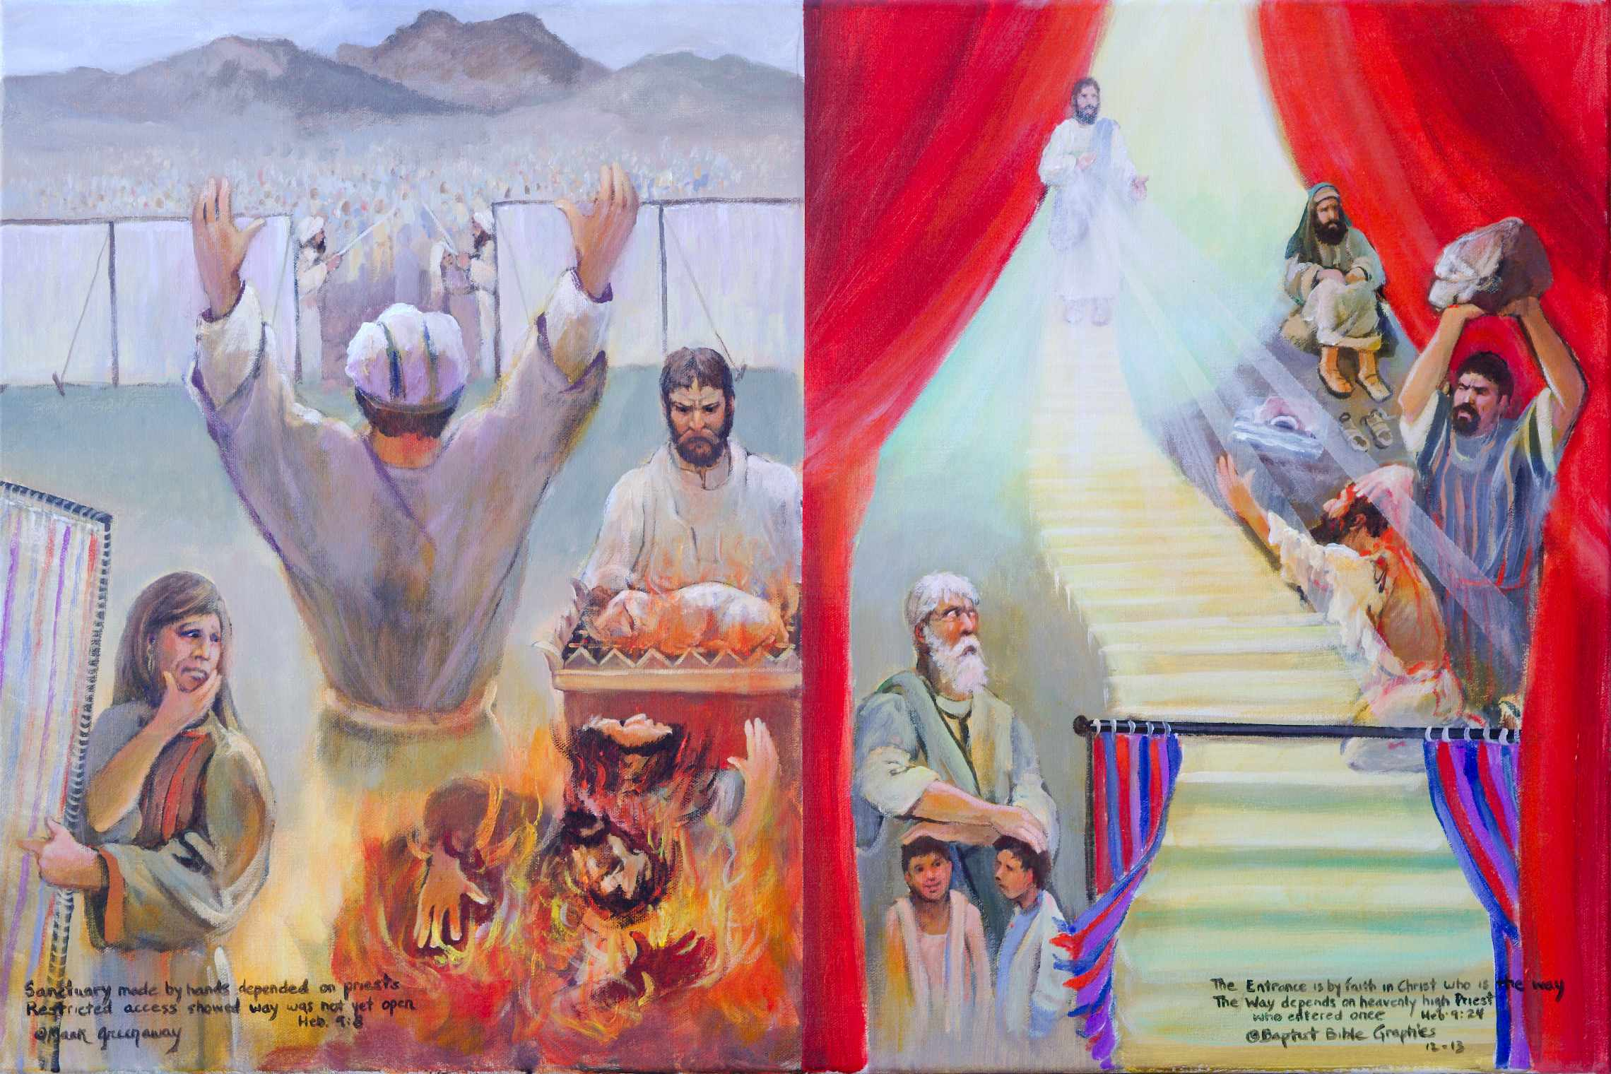
1. Based on Hebrews 9:8, 24. Hebrews repeatedly equated entrance into the holy place as admission into the very presence of God Heb 9:8, 12, 25. It depended on the faithfulness of the priest. Aaron with shoulders braced: He had the responsibility to enforce the regulations to make the whole system work. Jesus reaching out: He is at the head of the stairway because His work is finished. Behind the priest’s back: So much for God depending upon the faithfulness of the workers to accomplish His purpose. It was not God’s plan to make plain the way while the first tabernacle was still standing. In front of Christ: When Jesus came, God made plain the way. The veil is torn in two pieces leaving the stairway open for all who thirst to come into the holy place. Individual examples of workers who failed: The weaver is apprehensive, the Levite is out of it and the two sons of Aaron are on fire. Individual examples of living by faith: Before the Law, Jacob blessed his grandsons and worshipped Heb 11:23. Stephen saw the heavens open and Jesus standing when he was being stoned to death.
7. Saul, an individual who came to know Jesus: God made the way plain to Paul. He was one of the Sanhedrin who stoned Stephen to death. He is sitting, taking it all in. What he didn’t know was that God’s grace was taking hold of Him. He was not saved by a collective confession of faith but by individual trust in God. You can teach the gospel in your corner of the mission field daily facing opposition, refusing to give up, when your know that God’s grace is taking hold in the sinful heart of man! This picture is especially necessary for we who work hard ground. Therefore it was necessary that God disclose that Jesus of Nazareth is the better sacrifice that made the way plain to the heavenly holy place Jn 14:1-6; Heb 9:23-24.
2. Heb 9:8 The Old Covenant sanctuary was inferior because it was temporary. Aaron carried the weight of the Law on his shoulders. He has a hard time enforcing what is in front of him, besides what is taking place behind his back. The earthly tabernacle, that depended upon the faithfulness of the priests, was the best that God could do without sending His Son. The weakness of the tabernacle was that the priests were unable to obey all the regulations of the Law. The Law is holy and good. But sin, seizing the opportunity, took advantage of the Law Rom 7:8. Sin offered alternatives that were more attractive. They found it impossible to set their affections on things that were just temporary.
6. Stephen, an individual example of faithfulness: Stephen is on the stairway, because like Jacob, he saw heaven open. Stephen, whose face was like that of an angel, was full of the Holy Spirit when he fell on his knees. He cried out that the sin of his accusers not be held against them. Stephen is not shown kissing Jesus’ blood, like in the Sistine Chapel in Rome. I’ve been there where Martin Luther rose up against Rome’s doctrine of the priest’s abolition of sin. Like Stephen, we see Jesus only for forgiveness of sin.
3. Heb 9:11 The New Covenant sanctuary is superior because its ministry represents fulfillment. God in Christ Jesus made plain the way to the holy place. Jesus is pictured standing at the head of the stairs with His hands extended forward to the redeemed of Israel. Light is shining from Him unto all nations Gen 49:6. Entering the heavenly tabernacle depends upon the faithfulness of Jesus Christ. But sin also seizes the opportunity to deceive the sinner, even going so far as to kill Rom 7:11. My old nature is not eradicated. Oh wretched man that I am. Who can deliver me. I thank God that Jesus is able to deliver me Rom 7.
4. Individual examples of failure: The people were unable to fulfill all the regulations of the Law. Would the craftsmen follow exactly all the stipulations of the blueprint? Would the Levites over look the requirements of only offering a healthy animal? Would the priests burn only approved incense or offer up strange fire? The weaver is apprehensive, the Levite out of it and the two sons of Aaron are on fire. The Bible records that they repeatedly failed which left the people outside the camp to draw neigh to the holy place. So God didn’t intend the way to be made plain while the first tabernacle was still standing.
5, Jacob, an individual example of faithfulness: Why is Jacob in the picture? Because as a young man he saw the stairway leading into the holy place. And now as a blind old man, blessing Joseph’s two sons, he still saw the stairway open Heb 11:21. He leaned upon his staff and worshiped. It is not the placed were we worship but how we worship Jn 4:24. He had faith, my brother, faith in a faithful high priest, who is standing to receive Stephen at the top of the stairway Acts 7:56.

Slide 21
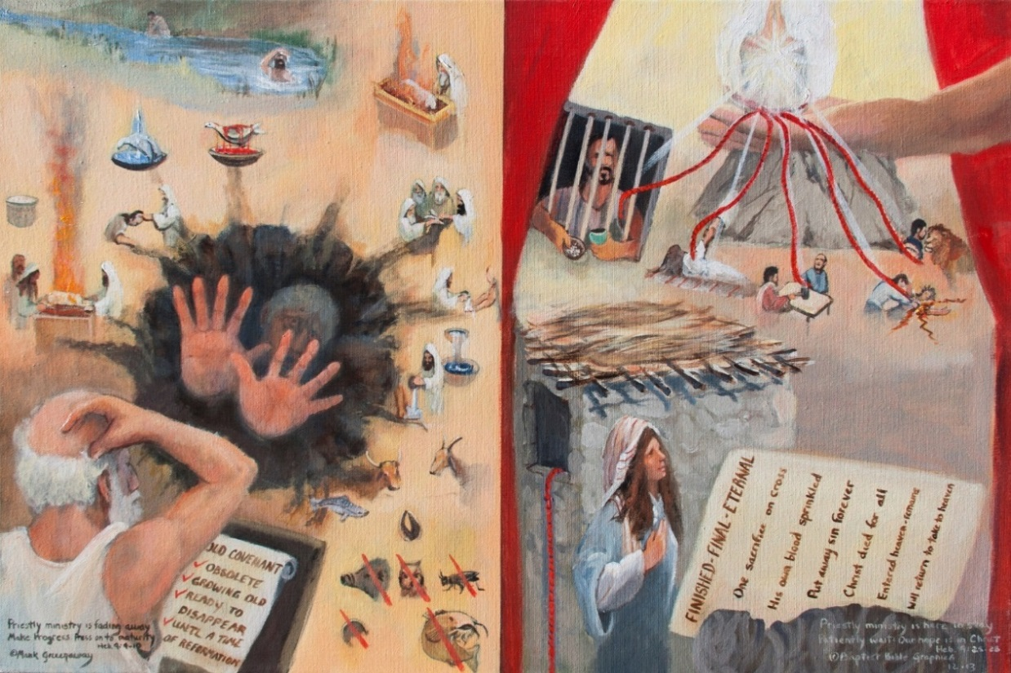
1. Based on Heb 9:9-10; 25-28. The offerings could not cleanse the conscience. A change was brought about by the completed sacrifice of Christ. Left side: The Old relied on blood, fire and water to purify Num 31:21-24, externals that could not make the conscience perfect. The tombstone records that the Old is obsolete. Right side: The New relies on Christ’s finished sacrifice. The final page records the internal change. Hand on head: Law keeping leaves little room to wiggle. The old man is scratching his head, trying to figure out why law keepers slip into the past. Food laws, ceremonial washings and animal sacrifice are too close to the edge to last very long. Hand on heart: Christ put away sin by the sacrifice of Himself which cleared the conscience and gave a new mind and heart. Water in slough: The time of reformation had come but the washings and sacrifices continued in the temple. External religion is shallow. Light on hill: To restore Jacob and be a light to the Gentiles, each a vessel of honor in the Master’s hand, being set free from the law of sin and of death Rom 8:2.
7. Light on a hill: The hand is on the far side because the New is not just the Old reaching forward. We are redeemed from the Law. Christ paid a price to buy us out of the grave the Old has been digging for all its adherents. The New Covenant is not just a new thread in an old garment, a new patch in an old wine skin. It was necessary that the New come to meet our inner most need, something the Law could never do. A crimson cord, a vital ray is reaching to Paul the prisoner, another to Peter’s mother-in-law sick with fever, another to Matthew the tax collector, another to the good Samaritan's neighbor, and another to all God’s children who are in the lion’s den of this world Heb 11:38. Look! The Potter is holding in His hand a vessel unto honor, fit for the Master’s use.
2. Heb 9:9-10 The Old sanctuary was inferior because its ministry was external, not internal. The dominate feature is a living death caused by blood, fire and water rituals that are used for external purification. The perplexed old man reading the tombstone is dumb founded. The Old Covenant has fulfilled its purpose. But why is the old man in the living death reaching upward? His clean external hands belie his unclean internal conscience. Externals are unable to cleanse the conscience. The composition is a symbol. While the earthly tabernacle is still standing, the external washings, sacrifices and burnt offerings made it impossible for the worshiper to press on to maturity, to make progress. An internal cleansing was needed.
6. River in a valley: The water is flowing, the baptisms and washings are wet. The temple was still standing in Jerusalem. You could here the calling of birds and animals brought for sacrifice. You could smell the fresh bread, festive foods are yummy. How can we leave the Old when the blessing upon the people depended upon the gifts and sacrifices of the earthly sanctuary Heb 9:9-10. Just doesn’t make sense. Now what? God has already explained to the Jews that Jesus also offered gifts and sacrifices which are superior to that of the Old Covenant Heb 8:3. And besides, the New Covenant is here to stay.
3. Heb 9:11 The New Covenant sanctuary is superior because its ministry is final and complete. A body in a grave is barely perceivable because bodily resurrection has shifted our attention to what is written. A Gentile woman has read the final page and understands what has happened in her heart. A light on a hill in His hand is reaching into our world giving direction. Jesus Christ’s finished sacrifice brought about a change in the conscience of the worshipers freeing them to worship in spirit and in truth wherever they are. Crimson cords extend from God’s hand. Rahab placed one from her window.
4. Hand on head The old man observes that Law keeping confines, leaves little room to wiggle. Kind of looks like the clean hands are signaling us to stay out, this is not the way. The true way to God is not by people and objects being purified by blood, fire or water, i.e., not by externals. You’ll die before that happens. Or using another symbol, you will die before you ever cross the finish line. Christ died to break sinners out of the grave, to break the tape, (now explaining the cords) to break out of the prison house, out of sickness, out of debt, out of legalism, out of this world. Rahab!
5. Hand on heart: Rahab was a women of ill repute, Gentile, prostitute, morally filthy. Neither her hands nor heart were clean. The Law keeping Jew had clean hands. But Rahab rrrsssss! (big laugh). By faith she hid the two spies the jail bird can see under the stocks of drying flax on her flat roof. And by grace she hung the crimson cord out her window for all Israel to see that the light unto the Gentiles is none other than Jesus of Nazareth, the I AM, the Messiah. Since the beginning, all who come to God by looking, live. Know the Person and you know the way, the truth and life!

Slide 22
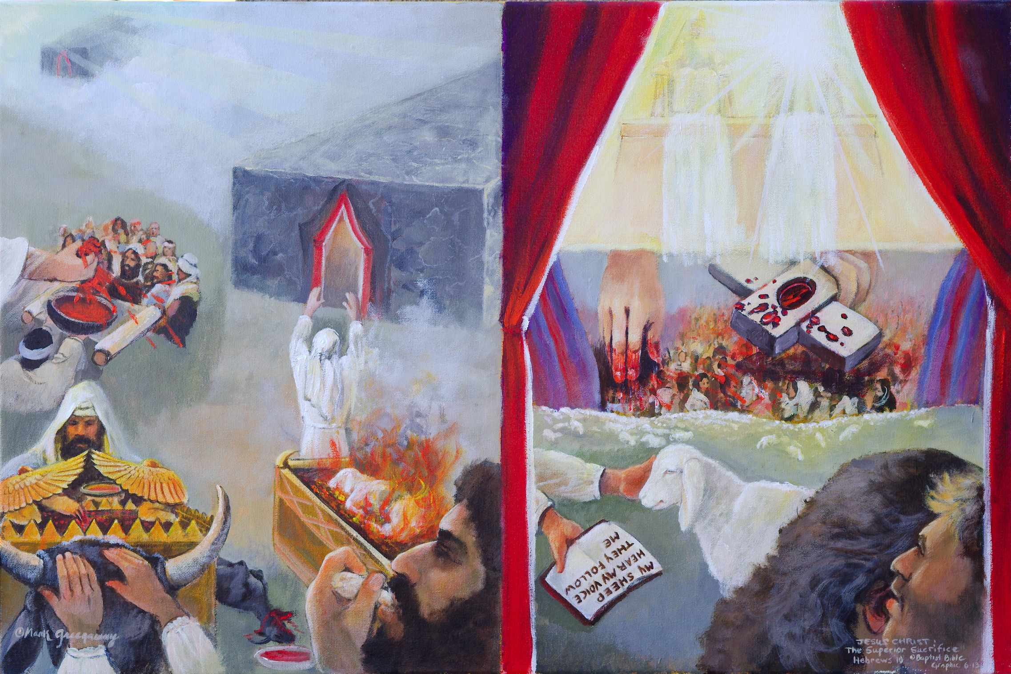
1. Based on Heb 10:1-18. On the left is the earthly sanctuary, on the right the heavenly. This picture is the last one illustrating the expository unit that began in Hebrews 7:1; BKC. Thus there is a red veil permanently open, here and in five previous pictures. Our high priest’s ministry in heaven is superior to the Aaronic earthly ministry Heb 9:1-10:18. For the Law Heb 10:1, The author states that Hebrews 10:1-18 is a summary of chapter 9. The many sacrifices of the earthly tabernacle are an outward expression of the sacrifice of a contrite heart Ps 51:17. Once for all Heb 10:10, Jesus Christ in His superior sacrifice did the Father’s will. We have been sanctified, set apart to worship God by faith. Cain and Abel talking: The first one who worshiped by faith was Abel Heb 11:4. We picture Cain turned away from seeing the Lamb of God. But Abel by faith sees the Lamb and believes the Word. And every priest Heb 10:11, Sacrifice in the earthly tabernacle was repeated in many scenarios. He sat down Heb 10:12, Christ’s sacrifice was never repeated Heb 10:12-18.
7. The dark foreboding closed tabernacle vs the bright inviting open way to God. Four layers covered the tabernacle seen in the doorway: white linen, matted goat hair, sheep skin, and sea cow leather. These veils was designed to conceal. But the heavenly sanctuary is designed to reveal that the only way is Jesus. The picture is designed to reveal that if you miss the way of the cross, there is no other sacrifice for sins Heb 10:26. No one goes to heaven without going through the veil of His flesh Heb 10:19-20. We have to keep this truth in mind as we go to the following faith narrative.
2. Heb 10:1-4 For the Law: Though a shadow, the tabernacle served the purpose that God intended. Lower right: Looking over the ministry is a worshiper eating unleavened bread. He, like all those who worshiped in the desert, had eaten the Passover. He sees Moses, the Levites and the priests but he is not allowed inside the tabernacle. His sacrifice is a broken spirit Ps 51:17. Center left: By faith Moses inaugurated the Law by blood. Right: By faith the Levite turns to God in the daily sacrifices. Lower left: By faith Aaron and his sons placee their hands on the head of a bull then sprinkle the blood on the mercy seat on the Day of Atonement. The blood could never make perfect the worshiper Heb 10:1-4. No sacrifice was final, they always had to be repeated Heb 10:11. So the picture emphasizes the drab color of the sea cow skins over the tabernacle vs the glory of heaven.
6. Jesus sitting at the right hand of God, Heb 10:12-13: What constant sacrifices of thousands of animals in a thousand years could not accomplish, Christ accomplished with once sacrifice forever. The fact that Jesus sat down after He had ascended to the Father in heaven is proof that His work was completed Heb 1:3, 13; 8:1. In the composition, the cross is between the earth and heaven. He is the mediator who applies what He set out to do. Many will be sprinkled or they would never believe for the salvation of their souls. His grace is efficacious. God accomplishes his intended purpose against stubborn wills, blinded minds and hardened hearts.
3. Heb 10:5-10 Once for all, center right: Perfection had to await the inauguration of the New Covenant Heb 10:5-10. Jesus of Nazareth did the will of God in becoming the sacrifice for sin once for all Heb 7:27; 9:12. He is able to sprinkle many people as a priest does in order to purity them Isa 52:15; 1 Pet 1:2. The Holy Spirit bears witness applying the sacrifice to the many who come to him by faith. Our picture features a herd of sheep feeding in green pasture. His sheep have been sanctified, set apart for guilt-free service to God Heb 2:11. One by one the sheep hear his voice and come to Him Heb 11:6. The first one who came by faith was Abel Heb 11:4.
4. Cain and Abel talking, lower right: The Holy Spirit placed Abel as the first one in a long list of those who came to God by faith Heb 11:4. Both brothers knew God’s will but only Abel offered his sacrifice by faith. Abel is shown speaking in Cain’s ear. Cain has turned his back on God. But Abel is facing God. Though long dead, he still speaks: Look unto me and be ye saved all the ends of the earth Isa 44:22.
5. And every priest, Heb 10:11. The Levitical priests could never sit down while they worked because their mission was never done. There sacrificial ministry was never completed. The furniture in the tabernacle did not include a chair. Besides, they offered the same sacrifices day after day. Nothing really varied from year to year. The constant repetition was proof that their sacrifices did not take away sin.

Slide 23
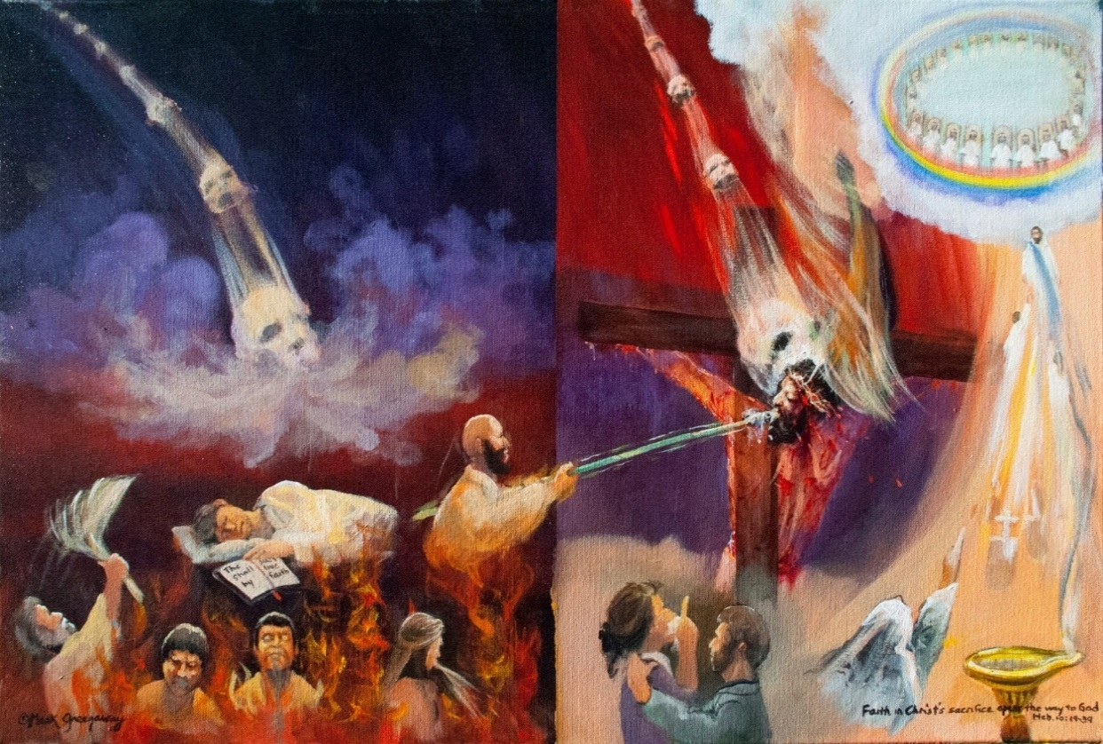
1. Based on Heb 10:19-31 A warning to live by faith and not misapply Christ’s sacrifice for sin. Right, flesh tones: No one enters the holy place without going through the veil of His flesh Heb 10:19-20. A hand holding hyssop dipped in blood is striking the Savior Ex 12:22; Jn 1:29; 1 Cor 5:7. Christian and Christiana are near the cross, entering through the veil of His flesh. Right, Great Priest: Jesus is the new and living way to God. Let us draw near to Calvary, a fountain laver that never has to be refilled Zech 13:1. Why the striking skull? To strike the Shepherd means to be taken in death Isa 53:9; Zech 13:7. In death Christ took the blow due the sinner giving the believer life eternal Jn 10:28. Death is striking both sides. If Christ is not your Savior, then death will strike you. Wake up or you’ll burn, burn, burn in a raging fire Heb 10:27. Trusted friends betray Him Ps 41:6, No Faith strikes bloodless hyssop in shame. No Hope can’t stand the New Covenant. No Love poke fun at the atonement, unable to stomach the one sacrifice for sin. But the just who live by faith are rewarded.
6. But the just who live by faith are rewarded: Your confidence has great reward Heb 10:35. Repentance is inseparable from cleansing. The cleansing from sin Zech 13:1, follows the mourning of those who look on Him whom they have pierced Zech 12:9. No one is left out who has entered through the veil of His flesh, illustrated by the ring of unending love and eternal reward. The harsh sounds of warning are past, changed to onomatopoeic sounds of comfort and encouragement Isa 40. Fiery judgment against Christians who would insult the Spirit of grace is changed to trusting God in the next picture.
2. Right side, flesh color: Tabernacle imagery is describes the veil of His flesh Heb 10:19-20. No one enters the holy place without going through the veil of His flesh. Christ’s body has removed the barrier giving believers access to the route to God. It was a dark day when Jesus died on the cross, receiving the blow due the sinner Isa 53:8. The connection to the Passover lamb is illustrated by a hand holding and striking the Redeemer, Ex 12:22. Faith is illustrated by Christian and Christiana standing near the cross which is superimposed over Christ’s flesh. The suddenness and certainty of death is illustrated by multiple skulls. God promised to meet the people for an appointed meeting, Ex 25:22, TWOT 878. God keeps his appointments, Gal 4:4. But the people didn’t always show up because sin separates from God, Amos 3:3. Three have kept God’s appointment at the foot of the cross, but twice their number, across the way, could care less.
5. Trusted friends shrinking back to destruction, Wavering in faith vs 22, love vs 23 and hope vs 24, they don’t draw near Heb 10:38. No Faith is farthest away with his bloodless hyssop, like Cain, closing church doors! The No Hope triology is asleep; is wavering, walking away from their confession of hope, blind to Christ’s coming. Sleep on! Burn baby, you have no future! Mr. and Mrs. No Love do not stimulate one another to love and good deeds. Rather they poke fun at the Son of God, treating as unholy the blood of the covenant and spewing out of their mouths the Spirit of grace. Living by faith is farthest from their minds. The composition depicts group isolation, loneliness in a crowd, shrinking back from each other, not in the habit of assembling together. Each of the six are doing their own thing. Am I my brother’s keeper? Hell is not in the picture. This is not the Lake of Fire. It’s what you have if you reject the one sacrifice for sin. If you think Mosaic justice was harsh, think again Heb 10:28-29. It’s terrifying when grace is rejected Rom 2:5; Heb 10:31. Faith, hope and love are three witnesses who will testify against you when you have your day in God’s court Heb 10:28.
3. Right, Great Priest: The tabernacle imagery is used to describe Jesus as the new and living way Heb 10:19-20. The red veil in the previous six pictures is the veil of His flesh through which the just enter the heavenly sanctuary. Calvary is a fountain laver now opened for the salvation of all living, especially at the return of Christ Zech 13:1. Ah, above is the circle unbroken, all saints in white who were washed in the blood of the Lamb. Faith, hope and love are united. Let us draw near, let us hold fast and let us consider that if we go on sinning willfully, there is no other sacrifice that cleanses from sin,
4. Skull striking: To strike the Shepherd Zech 13:7, and to be taken away means to be taken in death. Christ took the blow due the sinner, actions done by God the Father Isa 53:8 BKC; Baron, Rays 109. You will take the hit if you reject God’s one sacrifice for sin. Death will come fast, terrifying your soul. What seems so distant will suddenly fall upon you, illustrated by the multiple skulls. The loss is great for those who misapply Christ’s sacrifice for sin Heb 10:26-31. There is nothing to shield a renegade from God’s judgment by raging fire, divine retribution.

Slide 24
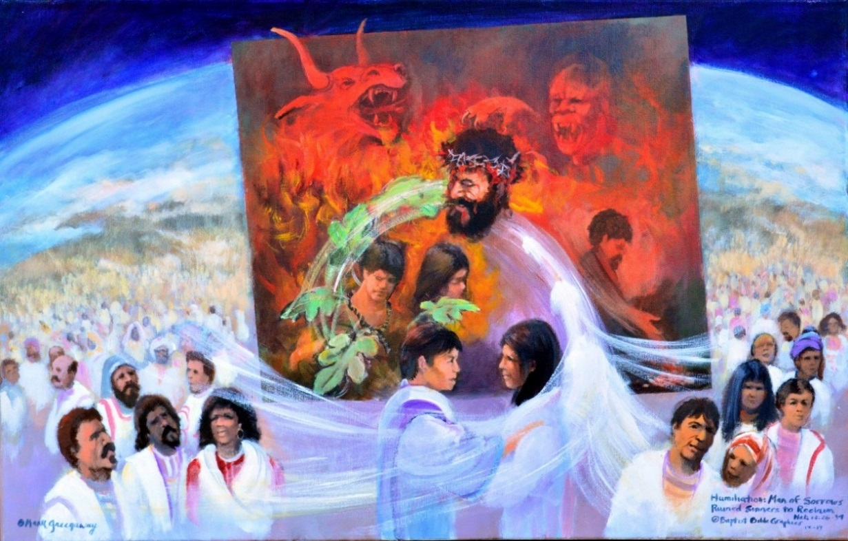
1. Based on Heb 10:19-11:1, Consider your High Priest and His sacrifice and live by faith Heb 7:1-10:19. Reckless faith will be judged by fire Heb 10:19-31. Despite suffering, be encouraged, a pattern in Ps 22 and Heb 2:10-12; suffering Ps 22:1-21b, then gratitude and consolation Ps 21c-31. A square framed in a circle, Our existence finds meaning in His existence Heb 12:3. Believers from all the world are learning what faith is by trusting Christ. He suffered when Satan’s plans ran adverse to God’s purpose Ps 22:11-21. The red depicts the rage of wild beasts, not flames. He shall bear their sorrows: Those who sneered at Him said he trusted in the LORD Ps 22:8, literally, he rolled His trust on God, TWOT #353. Learning from His sufferings, he became the source of eternal salvation Heb 5:7-9. Fig leaves: Adam and Eve trusted in God’s provision to cover their bodies. They rolled their cares upon the Man of Sorrows, 1 Pet 2:24; Ps 37:5-6, Delitzsch; 1 Pet 5:7. Wave: Faith is reliance, Ryrie, Basic, 377. Adam and Eve stand dressed in a righteousness not their own, their trust rolled upon the Lord. The justified of all ages join them. Faith gives reality and proof of things unseen. The picture sets the stage for Hebrews 11.
6. Have faith Heb 10:39. The events of faith are historical, taking place in our real world Heb 11. The Bible rejects modern philosophy that faith takes place as existential superhistory, Whitcomb The World that Perished 95-139. Faith involves our intellect, affections and will, our entire being, Ryrie, Basic Theology 378. Faith is active, as in each of the faith narratives in Hebrews, Faith means belief, confidence, trust or persuasion. Dillow, Reign of the Servant Kings, xiii-xiv; 7ff; 271ff. Exposition and faith merge in Hebrews 11.
2. Square in a circle: How do you picture faith? Faith is trust, belief, or persuasion, the reality and proof of things unseen. Pictured is Christ accepting unseen things as seen rather than as hope Heb 11:1. In the box with Christ is Adam and Eve rolling their cares upon the LORD. The opposite of faith is constant agitation, crises and rage. Behind Christ is Cain and the wild beasts Ps 22:11-18, doing Satan’s will, raging against the Man of Sorrows. But Christ had turned to the LORD and drew His confidence from his training as a child Ps 22:9-10. Powerful beasts struck His heel. Notice that his enemies are not making headway, they’re not going any place. Though raging, they’re stymied, not getting out of their box. Only Adam and Eve are getting out. Their faith is revealed in their trust, not in their obedience. Their faith is active, they are pictured out of the box, dressed in a righteousness not their own.
5. Cleansing wave Heb 10:37-39. Adam and Eve stand in the foreground with the justified of all ages, clothed in the righteousness of God. In Romans the sinner is justified by faith, ruined sinners to reclaim. His trust in the Savior is the basis for removing sin and its accompanying vises. Without salvation, life’s problems can never be permanently solved. In Hebrews, the saint is justified by faith. His daily trust is an outworking of holy living, sanctification. No where in Hebrews or in the Bible is there a professional elite of counselors that by definition make the untrained Christian unable to effectively counsel. The Bible and the Spirit of grace meets all our needs for comfort and encouragement..
3. He shall bear their sorrows: The square is adversity, the circle perfection. Christ is lifted above his foes, their rage against his body Ps 22:7; Heb 10:5, is laughably pathetic even in His weakest moment Ps 2:4. He suffered at the hands of cruel men and insensitive wild beasts, like powerful oxen and lions, scavenger dogs Ps 22:11, His enemies mockingly mimicked his not being heard by the Father. Our fathers trusted and you delivered them, but not me, a worm, helpless and frail. In sneering mockery they accused him of trusting in the LORD Ps 22:7-8, literally, rolling His cares upon the LORD, TWOT #353; Ps 37:5 Delitzsch. A rolling trust is the unifying feature in our design, uniting the circle of believers with Christ in the square. In the end, Christ was heard by the Father Ps 22:21 BKC. And his brethren Heb 10:19, trust in Him and are heard. Faith is as strong as the object of our faith. It’s not how big my faith is but how big my God is. This picture is designed to lay the foundation for God’s Hall of Faith Heb 11. All the people from Abel to Abram us, have our faith rolled upon Christ, such shoulders to lean on!
4. Fig leaves: The Man of Sorrow’s sacrifice on the cross provided for cleansing and forgiveness, past, present and future. To Adam and Eve God provided clothes made out of the skins of clean animals. Adam and Eve trusted God, removed the covering made with their own hands and clothed themselves with God’s garments. He’s bearing their sin and they are rolling their trust upon God. In the square, right front is another sinner, Cain, rolling his luck upon the altar of his own making. All he has to show for his actions is premediated murder. Now faith is the assurance of things hoped for, the evidence of things not seen Heb 11:1. By faith Abel… Heb 11:4.

Slide 25
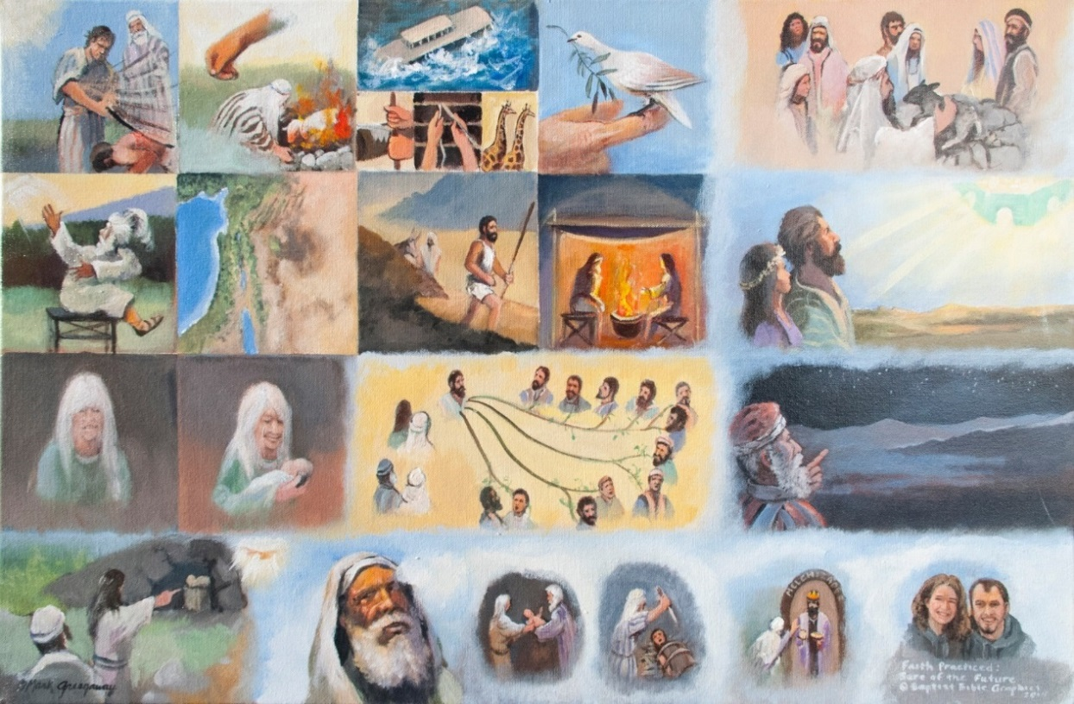
1. Based on Heb 11:1-16. Second of five pictures illustrating faith, here the certainty of a future. The parallelism is lineal, left to right, top to bottom, based on the Ascent Psalms 120-134, Delitzsch p 267, each testimony moving onward toward a climax, Jesus Christ, the object of faith. Faith fixes purpose in life as opposed to the fatalistic doubt of Kantian dialectic loop around. Men of faith are fulfilling God’s will, living fruitful lives and living God’s call. How did each father respond to God’s call? First line, Heb 11:1-7. Abel: the way of faith; Enoch: the walk of faith; Noah: the work and worship of faith. Second line, Heb 11:8-10. God’s call made the difference for Abraham, thus his position on the stool and their upward look. Third Line, Heb 11:11-12. Sarah holding her promised son, the 12 tribes and counting the stars. Fourth line, Heb 11:13-16. The pictures run together to reflect the change from by faith to in faith, that which was hoped for is now a present possession in Jesus Christ. The certainty of a future in Christ is ours as well, thus we end with a current living example.
6. Abel represents the righteous man referred to in Heb 10:38. We don’t know how Cain killed him. But we picture him being the first of many who were beaten to death because of their faith. At the end of God’s Hall of Faith men are still being hammered for their faith while the death drum continues to toll. Millennia later the beatings are still going on but men of faith, dressed in a righteousness not their own, lift their hand to God the keeper of their souls. They run with patience the race set before them, looking unto Jesus, the pioneer who opened the way of faith and finished the course. He sat down putting all enemies under his feet. Victory in Jesus!
2. First Line, The certainty of the future. Heb 11:4-7: Abel, Enoch and Noah are three fathers who gained approval before God. Abel: Cain is beating Abel to death yet Abel is still standing tall. He being dead still speaks. Cain succeeded in extinguishing his life but his testimony lives on. Enoch: He pleased God. Shown is a substitute lamb which died instead of Enoch. A hand is calling him home without dying. Noah: He built an ark that saved his family. Faith also saved the animals and brought home a promise, a dove holding an olive branch, title deed to the rainbow in the sky. Men of faith are grateful to God, Noah is sacrificing clean animals with his family. Noah’s personal faith was fruitful in his family. He became an heir of the righteousness which is by faith. Their future is certain because their faith is in God.
5. Fourth Line: Empty tomb, Heb 11:13-16. The text changes from by faith to in faith. That which was hoped for is now a present possession in Jesus Christ. The had no longing to go back to the old way of life, to leave the faith. Faith became a way of life. Abraham determined, looking forward: A pilgrim in faith is not at home in this world. Abraham and Sarah holding baby Isaac: They named him laughter. Laughter and gladness make for good company in faith. Isaac on the altar: A faith that can not be tested is not worth trusting. Melchizedek and Abraham; What more can we say, in faith Abraham saw the priesthood of Christ. Couple today: God is a rewarded of those who diligently seek him.
3. Second Line: Abraham, Heb 11:8-10. Called by God: He started his journey of faith by listening to God. He is shown jolted around because his father worshiped idols. Talk about a kid who didn’t have a chance to live a life of faith. Promised Land: The inheritance of his descendants by Isaac and Jacob. Ishmael has not part. Walking: He became a wanderer, not really knowing where he was going but he followed God by faith one step at a time. Dwelling in tents: He didn’t put down roots in this old world. Looking for the city: There is more to life than this terra firma. Abraham and Sarah see their faith rewarded in a heavenly city. Our present experience is a pilgrimage.
4. Third Line: Sarah, Heb 11:11, Poor Sarah, no child and past the age to bare children, but a burning faith drove her onward to a bright future Isa 51. Sarah holding Isaac: She overlooked her physical limitation to become a fruitful mother. The best medicine for being down in the dumps is laughter, and that is what Sarah named her son. Abraham, Isaac, Jacob and the twelve sons: By faith she looked ahead to her own descendants, the tribes of Israel. The four lines represent the four wives of Jacob: Lia six sons, Zilpah, Bilhah and Rachael each two sons. Abraham counting stars: From twelve tribes to being numerous like the stars of heaven. Faith turned her gloom into a bright future was rolled upon the shoulders of Christ Jn 8:56.

Slide 26
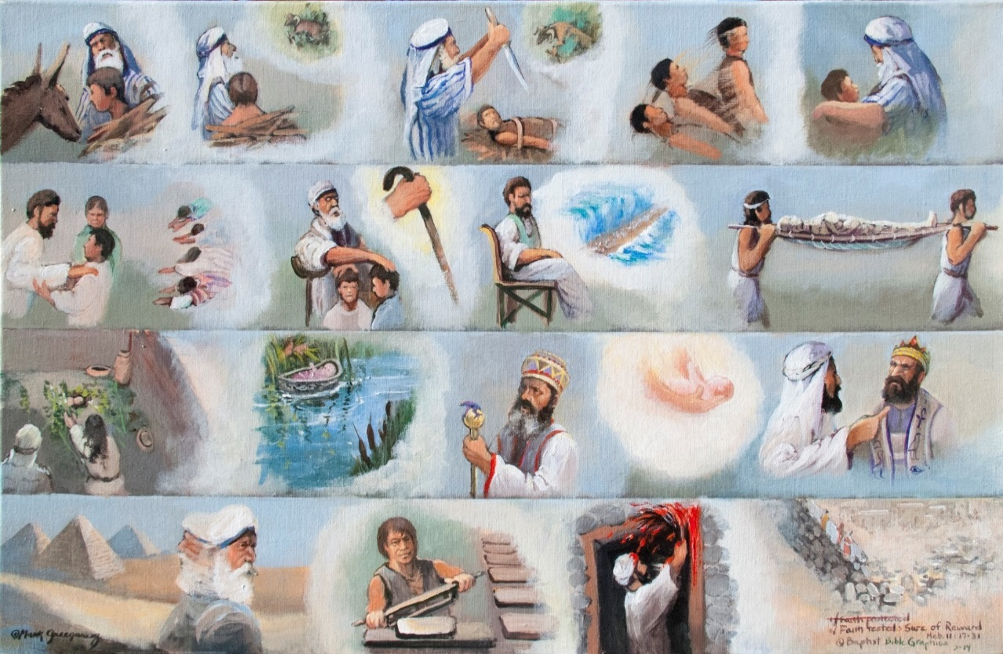
1. Based on Heb 11:17-31. Third of five pictures illustrating faith, here the certainty of reward. The parallelism is lineal, the next scene reinforcing the certainty of reward, faith leading the righteous forward, as opposed to just drifting thru life, concepts which come from the Ascent Psalms 120-134. Each year by faith they traveled up toward a climax, the sanctuary in Jerusalem. Our journey of faith is being led by Jesus Christ, the pioneer who blazed the trail in the wilderness of this world. He was rewarded and so are we. First Line Heb 11:17-19. Testing Abraham’s faith on Mt Moriah resulted his sure reward. Second Line, Heb 11:20-22, Isaac, Jacob, Joseph, co-heirs with Abraham, ATR. When faith is practiced the object of faith comes within reach. Third Line, Heb 11:23-26, Amram and Jochebed Ex 6:20, and son Moses, faith confronting death is rewarded with life. Fourth Line, Heb 11:27-31, by faith Moses turned his back on Egypt, identified with slaves making bricks and kept the Passover. By faith Rahab waited 39 years in Jericho and was rewarded with life in the Land of Israel.
2. First Line: Abraham Heb 11:17-19. The best way to grow in faith is to walk with the faithful. So the author returns to the life of Abraham on Mt Moriah when he was asked by God to offer up his son of promise. He not only had a bright future, he had a present reward. Donkey: He said to the men guarding the animals and supplies at the base of the mountain that they would return, I and my son Isaac. Isaac carrying the wood: Asking, where’s the sacrifice? God will provide a lamb. Bound on the altar: At the moment of death, faith allowed Abraham to see a bright future for his son and thus a present reward, resurrection. A substitute ram spared his son. Isaac would be resurrected: Believing that, if slain, Isaac would be raised to life is the reward of living by faith. Father and son arm in arm: Both were certain of their reward together.
5. Fourth Line, Heb 11:27-31. Moses in Egypt: He turned his back on the riches of Egypt, popularity, wealth, social prestige. Making bricks: He chose to suffer with the people of God. Passover: He kept the Passover and God gave them freedom from slavery and Egypt for good. What a reward! Rahab and her family on Jericho’s wall: Rahab welcomed the spies and saved her life as well. Jericho’s walls crumbled but not where her house stood. What a reward when your enemies are destroyed and your friends are saved.
3. Second Line, Heb 11:20-22. Isaac blessing his twin boys: The prospector for water also saw a prospective reward for Jacob and Esau for things to come. Bowing down: Four men on their knees, the reward of the nations would be to bow down to his Descendent. Jacob crossing his arms: Despite Joseph placing the older son at his right side, old Jacob crossed his arms to bring a greater reward to the younger son. Staff: Jacob leaned upon his staff, a symbol of being dependent on God for his reward. Joseph: He was rewarded with a long life and a sharp mind. By faith he saw the crossing of the Red Sea and that the future for the nation of Israel was not in Egypt. Carrying Joseph’s mummified bones: Joseph was rewarded by being buried in the land of his fathers. They carried his bones for forty years.
4. Third Line, Heb 11:23-26. Moses’ father and mother: They saw their son through the eyes of faith. He was a level headed man, beautiful in his disposition and refined in his manners. First they hid Moses three months, maybe in a hole in the floor. Floating in the river: Behind is his sister keeping an eye on him. Stern Pharaoh: The law is the law, Moses must die, but Amram and Jochebed where not afraid of Pharaoh’s death edict. Baby Moses handed back to his father and mother: They had just a few fleeting years to instill within their boy the fear of the LORD. Children are a gift from God on loan to father and mother. Moses confronting Pharaoh: Amram and Jochebed were rewarded when their son was not afraid of Pharaoh 40 years later. If he would have gone along with Pharaoh, his popularity would have been short lived in Egypt

Slide 27
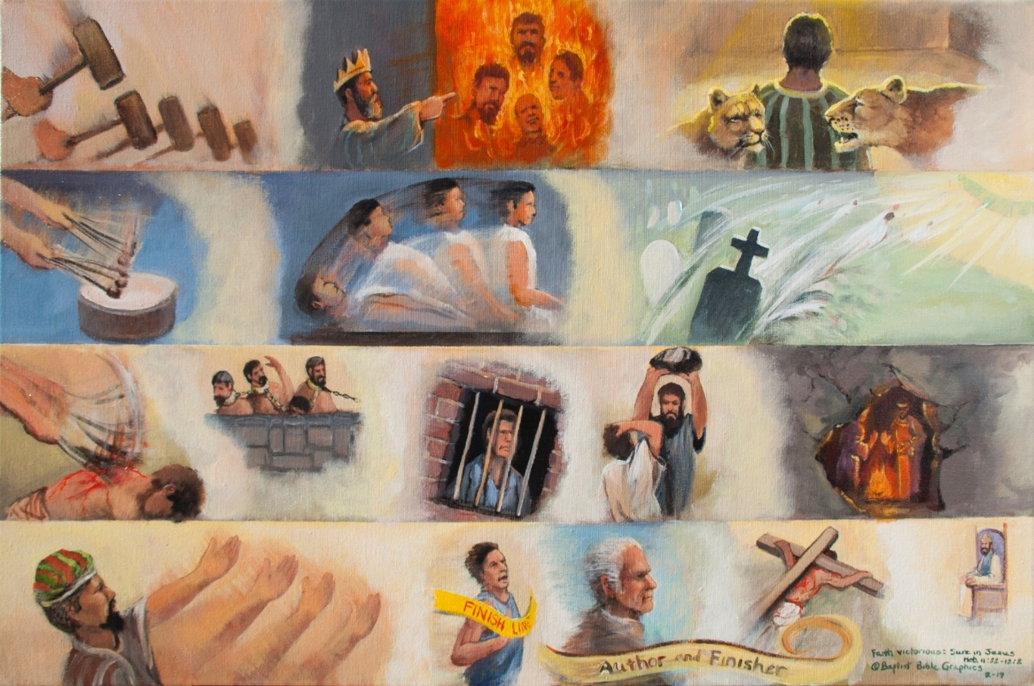
1. Based on Heb 11:32-12:2. Fourth of five pictures illustrating faith, here the certainty of victory. The parallelism is lineal, each scene reinforcing the certainty of victory. First Line, Heb 11:32-34. Opposition is intense, men of faith are being hammered, ATR. Second Line, Heb 11:35, faith overcomes the drum beat of death in temporary resurrection when women received back their dead and in the better resurrection to life everlasting. Third Line, Heb 11:36-38, Others, it takes more faith to endure whippings than to escape by death, a transition from faith’s triumphs to what appears as defeat. Fourth Line, Heb 11:39-12:3. No matter your circumstance, those who live by faith are winners because Jesus is a winner. What made Jesus a winner is that he knew he would come out of the grave alive, He would walk out of the tomb Ps 16:11. He knew he would be exalted to glory Ps 110:1-4. He knew he would complete His Father’s will Acts 2:34-36. He knew he would have the joy of presenting to His Father the redeemed Jude 24.
6. The certainty of victory in Christ is ours as well, thus we end with a current living example for our children, Listen My Children: God Has Spoken. Our children should grow up making men and women of faith their heroes, not sleazy politicians, immoral movie stars or the wicked of this world.
2. Hammered, Heb 11:32-34. Hammers: Rapidly nine categories of witnesses are pounded. There are too many heroes of faith to mention them all by name. What a victory of faith that doesn’t let death defeat it. They stood by faith against kings, defied the armies of the heathen, one with God is a majority. Fiery furnace, Dan 3:23-28. Lion’s den: Faith rendered the teeth and claws useless. Whatever your individual experience, be assured that faith puts us in Christ who is victorious.
5. Fourth Line, Heb 11:39-12:3. Hand repeatedly reaching forward: Faith connects our weakness to God’s strength. Crossing the finish line: Looking unto Jesus is a lifelong discipline of living by faith, not just a single look. I’ve added personal touches to the faith narratives, even here, as God’s Hall of Faith doesn’t end with chapter 11. We’ve interpreted the faith narratives with personal touches as an incentive to holy living, Heb 12:14. Thus I’ve added personal touches: a fishing pole, 2:1-4; our family in 3:7- 4:16; the teacher is my gross papa Abraham Claassen, 5:11-6:20; church planting, 10:32-39; and breaking the tape in Heb 11. I have fought the good fight, I have finished the race, I have kept the faith. On Throne: He carried His cross with His face set like a flint to the throne where he sat down, mission completed.
3. Second Line, Heb 11:35. Drum beat: Death takes its toll. The enemy is determined. Child being resurrected: What a climax to the victory of faith when women received their dead back to life again, 1 Ki 17:17-24; 2 Kin 4:17-37. But all these died again. Glorious resurrection: There’s a better resurrection, the resurrection of all who are victorious over the grave. By faith we claim part of the better resurrection where we never more die.
4. Third Line Heb 11:36-38. Whippings: The others are those who suffer, when it takes more faith to endure than to escape death. Chained: What keeps them going? Faith! Why don’t they give up? Faith! Jailed: False charges leveled against them, isolation, starvation, or worse. Stoned to death: Painful to be pelted to death, racking the body, jeering the soul. He’s clothed in goat skins, just eking out a bare existence, and then this. Living in caves: The author mentions a whole cross section of afflicted, destitute, ill treated men and women of faith, of whom the world was not worthy.

Slide 28
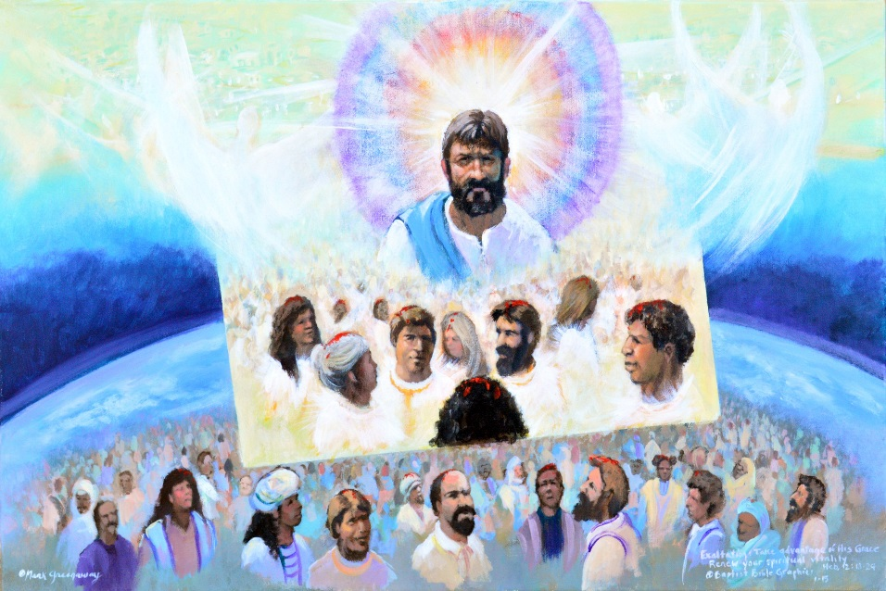
1. Based on Heb 12:3-4. The last of five pictures illustrating faith. The parallelism is not side by side but one over the top of another treating the future as present and the invisible as seen by the redeemed of all ages. Faith is reliance upon Jesus Christ who is known to be trustworthy. Faith realized: Christ is seated at the right hand of the Majesty on high Heb 1:3. His enduring such contradiction of sinners introduces God’s Hall of Faith Heb 10:32-39. The three pictures-in-one illustrating Hebrews 11 ends with Christ sitting at the right hand of God Heb 12:2. He is exalted Acts 5:31. Look to the author: He is the pioneer of personal faith. Instead of wearing the crown of thorns, he is wearing the blue sash associated with priesthood. Instead of his enemies surrounding Him, the glory of the LORD surrounds Him. Near at hand are blood-washed sinners, His church. Look to the finisher: Looking to Him will renew your spiritual vitality. He perfected the way of faith since he reached its end successfully. He keeps His eye on the joy set before Him. The oil of gladness rests on those who come to Him from the whole earth. Come join the triumphal procession of blood-washed sinners saved by grace thru faith.
2. Faith realized, a complete bow around Christ: Christians live in a God centered world. Jesus is the author and finisher, the pioneer and perfecter. Blood-washed sinners comprise His inner circle, complete in Christ, at peace with God. This is true progress. In contrast the worldling lives in a crisis centered earth. No progress is being made if there isn’t conflict on every side. Nothing is stable, all is loop around dialectical materialism. Change is the watch word. In the first of the five pictures illustrating faith, the power of darkness is pictured as rage Ps 22. Here the power of darkness engulfs the earth to keep the light from shinning, Heb 12:1, sin encircles. Notice in the picture that the power of darkness has engulfed the world. But by God’s grace blood-washed sinners are coming to the Light. Red in a rainbow is closest to the light. They walk in the light as He is in the light, in fellowship with God. Faith is being realized.
5. The five pictures illustrating faith need to be viewed as a single unit. First, it’s the Man of Sorrows surrounded by His enemies. Our enemies are your enemies, so when we’re in danger, you’re in danger. Now it’s the finisher, the One who perfected the way of faith opening His presence to His saints in the Beloved. Between these two positions are the Men of Faith Heb 11, who have rolled their trust upon Jesus even as He rolled His trust upon God Ps 22. We are in the world but not of the world. The overall thrust of the five reinforce the presence of God with His people and the difference it makes when we trust Him in the changes and difficulties of life, Ps 46, Wiersbe.
3. Jesus the author, opened the way for sinners coming to the light: Jesus was described as the Captain, Author, of a loyal band of believers whom God is preparing for glory Heb 2:10. Jesus forged the way out of darkness to light. He is qualified to be the Leader of man’s salvation. Christ is not wearing the crown of thorns but the blue sash associated with priesthood. The crucifix is past, redemption is completed. Christ is exercising his role as high priest in bringing many sons to glory. This is the intended thrust of the picture, showing people from every nation being brought by Jesus to the light. We are not picturing the corporate faith of a covenant people, like it’s the faith of the whole church that counts. Like the church exercises faith every day just like the church believes every day. No, He pioneered the path of faith that Christians should individually follow.
4. Jesus is the finisher of faith: He perfected the way of faith since He reached its end successfully. So in the previous picture, He broke the tape. Now God sees us in Christ and declares that we broke the tape as well. Gathered around Him are pilgrims who are in the Beloved Eph 1:6. We can not make ourselves acceptable to God. But He, by God’s grace makes us acceptable in Christ. This eternal position is freely bestowed on us in the Beloved. Another way of explaining our picture is that He has be-graced us in the Beloved. Because of God’s grace in Christ, we are accepted before Him. Faith results in everyday consequences, our spiritual vitality is renewed Rom 12:1. And be not conformed to this world Rom 12:2. His companions are those in the inner circle of the picture who are proving the good and acceptable and perfect will of God.

Slide 29
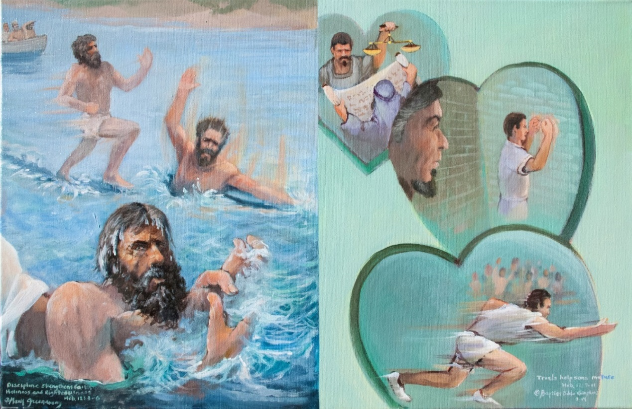
1. Based on Heb 12:1-13. Jesus Christ is pioneer who opened the way to faith. Trials strengthen faith, Heb 12:3-4. Peter walking, sinking and trusting, his faith strengthened, secure in the outstretched arm of God. Remember, Satan wanted to sift him like wheat. In like manner chastening doesn’t seem profitable to the recipient but afterwards it yields the peaceable fruit of righteousness. Child training is an exercise that flows from the father’s heart to the son’s heart. Top heart, Chastening is an evidence of the father’s love, Heb 12:5-7. The father corrects his son with justice by the Bible; the son with a scales, the father with a scroll. Middle heart, Lack of discipline is evidence of being illegitimate, Heb 12:8. A father chastens only his own son. If you don’t receive discipline, then you are not his son but a bastard. There is a disconnect thru the middle of the heart, the kid getting his own way. Bottom heart, Discipline trains the heart to stay focused, Heb 12:9-13. A disciplined life calls for hard training to perfect skill to reach the joy set before him. There’s no doubt, the runner has his eye on the goal.
6. Bottom heart, Discipline trains the heart to stay focused, Heb 12:9-13. A disciplined life calls for hard training to perfect the skill needed to reach the joy set before him. He is convinced that he is doing God’s will. Never mind the crowd behind him. His face is set like a flint Isa 50:7. He’s reaching toward the prize of the high calling of God in Christ Jesus. What a contrast to the undisciplined James Dean East of Eden pounding sand in the middle heart; my father doesn’t understand me. Let the judge and the jury make hurl their comments as Faithful travels a straight path through Vanity Fair. We buy the truth! Behind him jeer the same mixed multitude of Moses’ day, still hanging around to hinder Christian in his pilgrimage, Ex 12:38.
2. Trials strengthen faith, Heb 12:1-3. The teaching narrative presents Christ as superior, the faith narrative is strongly worded to increase the believer’s faith. The teaching narrative and the faith narrative are parallel in Heb 1-10, illustrated with 22 pictures. Jesus Christ is superior and faith is the only way to go. One without the other is only half the story. Then the two combine in Hebrews 11, illustrated with 5 pictures. Faith and doctrine go arm in arm exhorting partakers in all things concerning life and godliness, Heb 12-13, illustrated by 5 more pictures. Read about Jesus in the gospels to remove doubt and increase your faith. Any number of the 35 recorded miracles could have been used to illustrate faith. We have chosen Jesus walking on water because this miraculous sign was recorded to engender faith in men’s hearts, Mt 14:31; Jn 6:20; 20:30-31; Unger, Bible Handbook, p 422.
5. Middle heart, Lack of discipline is evidence of being illegitimate, Heb 12:8. A father chastens only his own sons. Those not punished loose out on their inheritance and are subject to severe judgment by the Lord for their disloyalty. The heart is split down the middle, a disconnect exists between them. His arms show that he really doesn’t have a purpose in life. Frustrated, bitter, he finds himself up against a wall. He thinks he’s free but he’s really penned up by his own narcissistic self will. He who rejects child-training often ends up on the jailhouse roster.
3. Chastening engenders faith in the heart, Peter, Heb 12:1-4. All the men of faith endured trials, Heb 11. Yet our Lord went through more suffering than they did. Consider how Jesus gained the victory. He kept the eye of faith upon the joy that was set before Him, Ps 16:8-10. Jesus taught Peter to keep his eyes on Him, Mt 14:22-33. When he looked at the sea and saw the wind, he began to sink. Doubt made his faith fail. The storms of life are not easy but they are necessary. They teach us to trust in the LORD will all your heart, no matter the circumstance. Jesus has left us and has gone back to heaven. He sent the Holy Spirit to teach us to love and trust God. Keep your eye of faith looking always unto Jesus. And immediately the boat was at land, to the place they were going, Jn 6:21.
4. Top heart, Discipline is evidence of a father’s love, Heb 12:5-7. Child training is an exercise that flows from the father’s heart to the son’s heart as proof of sonship. Divine discipline is evidence of divine love Prov 3:11-12. The father is being taught by the Holy Spirit in righteousness, he has his Bible open, 1 Tim 3:16-17. The son, holding the scales, is assured that the law of the LORD is perfect Ps 19:6-14, being equipped for every good work, Prov 3:11-12, Heb 13:21.

Slide 30
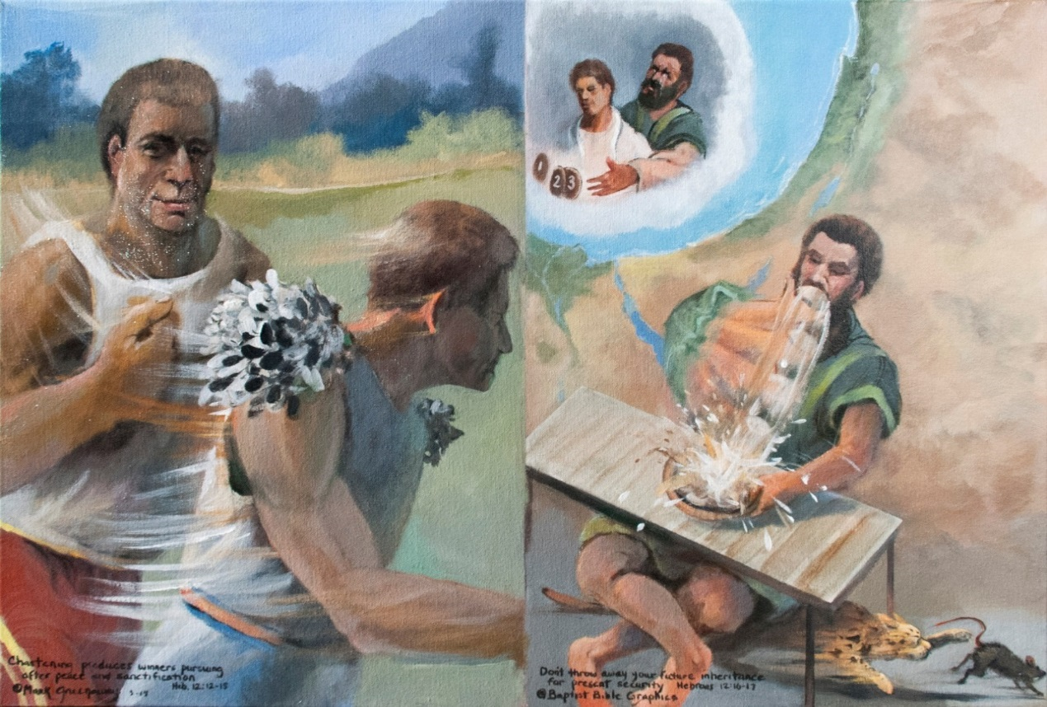
1. Based on Heb 12:12-17, Direction in life. Training with a purpose produces winners Heb 12:12-15, the lack of chastening produces sore losers like Esau Heb 12:16-17. The tendency in life is to get out of shape. Keep working out, putting on the cumbersome training weights. Show progress. Pursue the level paths which righteousness entails. Even the weakest among you will be healed. Lay aside the weight that so easily besets us. Peace with all men, Heb 12:14. So it is with the Christian life. Personal holiness must take priority in the Christian life. Separation from sin unto the Savior must be taught to the next generation. Don’t miss out on the grace of God, Heb 12:15-17. You tap your roots into the wrong soil and you’ll grow up bitter. Choose the wrong friends and you’ll be influenced to ungodliness. Esau’s undisciplined character lead him to be impulsive. To stave off hunger, for a single meal he sold his inheritance. He lived to regret his decision. Don’t sell your future inheritance for present security. You’ll be left out in the cold pounding sand like the middle heart in the previous picture.
6. Present security. Esau is turned away from the Promised Land. He wasn’t interested in the blessing given to his grandfather and father, Gen 12:1-3. His descendent was Herod, who tried to kill the Christ-child. As the older of two sons, he was to receive two thirds of his fathers wealth. On impulse Esau sold his birthright. We picture Jacob in front with one portion and now with two more that his brother sold him. Afterward Esau felt bad over what he had done and whined to get his inheritance back. But Jacob wasn’t for the tradeoff. Really, Esau never repented, his bellyaching was all show. He never learned the lesson that you don’t throw away your future inheritance for present security.
2. Direction in life. Training with a purpose makes winners The bottom heart in the previous picture shows the runner leaving the blocks. Starting out is one thing, to keep going is quite another. Runners in Bible times practiced with lead chips fastened to shoulder pads, like in the picture. Conditioning with training weights pays off in stamina. The faces of both runners are set like a flint, Isa 51:7. In the front His eye is on the goal; in the back, confident in pleasing the Father. In front He is the pioneer, forging the way, in preparation for others to follow, Heb 2:10-12. In back, He is victorious, having drank from the brook in the way, Ps 110:7. Far removed is Esau sitting at the table. The picture emphasizes the undisciplined manner in which he ate, not the quantity he ate, TWOT 554. He wasn’t necessarily physically immoral but a riotous eater of flesh, worldly and materialistic. In the inset he is behind, a whining loser, grasping, to no avail.
5. Not like Esau, Heb 12:16-17. Esau was a likeable man, he loved his father, but he didn’t have any use for God. He was impulsive, shown by his constant elbow exercise from plate to mouth. He had no spiritual inclination to run the race of life. He was not interested in pursuing righteousness. I doubt whether he even noticed the cat ripping under his seat. The cat’s more interested in pursuing a mouse than Esau in pursuing peace. Sounds like the sons of Esau and Ismael today. An obnoxious appetite and a bent out of shape attitude were just outward symptoms of the lack of an inward desire to please God.
3. Show progress, Heb 12:13. Lay aside the weight that so easily besets. The runner who pursues the goal of peace and holiness will train with faith and diligence. He will pursue the level paths which righteousness entails. He will not leave the straight wheel tracks, a good case for total abstinence Heb 12:13, ATR. He will strengthen his hands that are weak and his feeble knees. The runner who is lazy and undisciplined carries the heavy weight of regret and bitterness. He looks back and fails of the grace of God. His nature leads him astray. In his pursuit of pleasure he leaves the straight path, intentionally getting lost in his effort to drown his sorrows in pot. He follows his own ambitions and material pleasures. He lives to possess, not to pursue. Esau is his name, reaching for the birthright he impulsively sold. Jacob and Esau parted ways in their youth.
4. Pursue peace and holiness, Heb 12:14. God disciplines His sons for their good, getting them spiritually fit to share in His holiness, Heb 12:10. They are ready to produce the fruit of righteousness in godly living, giving peace a chase as if in a hunt, Heb 12:11, ATR. Bitterness doesn’t take long to sprout and grows real fast once rooted. Never give up the pursuit. Run by the rules. Please the One for whom you are running. In the picture the front runner’s arm picks up the motion of the cat in hot pursuit of a mouse. With cat like determination, pursue peace and holiness. The best rewards in life will not just come drifting your way. It is God who works in you both to will and to work out His good pleasure, Phil 2:12-13. But like the cat you need to both run fast and reach out in working out your own salvation with fear and trembling.

Slide 31
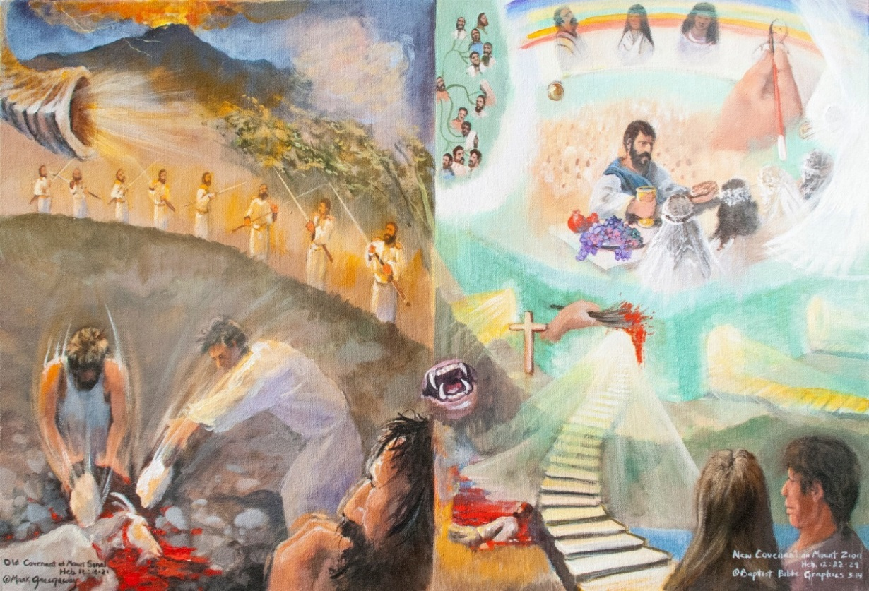
1. Based on Heb 12:18-29, The Old Covenant and the New Covenant are contrasted by comparing Mount Sinai with Mount Zion. The author contrasted these two mountains to create a desire to move from Moses to Christ, from earthly Jerusalem to heavenly. Sinai, the Old Covenant mountain. When God gave the Law to Moses the place was all aflame. The result was fear. In the lower corner is a man biting his nails. Zion, the New Covenant mountain. Keep your eye on Zion. The steps of ministry lead down across the gulf, under the revealed arm of the LORD, Isa 53:1, TWOT 583, thru the gate up to the delectable mountain of Zion. Jesus Christ the mediator holding the cup and bread at a banquet table. Angels are on the right side. Gathered around are a multitude of friends, seen across the top as the twelve tribes of Israel, all those under the blood, defined by a hand drawing on a scroll another sinner. They are not present by covenant blessing but because of individual faith in Christ. Blessed are the undefiled in the way, who walk in the law of the Lord.
7. Specific teaching to worship God acceptably. Don’t set your affection on the blood of Abel screaming like a wild beast out of sheol: Justice! Justice! See revealed the blood of the Lamb crucified outside the city walls: Grace! Mercy! Peace! Christian and Christiana believe the good news that the arm of the LORD has been revealed: He was wounded for our transgressions, Isa 53:1, 5. Illustrated in the next picture is their love for the Lord Jesus, constraining them to service, Heb 12:28-29. They will cross the bridge above hades, the flames not seen in the picture, Heb 12:29. Love is the driving force of their ministry, Heb 13:1-4. The LORD their helper has promised never to forsake them, Heb 13:5-6. They boldly go forth at home or to the regions beyond unafraid. Where sin abounded, grace did much more abound. No matter how great sin becomes, God’s grace overflows beyond it and abundantly exceeds it, Rom 5:20; BKC.
2. Sinai, the Old Covenant mountain, the Mosaic Law, Heb 12:18-21. This is the view you get when you train your eye on earth. The mountain is all aflame, the earth quaking below, and stormy wind, the rocks rolling down. God’s voice became like the blast of a ram’s horn. They were terrified and begged God not to talk to them any longer. They wanted to hear only the voice of man.
3. You only want to hear the voice of man? Behind and above the man biting his nails in fear is the blood of Abel crying out. When the voice and tread of a wild beast are distinctly heard close at hand, your awe becomes fear, Heb 12:28, ATR. Looks and sounds like what a people get when a nation turns their back on God. Prosperity looses its luster. Healings become irrelevant. Tongues are tied. Prophecies are on the rocks. Men chose death instead of life.
6. There is Jesus, the mediator of the New Covenant, He is holding the cup of the blood of the New Covenant. And in His other hand is the bread of his resurrection body. Hallelujah! That moment has arrived that we have all been waiting for. Look up by faith, it’s ours to claim. Keep this goal before you in the race of life. It’ll make each of us winners.
4. They preferred death rather than life. Now who in their right mind would chose death? Yet that is exactly what happens when a man turns to Moses to try and be acceptable before God. Armed guards were placed day and night all around the base of the mountain to keep man and beast from coming close. Anybody or any animal that touched the mountain died without mercy, being stoned to death. Pictured are two men killing a goat that got to close. They’re bashing its head in with rocks. In the picture the mouth of the wild beast makes sheol pass below Mt. Sinai into a slough blocking the way to Mt. Zion. Camp out at Mount Sinai and you die, sheol being the designated place for the body. Look up to Mount Zion and your live.
5. Look up to Mount Zion. The celestial city looks like a bride, dear in the sight of God. The heavenly Jerusalem is the city where a great multitude of angels favor every wind. The table is spread before the church of the first-born. Set in the backdrop are the millions of spirits of righteous men made perfect. The sons of Jacob are enumerated according to their birth mother in the top left. The redeemed appear like a rainbow in the heavens, the red of redemption identifying each one. A hand draws in the face of one more righteous man on the scroll. Their names are engraved in the Book of Life. In the lower right walk Christian and Christiana. The path they follow are steps to indicate deliberate action on their part. Man must initiate his course of action but the full consequence of the outcome belong to the LORD, TWOT 1943. The stones have been cleared so steps can be laid up to Zion, Isa 62:10.

Slide 32
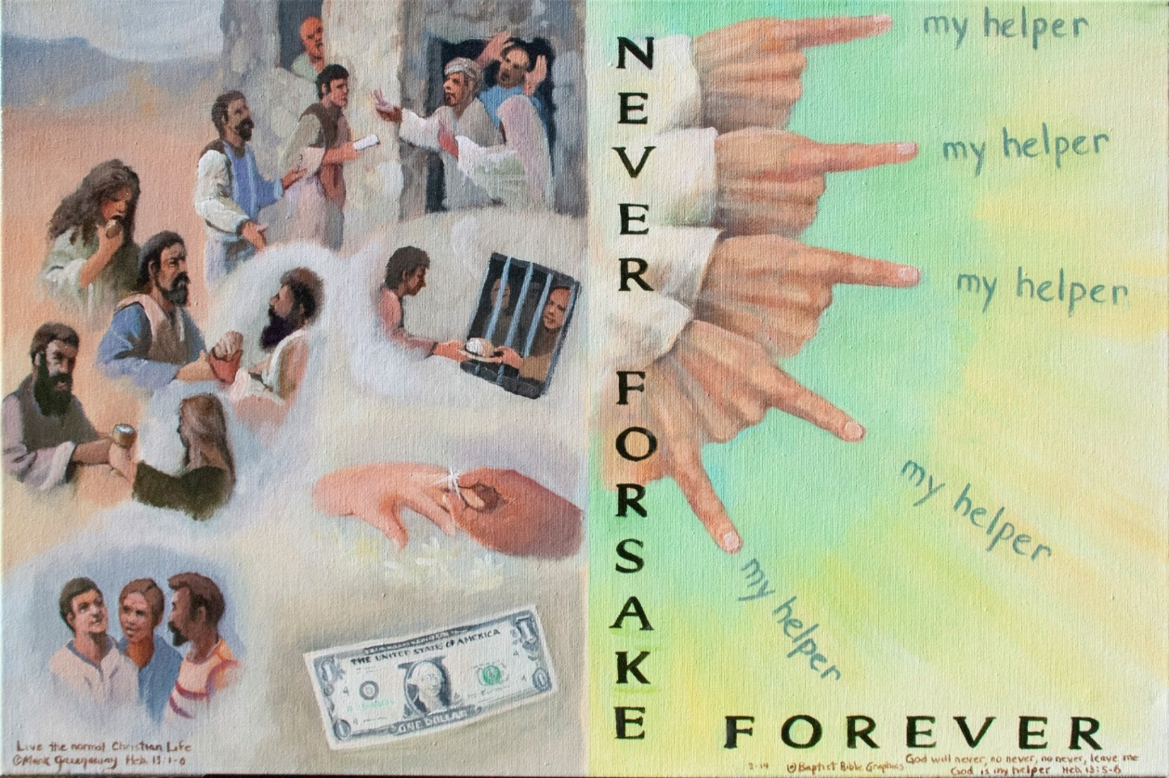
1. Based on Hebrews 12:22-13:6. Continuing from the previous picture, we belong to an eternal kingdom Heb 12:22-24. The God who shakes the earth will some day shake the heavens Heb 12:25-27. Seeing that all these things are so, let us serve God in an acceptable manner Heb 12:28-29. Specific instruction to serve (worship, BKC) God acceptably: Love the brethren Heb 13:1; Do good to strangers Heb 13:2; Remember prisoners Heb 13:3; Honor marriage Heb 13:4; Avoid monitory greed, Heb 13:5a. God sustains His servants with His abiding presence. He Himself has said, Heb 13:5b. His Word is sufficient that we need not be anxious. Therefore we wrote down the side and across the bottom NEVER FORSAKE FOREVER. He is my helper. The admonition includes five negatives reinforcing the impossibility of being forsaken, of being left behind without a helper, ATR. We show God’s hand with the index finger pointing to my helper repeated five times for positive emphases. From the top to the bottom, from the first to the last, the hand speaks of immutability.
10. Immutability:
How firm a foundation, ye saints of the Lord,
Is laid for your faith in His excellent Word!
What more can He say then to you He has said
To you, who for refuge to Jesus have fled?
Fear not, I am with thee, O be not dismayed
For I am thy God, I will still give thee aid; I’ll strengthen thee, help thee, and cause thee to stand,
Upheld by my gracious omnipotent hand.
The soul that on Jesus hath leaned for repose,
I will not, I will not desert to his foes;
That soul, tho all hell should endeavor to shake,
I’ll never, no never, no never forsake! copied.
It is at His right hand that godly people taste eternal pleasures and delights, TWOT 872.
2. Specific teaching to worship God acceptably, Heb 13:1-6. Those to whom the arm of the LORD has been revealed, now have a proper concern for social justice. Love the brethren Heb 13:1. In the lower left are three men living normal Christian lifes, loving one another.
3. Do good to strangers Heb 13:2. Above love for one another is pictured concern for physical needs, bread water, clothes, shelter, and spiritual needs, bringing the Word of God to a household. There’s an element of truth to the adage: The way to a man’s heart is through his mouth.
9. God is my helper. The five negatives reinforce the impossibility of being forsaken, of being left behind without a helper. His steadfast faithfulness is forever. We show God’s hand with the index finger pointing to my helper, repeated five times, Ps 118:6. From the top to the bottom, from the first to the last, the hand signals finality, immutability, Thus saith the LORD. God said it. I believe it. That settles it.
4. Remember prisoners Heb 13:3. Government is for our good, though some do feed off of gulags, concentration camps, torture and death squads. Don’t neglect prisoners in your deeds of kindness..
5. Sanctity of marriage: One man with one woman, husband and wife, as God established marriage from the beginning. Marriage pictures Christ’s love for His church, Eph 5:22-33. A man is slipping on a wedding band on his spouses’ finger.
6. Avoid monitory greed, Heb 13:5a. It is a must in Christian service that a man not get caught up with a love for material possessions. And don’t go head over heels into debt. You can’t spend yourself into prosperity, economics 101. God will supply the laborer’s financial needs. Placed in a corner by its lonesome is the almighty dollar.
7. Seeking the lost, yes kindly entreating, wanderers on the mountain astray; Come unto me His message repeating, Words of the master speaking today.
Seeking the lost and pointing to Jesus, souls that are weak and hearts that are sore; Leading them forth in ways of salvation, Showing the path to life evermore.
Thus would I go on missions of mercy, following Christ from day unto day. Cheering the faint and raising the fallen, Pointing the lost to Jesus the way, W A Ogden.
8. God sustains His servants with His abiding presence. He Himself has said, Heb 13:5b; Dt 31:6. No matter where God sends us, His Word is sufficient. Don’t be anxious. The promise is reinforced by five negatives. He will never, no never, no never forsake us. Therefore the bold letters down the side and across the bottom: NEVER FORSAKE FOREVER.

Slide 33
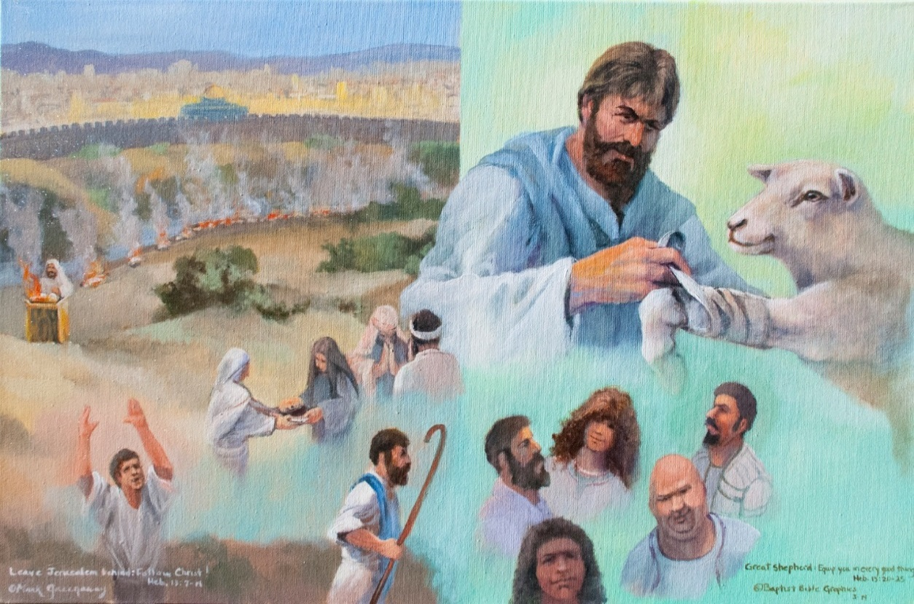
1. Based on Heb 13:7-25, Continuing from the previous pictures, we belong to an eternal kingdom Heb 12:22-24. The God who shakes the earth will some day shake the heavens Heb 12:25-27. Seeing that all these things are so, let us serve God in an acceptable manner Heb 12:28-29, in social justice Heb 13:1-6 and spiritual duties Heb 13:7-19. Obey spiritual leadership in the church, Heb 13:7-9. The founding church leaders will soon be gone but Jesus Christ remains the same. We have an altar, a figure of speech for the sacrifice of Christ, Heb 13:10. Therefore there is no altar between the Jerusalem sacrifices and Christians offering their sacrifices to God. Leave earthly Jerusalem behind, Heb 13:11-14. Seek the city which is to come. In the back ground is Jerusalem with its continuous sacrifices. Offer sacrifices acceptable to God, Heb 13:15-19. Continual praise to God and the good works of sharing and prayer. Great Shepherd of the sheep, Heb 13:20-21. Though we have God-ordained leaders, Jesus is the one who equips, mending broken bones and shattered relationships.
6, Great Shepherd of the sheep, Heb 13:20-21. Though we have God-ordained leaders, Jesus is the one who equips, mending broken bones and relationships. He’s the one who equips us for life on earth. He’s the one who guides us each step of the way. Go back two pictures and see that He is the one that brings us across the gulf of hades, under the blood, through the gate and into the city where we has a banquet spread. “And the Spirit and the bride say, Come. And let him that is thirsty come. And whosoever will, let him take of the water of life freely,” Rev 22:17. Grace be with you all. Amen, Heb 13:25.
2. Obey spiritual leadership in the church, Heb 13:7-9, 17, 22-25. Imitate the faith of our former leaders. Especially be on the lookout for new doctrines that conflict with the unchanging message of Christ. Remember the teaching of your former leaders and obey the present ones, Heb 13:17. It’s the writers hope that he and Timothy would soon see them, Heb 13:22-25. Take care of the spiritual side of life and the material will find its place Mt 6:33. We show a pastor with a shepherd’s staff, and other leaders in front and below the great Shepherd.
5. Offer sacrifices acceptable to God, Heb 13:15-19. Offer continual praise to God. That which comes from our lips comes out of our hearts. It bears the stamp of the fruit of gratitude. A man is looking unto the great Shepherd with both arms raised up. Then there’s the good works of sharing and prayer. These too are the sacrifices of a contrite heart before God. Elsewhere a believer’s body presented to the Lord is a spiritual sacrifice, Rom 12:1-2. Hospitality to strangers and meeting the needs of prisoners would also be included in good works of sharing; also sharing food, sharing transportation, sharing money, sharing with neighbors. And above all, praying. Sharing and praying are depicted by the great Shepherd’s right arm.
3. We have an altar, Heb 13:10. A New Covenant believer’s altar is the person of Jesus Christ. It is through Him that we offer our spiritual sacrifices. The picture makes the great Shepherd bigger than life. Jerusalem had it’s altar at the time Hebrews was written. But in a few short years Rome destroyed the city and burned the temple. Later the Muslims occupied the city and placed a mosque right where the temple stood. The picture shows the city in modern times. The Dome of the Rock occupies the place on Mount Moriah where God sent Abraham to offer Isaac, Gen 22.
4. Leave earthly Jerusalem behind, Heb 13:11-14. The emphasis in this section is on separation from dead religion and identification with the Person of Christ. Though Jerusalem had its visible sacrifices in that day, the Spirit of the Lord had departed from the temple, only to return his residence in the future millennial temple, Ezek 43. The sin offering was burned outside the camp in a place of reproach, Lev 16:27. This was repeated year after year on the Day of Atonement. We picture the burning of the sin offering outside of Jerusalem. Christ was crucified outside the gate of Jerusalem. Christians must come to him outside the camp to the place of reproach and rejection in their separation from dead religion.

